Slide 1

General Paediatrics
What is the new curricula?
May 2026

Slide 2
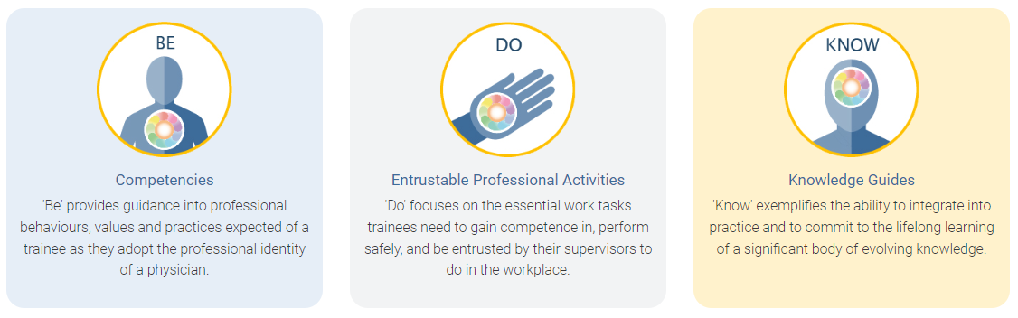
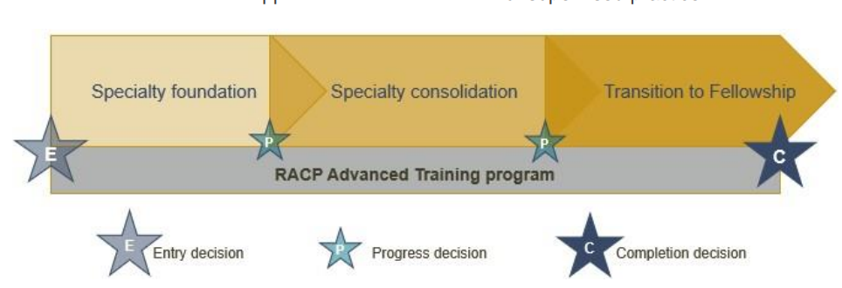

Framework overview
All new curricula in Advanced Training programs use the same frameworks
Curriculum standards
Learning, teaching and assessment (LTA)
structure
Learning goals within each training program categorised by the curriculum standards: Be, Do and Know.
More information about the curriculum standards and learning, teaching & assessment structure can be found in the LTA of each training program.
Notes:
All new curricula in Advanced Training programs use the same framework. You can see here the learning goals, the three phases of the training program and the learning, teaching and assessment requirements as outlined in the program requirements. We will go though each of these areas in more detail.

Slide 3
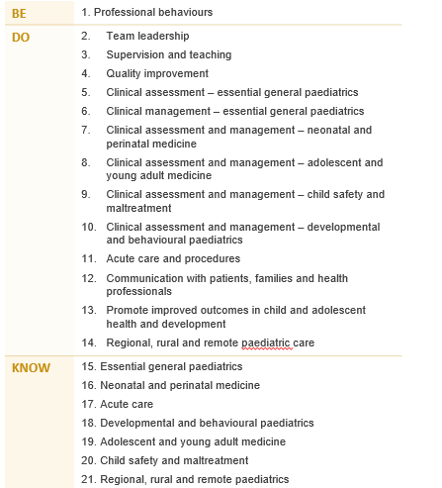

Learning goals
General Paediatrics
The Advanced Training curricula standards are grouped into 21 key learning goals that guide learning, teaching, and assessment in the new programs.
Notes:
Each training program is grouped into learning goals, guided by the curriculum standards: Be, Do & Know. This includes professional behaviours, entrustable professional activities (or EPAs) and knowledge. These learning goals are used for all learning and assessment activities across each program.
General Paediatrics has 13 specific EPAs and 7 specific knowledge guides. Within the curriculum standards document, you can see a very detailed breakdown of the expected behaviours and knowledge at the end of training, under each of these goals. These should be used by trainees and supervisors to ensure they are meeting the expected standards and identify strengths and areas that need further development and then to plan their learning of how they will achieve these outcomes.

Slide 4

Learning and assessment programs
Requirements over the course of training
1 entry application
Complete at least 36 months FTE training - professional experience
8 learning themes
paediatric advanced life support certification valid at the end of training
RACP online courses
Supervisor Professional Development Program
1 Advanced Training Research Project (over the course of training)
Requirements
1 rotation plan per rotation
12 learning captures per phase
12 observation captures per phase
4 progress reports per phase
Notes:
Here we have provided an overview of the learning and assessment programs information. Over the course of training, trainees are required to complete 36 months of full time equivalent clinical experience with 1 rotation plan per rotation. Per phase of training, there are assessment program requirements.
The new RACP curriculum assessment plan is based on programmatic assessment framework and principles, which combines multiple sources of qualitative and quantitative information about a trainee collected over time to inform progress decisions. This acknowledges that there is no one test that can measure the leaning and development when you are training people to become experts, and the complex integration of clinical and professional skills and qualities that being an expert in their field involves.
We will have a closer look at all the required tools over the next few slides.

Slide 5

Notes:
<replace outro slide>

