Slide 1

General Paediatrics
Regional, rural and remote training
May 2026

Slide 2
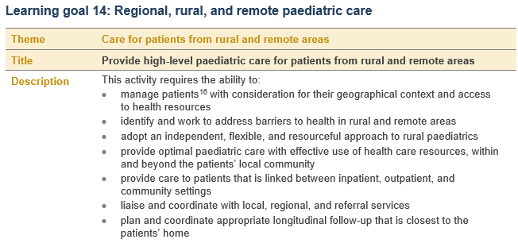
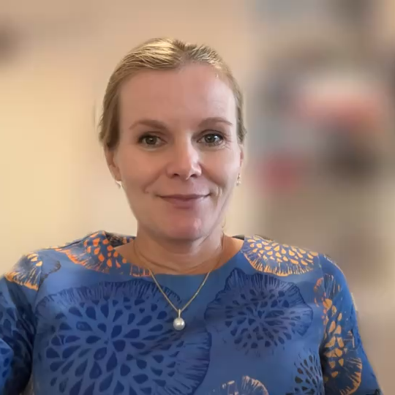
Regional, Rural and Remote Paediatrics – learning theme
The learning theme maps specifically to two curriculum learning goals learning goals:
Learning goal 14. Regional, rural and remote paediatric care (EPA)
Learning goal 21. Regional, rural, and remote paediatrics (knowledge guide)
Learning theme requirements – option 1
To fulfill the Regional, Rural and Remote Paediatrics learning theme, trainees should plan to complete the requirement outlined in option 1.
Rural training rotation. An advanced training professional experience rotation of a minimum 6 months’ FTE at a training site accredited for rural, regional or remote general paediatrics training.
Notes:
The new curriculum for Advanced Training in General Paediatrics has strengthened the rural training component, recognising the growing need for general paediatricians in regional, rural and remote Australia and Aotearoa/New Zealand and the rich value of rural training experiences for trainees learning and development
There are now specific regional, rural and remote paediatrics learning outcomes including a whole EPA and knowledge guide
There is also a R,R,R learning theme and the professional requirement of minimum 6 months is retained. There is also increased flexibility in professional experiences so that there is now potential to complete all or most of you advanced training in General Paediatrics at a rural site.

Slide 3
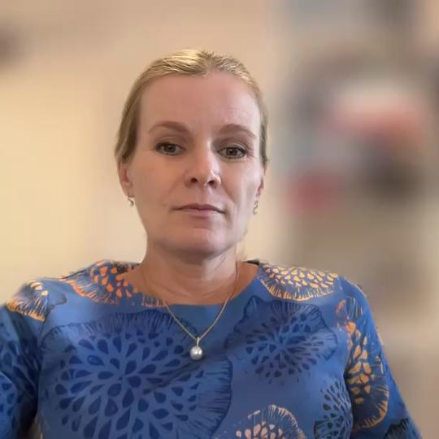
Region, Rural and Remote Paediatrics – alternate pathway
If trainees are unable to meet the requirements of option 1, there is an alternate way to meet the learning theme
Trainees granted special consideration on a case-by-case basis may complete a portfolio demonstrating rural medicine exposure that is prepared and submitted for consideration by the training committee/Progress Review Panel.
Learning theme option 2
2. Portfolio of rural medicine exposure. Trainees granted special consideration on a case-by-case basis may complete a portfolio demonstrating rural medicine exposure that is prepared and submitted for consideration by the training committee/Progress Review Panel. The portfolio should include 2a and at least one of the options listed under 2b.
  2a. Minimum 12 learning captures AND 12 observation captures addressing rural paediatrics learning goals 14 and 21 identified as the primary learning outcomes, specifically referencing the trainee’s involvement in care of rural/regional patients.
  AND
  2b. Evidence of one of these professional experience options that demonstrate achievement of rural learning goals 14 and 21:
    A training rotation relevant to rural and remote paediatrics completed as part of any stage of paediatric training. E.g., a rural rotation in Basic Training.
    OR
    A training rotation completed in a rural or remote training setting at PGY1 or PGY2 level. E.g., a 3-month rural rotation in resident year.
    OR
    An Advanced Training rotation with a specific focus on liaising and in-person care of patients at rural and remote sites. This will require prospective approval via a rotation plan before the start of the proposed rotation.
Notes:
If trainees are unable to meet the requirements of option 1, there is an alternate way to meet the learning theme
Trainees granted special consideration on a case-by-case basis may complete a portfolio demonstrating rural medicine exposure that is prepared and submitted for consideration prospectively by the training committee/Progress Review Panel.
This may look something like a 12 months part time metropolitan based Rural paediatrics Advanced Training rotation with regular liaison with General paediatric and specialist teams for complex inpatients from rural areas to provide leadership in coordinated, holistic care, liaising regularly with rural referral hospitals in regards to current inpatients and complex outpatients, regular outreach clinics to at least one rural/remote site to provide paediatric clinics and opportunistic acute paediatric support to local health service

Slide 4
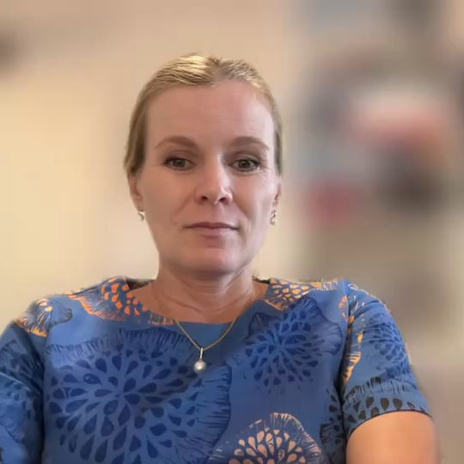
Region, Rural and Remote Paediatrics – exemptions and RPL
  Exemption information
  Rural Training is identified as a valuable training experience for Advanced Trainees. An exemption to this requirement is available for trainees who can demonstrate exceptional circumstances affecting their ability to undertake a rural training rotation. (Example – trainees who have long-term legal or medical reasons preventing relocation).
  The Committee appreciates that it can be complex to balance work, family and training obligations in relation to rural training. However, this is not considered to be exceptional circumstances warranting an exemption to the requirement. Requests for exemption to this requirement will be considered on a case-by-case basis.
  Recognition of prior learning
  Australian trainees can complete their rural term during Basic or Advanced Training. Trainees can email the RACP to find out if they are eligible to have prior training recognised.
  E: GeneralPaedsAdvanced@racp.edu.au
Notes:
Trainees may be granted recognition of prior learning or an exemption in line with the RACP policy and upon approval by the RACP on a case-by-case basis.
Application for exemption is available for trainees who can demonstrate exceptional circumstances affecting their ability to undertake a rural training rotation. For example – trainees who have evidence of significant long-term legal or medical reasons preventing relocation. The training Committee appreciates that it can be complex to balance work, family and training obligations in relation to rural training. However, this is not considered to be exceptional circumstances warranting an exemption to the requirement.
s for applying for exemption or RPL, explain alternative way to meet learning outcomes

Slide 5

Notes:
<replace outro slide>

