Slide 1

Introduction to the new curriculum
2026 implementation – Advanced Training in General Paediatrics
May 2026
Notes:
This information session is for trainees completing the Advanced Training: General Paediatrics, as an introduction to the new curriculum.

Slide 2
About this session
At the end of this session, participants will be able to:
Discuss the changes and components of the new curriculum
Outline the learning and assessment requirements
Notes:
During this session we will be reviewing the curriculum and associated learning and assessment requirements

Slide 3
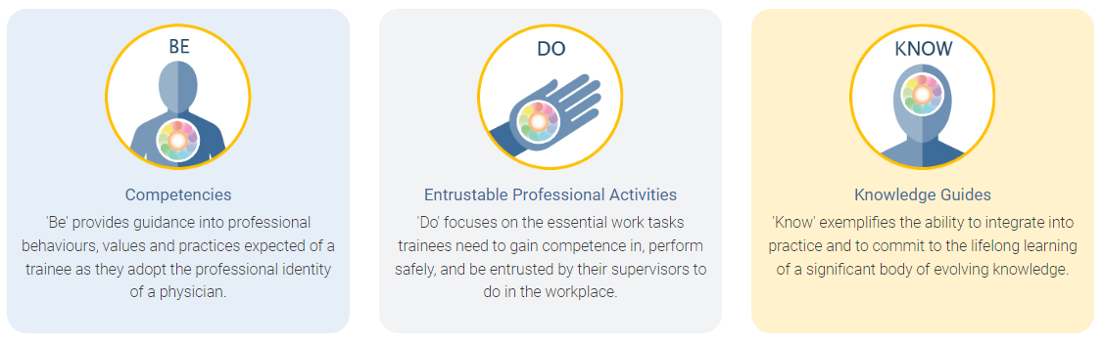
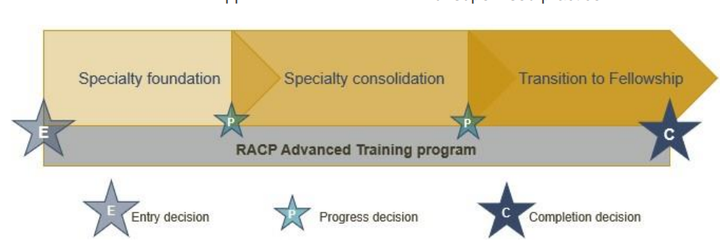
Framework overview
All new curricula in Advanced Training programs use the same frameworks
Curriculum standards
Learning, teaching and assessment (LTA)
structure
Learning goals within each training program categorised by the curriculum standards: Be, Do and Know.
More information about the curriculum standards and learning, teaching & assessment structure can be found in the LTA of each training program.
Notes:
All new curricula in Advanced Training programs use the same framework. You can see here the ten learning goals, the three phases of the training program and the learning, teaching and assessment requirements as outlined in the program requirements. We will go though each of these areas in more detail.

Slide 4
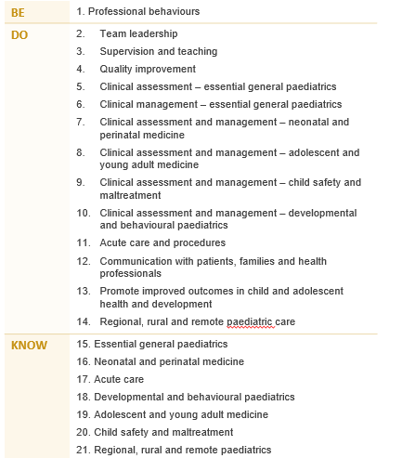
Learning goals
Progression criteria for the Specialty foundation phase By the end of this phase, trainees will:
Level 5
Level 3 Level 3 Level 3 Level 3 Level 3 Level 3 Level 3 Level 3 Level 3 Level 3 Level 3 Level 3 Level 3
Level 3 Level 3 Level 3 Level 3 Level 3
General Paediatrics
The Advanced Training curricula standards are grouped into 21 key learning goals that guide learning, teaching, and assessment in the new programs.
Each learning goal has set progression criteria that set the expected standard of performance for trainees.
Notes:
Each training program is grouped into learning goals, guided by the curriculum standards: Be, Do & Know. This includes professional behaviours, entrustable professional activities or EPAs and knowledge. These learning goals are used for all learning and assessment activities across each program. Each learning goal has set progression criteria that set the expected standard of performance for trainees. This is what trainees are assessed against at the end of each phase.
More information about your program’s specific learning goals can be found in the LTA of each training program.

Slide 5
Learning and assessment programs
Requirements over the course of training
1 entry application
Complete at least 36 months FTE training - professional experience
8 learning themes
paediatric advanced life support certification valid at the end of training
RACP online courses
Supervisor Professional Development Program
1 Advanced Training Research Project (over the course of training)
Requirements per phase
1 rotation plan per rotation
12 learning captures per phase
12 observation captures per phase
4 progress reports per phase
Notes:
Here we have the learning and assessment programs information. Over the course of training, trainees are required to of full time professional experience, 1 rotation plan per rotation and a variety of learning courses.
Per phase of training, there are assessment program requirements. We will have a closer look at all the required tools over the next few slides.

Slide 6


Learning themes
Learning Themes have been added to provide options and flexibility for trainees to meet learning goals. Trainees must demonstrate competence in all the curriculum learning goals, fulfill the options outlined in the learning themes, and complete all learning and assessment requirements.
1. Developmental and behavioural paediatrics | 2. Regional , rural and remote paediatrics | 3. Acute care | 4. Neonatal and perinatal medicine
5. Adolescent and young adult medicine | 6. Promote improved outcomes in childhood and adolescent health and development | 7. Child safety and maltreatment | 8. Research, quality and improvement
Notes:
More information can be found in the LTA and in the recorded videos on the General Paediatrics webpage.

Slide 7


General Paediatrics Advanced Trainee Journey #1
Year 1
Year 2
Year 3
Sophie began her Advanced Training in a tertiary General Paediatrics rotation, managing deteriorating patients as part of the after-hours roster. She then completed a respiratory rotation, developing skills in clinical audit and service improvement.
Sophie moved to an outer-metropolitan hospital, completing another General Paediatrics rotation with weekly outpatient clinics for behavioural and developmental patients. She gained experience managing paediatric and nursery inpatients, admitting patients from the emergency department, and completed the Child Protection Course.
In her final phase, Sophie undertook an Adolescent and Young Adult Medicine rotation with a strong outpatient focus, supporting patients with behavioural and developmental needs. She then completed a rural rotation involving weekly outpatient clinics, inpatient and nursery care and emergency admissions.
Training rotations
Developmental & behavioural paediatrics LG 14
Learning themes
addressed
Acute and emergency care LGs 7 & 13
Neonatal & perinatal medicine LGs 7 & 12
Adolescent and young adult medicine LG 15
Research & quality improvement LGs 1 & 4
Child safety and maltreatment LG 16
Rural paediatrics LGs 10 & 17
Promote improved outcomes LG 9
Hospital
Paediatrics (core)
6-month rotation
Full time
Non-core
6-month rotation
Full time
Essential General Paediatrics (core)
12-month rotation
Full time
Developmental
and Behavioural Paediatrics (core)
6-month rotation
Full time
Essential General Paediatrics (core)
6-month rotation
Full time
Professional experience requirements
met
This is a fictional journey for illustrative purposes only. In addition to rotations, trainees need to meet the progression criteria to progress to the next phase of training and fulfil all learning and assessment requirements of the curriculum.
curriculum@racp.edu.au

Slide 8


New assessment tools
Rotation plan
Trainee and supervisor outline rotation details, learning goals and opportunities for the upcoming rotation.
Observation capture
Trainee is observed by an assessor to demonstrate their skills and knowledge in one learning goal.
Learning capture
Trainee reflects and provides evidence on a professional development experience linked to one learning goal.
Progress report
Supervisors document trainee progress against learning goals.
Roles involved:
Trainee
Supervisor(s)
Roles involved:
Trainee
Assessor
Roles involved:
Trainee
Assessor (optional)
Roles involved:
Trainee
Supervisor(s)
Notes:
Here is an overview of the new assessment tools in the new curriculum. These are due within each phase.

Slide 9



Other learning and assessment requirements
Learning programs
Professional experience
Learning courses
Research project
A trainee-led study involving significant involvement in design, conduct and analysis.
Learning themes
Options for trainees to meet learning goals in line with the General Paediatrics Advanced Training curriculum standards
Roles involved:
Trainee
Roles involved:
Trainee
Research Project Supervisor
Roles involved:
Trainee
Notes:
These are due by the end of Advanced training.

Slide 10
Rating scales
Be - Professional behaviours ​
0 ​ | unable to rate ​
1 ​ | Needs to work on their behaviour in more than five domains of professional practice ​
2 ​ | Needs to work on their behaviour in four or five domains of professional practice ​
3 ​ | Needs to work on their behaviour in two or three domains of professional practice ​
4 ​ | Needs to work on their behaviour in one domain of professional practice ​
5 ​ | Consistently behaves in line with each of the ten domains of professional practice ​
Do - Entrustable professional activities
0 ​ | unable to rate ​
1 ​ | Is able to be present and observe ​
2 ​ | Is able to act with direct supervision
3 ​ | Is able to act with indirect supervision (i.e., ready access to a supervisor)
4 ​ | Is able to act with supervision at a distance (i.e., limited access to a supervisor) ​
5 ​ | is able to supervisor others
Know - Knowledge​
0 ​ | unable to rate ​
1 ​ | Has heard of some of the topics in this knowledge guide
2 ​ | Knows the topics and concepts in this knowledge guide ​
3 ​ | Knows how to apply this knowledge to practice ​
4 ​ | Frequently shows they apply this knowledge to practice ​
5 ​ | Consistently demonstrates application of this knowledge to practice ​
Traditional rating scales | Level of new rating scales
Satisfactory to superior ratings Task components separated (e.g. medical interviewing skills, clinical judgement) No links to the expectation of the standards required | Increased levels of independence over time Comprehensive rating of clinical and professional expertise Expected standards of performance at the end of each phase to direct learning
Notes:
These are the rating scales that will be used in all the assessment tools. There is a rating scale for the three types of learning goals. These rating scales also relate to the progression criteria outlined at the end of each phase of training. This criteria specifies the standard of achievement for trainees at the end of each phase.
The new rating scales compared to traditional rating scales align to the increased levels of independence over time, rather than using satisfactory to superior descriptors. The new scales provide a comprehensive rating of clinical and professional expertise, where in the past, components have been separated. They also explain the expected standard of performance at the end of each phase.

Slide 11
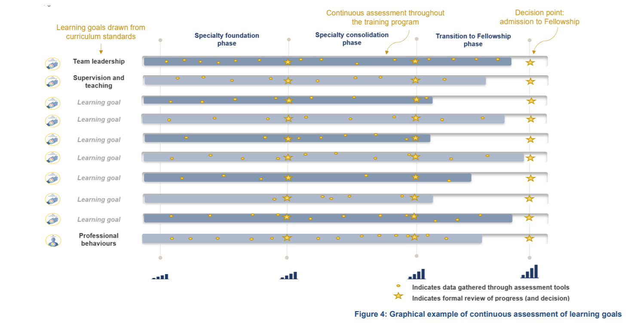
Continuous assessment
Notes:
Trainees will be continuously assessed on the key learning goals through regular capture of work-based learning in a range of assessment tools. The use of multiple data points build a complete picture of trainee progress over time. Supervisors offer ongoing feedback through multiple tools to support progressive assessment, encouraging the use of narrative feedback to explain the ratings selected in the assessment tools.

Slide 12
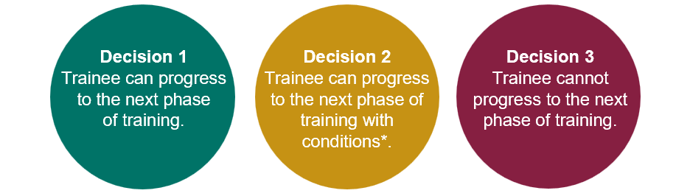
Progression
Each phase of training has clear progression criteria. Trainees must meet these standards to progress to the next phase or complete the program.
Progression decisions and completion decisions will be based on aggregated assessment data, providing richer evidence.
The Progress Review Panel will assess the evidence and make one of the following decisions:
Notes:
The alignment between the learning goals and learning, teaching and assessment programs forms a comprehensive picture of trainee performance over a phase of training. The data comes together to provide robust assessment information that is used by a progress review panel to make decisions about progression.

Slide 13



More information
New curricula support hub
Visit the RACP new curricula support hub to find updates about 2026 implementation
Find details about other online training sessions about the new curricula and assessment tools
RACP Online Learning
Log into RACP Online Learning to learn about the new curricula
RACP Member Support Centre
Contact membersupport@racp.edu.au if you have any questions about the new curricula
Notes:
Thank participants for attending and review where they can get some more information.
More information:
RACP new curricula support hub
RACP Online Learning
RACP Member Support Centre contact: membersupport@racp.edu.au

Slide 14
Development process to date
Specialist contractor and CRG
The new curriculum was developed
2023
Consultation round 1 & partial approval
Feedback: Further review of the LTA programs required, particularly the professional experience requirements
2024
Consultation round 2
Feedback centered around the constructive alignment uncertainty and the new professional experience requirements
Oct-Dec 2025
Review and refine
New EPAs and plans to embed new accreditation criteria developed
15 Jan 2026
Endorse and approve
Jan – Feb 2026
Training Program Committees in General Paediatrics endorsement meeting
CEC review and approval decision
Notes:
Briefly mention timeline of development
Challenges – complex training program with many sites across two countries, managing what is ideal v what is feasible, balance training v service requirements, many stakeholders
Communication and process barriers within college and health jurisdiction complexity??
Consultation phases x2 – subsequent changes and layers of approval

Slide 15
Principles of competency based medical education
Competencies/ Outcomes determined by the profession, the public and the policy makers
System needs/Health needs
Competencies/outcomes
Curriculum
Learning exposures/experiences
General Paediatrician
Assessment
Notes:
Best practice and many of the medical schools and specialty training colleges Internationally have moved towards CBME
System determines the outcomes required
Learning experiences that assist learner to achieve learning outcomes and assessment that allow learners to demonstrate achievement
Produce general paediatricians that meet the needs of the population/health service.
Advantages include:
Learner centred – learners identify their learning needs and together with their supervisor plan how they will meet the learning outcomes
More flexible, some learners may require more time to achieve competency in certain areas, other learners may have a certain area they would to focus on more than others
The new curriculum presents a hybrid model of CBME with time based components in order to retain some structure, consistency and guidance to learning rather than a choose your own adventure
This is a big change in conceptualising training – focus on learning outcomes rather than time based rotations!

Slide 16

Principal improvements
 | Clarity | Increased clarity on what a general paediatrician is, and how they meet the needs of society
 | Training based in practice | Make training better resemble consultant roles as a Fellow e.g. greater emphasis on outpatients, developmental paediatrics and regional/rural paediatrics
 | Flexibility | Increase flexibility and remove unnecessary barriers
Notes:
The new curriculum aims to meet the needs identified by fellows and trainees to address the gaps and barriers of the current curriculum
Strengthening General Paediatrics as a specialty training program to produce strong general pediatricians that meet the societal need, rather than a default program to add on to a subspecialty
Make training better resemble consultant roles as a Fellow eg greater emphasis on outpatients, developmental paediatrics and regional/rural paediatrics
Increase flexibility recognising there are many great learning paths and experiences to achieve learning outcomes such as neonatal/perinates and acute care that extend beyond the limits of what is currently accredited for these training rotations

Slide 17
The new curricula
What's not changing
Trainees and supervisors will still....
Plan learning for a rotation
Work with and observe trainees doing their job
Provide feedback to trainees on their performance and progress
Assess trainees through rotation and at the end via a report
Contribute to the learning and understanding of the curriculum
Enter learning and assessment information onto an online platform
PREP versus new curricula
Be aware of the different learning goals/outcomes
  New curriculum learning goals
  PREP and PQC
Use 2 online platforms
  PREP portal
  TMP
Use different learning and assessment tools with differences in rating scales
  LNA or rotation plan
  Mini-CEX/CbD or observation capture
Use expected standards to benchmark performance
  Progression criteria (new program only)
Notes:
Here is a supervision overview, highlighting the things that are staying the same and the things that are changing that supervisors must be aware of. Supervisors will still plan learning and work with trainees day-to-day, providing feedback throughout. They will assess them and enter this information into an online platform, taking responsibility to contribute to their understanding of the new curriculum.
The learning goals are changing as well as the online platform. The new curriculum has different assessment tools and standards for trainees. It is important for supervisors to understand these changes, especially when managing trainees on both programs.

Slide 18




Supervision overview for Advanced Training
All supervisors
Role specific activities
Are nominated by trainees
Have access to trainee dashboards
Identify learning opportunities
Plan how to achieve learning goals
Review rotation plans
Feed back on learning captures (optional)
Feedback on and rate observation captures
Complete progress reports and make a progression decision
Rotation Supervisor
Advanced Training
Research Project Supervisor
Advanced Training
The research project supervisor guides trainees with their project choice, method, data analysis and interpretation, and quality of written and oral presentation
Identify rotation learning opportunities
Complete progress reports and make progression recommendations for a phase of training
Assessors
Progress Review Panel
RACP body
RACP oversight committees
No access to TMP (unless they are a nominated supervisor)
Feedback and ratings for observation captures
Review and assess trainee’s progress
Report on progress decisions
Monitor local training delivery
Ensure compliance
Oversee implementation of training programs
Work with progress review panels
Decision making feedback and guidance
Check the teaching requirements for information about program-specific supervisor requirements
Notes:
There are several supervisor roles in the new curriculum, with differing roles and responsibilities. This information can be found in the basic program handbook on the e-learning site. Overall, all supervisors will be nominated by either a trainee or DPE, access their dashboards on TMP, identify learning opportunities and plan how to achieve the learning goals. They review rotation plans and give feedback on the assessment tools. Supervisors may have some involvement with progress review panels.

