Slide 1

Introduction to the new curriculum 2026 implementation – Advanced Training: Haematology (Adult Medicine)
April 2026
Notes:
.

Slide 2
About this session
At the end of this session, participants will be able to:
Discuss the changes and components of the new curriculum
Outline the learning and assessment requirements
Identify draft training requirements for joint haematology trainees in 2027

Slide 3
What is changing?
Standards
Practical, work-focused learning goals
Explicit standards of achievement
Learning and assessment
New learning and assessment tools
Increased assessment frequency
Progression
Progress Review Panels
Technology
New technology (TMP)

Slide 4
The new curricula
What's not changing
Trainees and supervisors will still....
Plan learning for a rotation
Work with and observe trainees doing their job
Provide feedback to trainees on their performance and progress
Assess trainees through rotation and at the end via a report
Contribute to the learning and understanding of the curriculum
Enter learning and assessment information onto an online platform
PREP versus new curricula
Be aware of the different learning goals/outcomes
New curriculum learning goals
PREP and PQC
Use 2 online platforms
PREP portal
TMP
Use different learning and assessment tools with differences in rating scales
LNA or rotation plan
Mini-CEX/CbD or observation capture
Use expected standards to benchmark performance
Progression criteria (new program only)

Slide 5
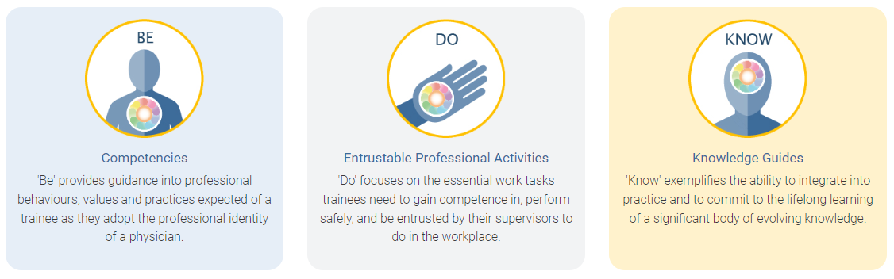
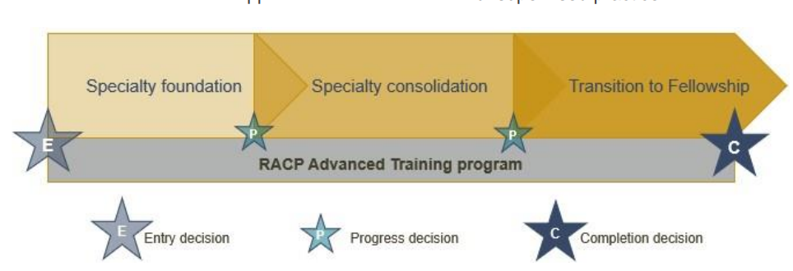
Framework overview
All new curricula in Advanced Training programs use the same frameworks
Curriculum standards
Learning, teaching and assessment (LTA)
structure
Learning goals within each training program categorised by the curriculum standards: Be, Do and Know.
More information about the curriculum standards and learning, teaching & assessment structure can be found in the LTA of each training program.

Slide 6
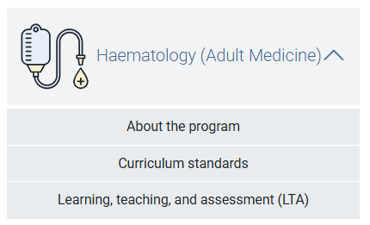

Curriculum documents
<insert training program curriculum standards location>
<insert training program LTA location>

Slide 7
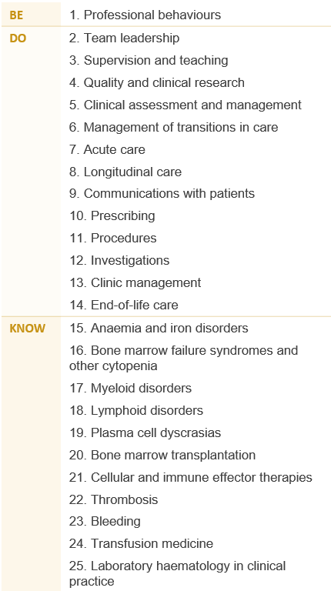
Learning goals
Clinical Haematology (Adult Medicine)
The Advanced Training curricula standards are grouped into key learning goals that guide learning, teaching, and assessment in the new programs.

Slide 8



Applying learning goals
How an observed clinical activity achieves the learning goal components in real time.
Dr Alex, an Advanced Trainee in clinical haematology, is completing a core diagnostic laboratory training rotation, and has been asked to complete a blood film examination on a patient presenting with sepsis, a life-threatening disorder.
01. Professional behaviours
Medical expertise
Communication
Quality and safety
Research
Leadership, management, and teamwork
15. Anaemia and iron disorders
25. Laboratory haematology in clinical practice
05. Clinical assessment and management
06. Management of transitions in care
12. Investigations

Slide 9
Covering learning goals
Each trainee is expected to develop and demonstrate progress across all learning goals by the end of the Advanced Training program, not in every rotation.
It is normal for some learning goals to have limited or no exposure in certain settings.
Use your rotation plan to identify which goals can be developed in your current setting
Use learning captures for less common, more complex tasks that may not be available during a rotation
Progress Review Panels review evidence across all phases of training, considering overall growth rather than exposure per rotation.
Watch the rotation plan on-demand workshop to learn how to choose and track learning goals across each phase of training.
Settings and networks are encouraged to participate in curriculum mapping to show which learning goals are covered in their rotations and provide a resource to help trainees plan their learning.

Slide 10

Learning and Teaching Assessment (LTA) summary

Slide 11

Advanced Training in Haematology (Adult Internal Medicine) Proposed learning, teaching and assessment programs summary
ENTRY CRITERIA
PROFESSIONAL EXPERIENCE
LOCATION OF TRAINING
Summary of proposed changes
No proposed changes
Summary of proposed changes
Removal of extension training disciplines that can be counted towards training to keep it general for trainees
Summary of proposed changes
Training must be completed in at least 2 different accredited training settings but maximum of 24 months at 1 setting has been removed
CURRENT REQUIREMENT | Prospective trainees must: have completed RACP Basic Training, including the Written and Clinical Examinations hold a current medical registration have been appointed to an appropriate Advanced Training position
PROPOSED REQUIREMENT | Prospective trainees must: have completed RACP Basic Training, including the Written and Clinical Examinations hold a General medical registration with the Medical Board of Australia if applying in Australia, or a medical registration with a general scope of practice with the Medical Council of New Zealand and a practicing certificate if applying in Aotearoa New Zealand. have been appointed to an appropriate Advanced Training position
CURRENT REQUIREMENT | 36 months of certified training time consisting of: Minimum 24 months core clinical training Minimum 6 months core laboratory training Maximum 6 months non-core training. Non-core can be undertaken in relevant rotations such as: medical oncology palliative medicine infectious diseases research relevant to haematology
PROPOSED REQUIREMENT | Complete at least 36 months of relevant professional experience in approved rotations in at least 2 different training settings, including: 24 months minimum FTE in core accredited Haematology training positions 6 months minimum FTE in core diagnostic laboratory Haematology training 6 months maximum FTE in approved non-core training.
CURRENT REQUIREMENT | Maximum of 24 months may be spent at 1 setting Complete at least 24 months of training in Australia and/or Aotearoa New Zealand
PROPOSED REQUIREMENT | Complete training in at least 2 different accredited training settings. Complete at least 24 months of training in Australia and/or Aotearoa New Zealand

Slide 12
Advanced Training in Haematology (Adult Internal Medicine) Proposed learning, teaching and assessment programs summary
LEARNING PROGRAM
LEARNING COURSES
LEARNING ACTIVITIES
Summary of proposed changes
Learning Needs Analysis will be replaced by the new Learning plan
Summary of proposed changes
Addition of learning courses that are common to all RACP Advanced Training programs
Completion of Lifeblood’s Clinical Transfusion Program is now recommended
Summary of proposed changes
Addition of attendance at a national or international annual scientific meeting (recommended only)
CURRENT REQUIREMENT | 2 Learning Needs Analysis per year
PROPOSED REQUIREMENT | 1 Learning plan per rotation
CURRENT REQUIREMENT | Australian Aboriginal, Torres Strait Islander and Māori Cultural Competence and Cultural Safety resource, by the end of Advanced Training
PROPOSED REQUIREMENT | RACP Advanced Training Orientation resource (within the first six months of Advanced Training) RACP Health Policy, Systems and Advocacy resource (recommended completion before the Transition to Fellowship phase) RACP Supervisor Professional Development Program, by the end of Advanced Training Australian Aboriginal, Torres Strait Islander and Māori Cultural Competence and Cultural Safety resource, by the end of Advanced Training Lifeblood’s Clinical Transfusion Program (recommended only - recommended completion in the Specialty Foundation phase)
CURRENT LEARNING ACTIVITIES | N/A
PROPOSED REQUIRED LEARNING ACTIVITIES | Attendance at x1 national or international annual scientific meeting (recommended only - recommended completion before the Transition to Fellowship phase)

Slide 13
Advanced Training in Haematology (Adult Internal Medicine) Proposed learning, teaching and assessment programs summary
TEACHING PROGRAM
ASSESSMENT PROGRAM
Summary of proposed changes
Introduction of Progress Review Panels
Core training requires a supervisor with FRACP in Haematology
Summary of proposed changes
Learning captures to replace Trainee’s Report
Observation and learning captures to replace Case-based Discussions
Progress Reports to replace Supervisor’s Report.
CURRENT REQUIREMENT | Core training 1 x supervisor per rotation, who is a Fellow of the RACP 1 x supervisor per rotation, who can be a Fellow of the RACP Non-core training 1 x supervisor per rotation, who is a Fellow of the RACP 1 x supervisor per rotation, who can be a Fellow of the RACP
PROPOSED REQUIREMENT | Core training: 2 individuals for the role of Education Supervisor Minimum of 1 supervisor per rotation who is a Fellow of the RACP in Haematology Non-core training: 2 individuals for the role of Education Supervisor Other 1 individual for the role of Research Project Supervisor (may or may not be the Education Supervisor) 1 RACP committee to act as a Progress Review Panel
CURRENT REQUIREMENT | 1 Supervisor’s report per rotation 2 Case-based Discussions per year 2 Mini-Clinical Evaluation Exercises (Mini-CEX) per year 1 Research project
PROPOSED REQUIREMENT | 12 Observation captures per phase 12 Learning captures per phase 4 Progress reports per phase 1 Research project over the course of training

Slide 14
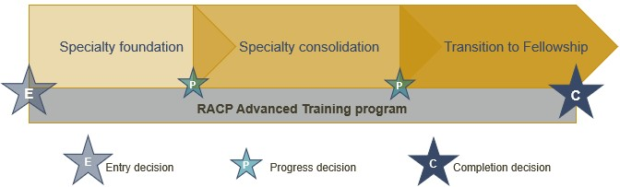
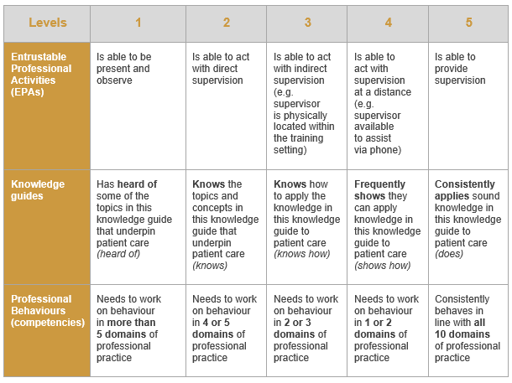
Advanced Training in Haematology (Adult Medicine) Proposed learning, teaching and assessment programs summary
LTA STRUCTURE
PROGRESSION CRITERIA
 |  | Entry criteria | Progression criteria |  | Completion criteria
 | Learning goals | At entry into training | End of specialty foundation | End of specialty consolidation | End of Transition to Fellowship
Be | 1. Professional behaviours | Level 5 | Level 5 | Level 5 | Level 5
Do (work tasks) | 1. Team leadership | Level 2 | Level 3 | Level 4 | Level 5
 | 2. Supervision and teaching | Level 2 | Level 3 | Level 4 | Level 5
 | 3. Quality and clinical research | Level 2 | Level 3 | Level 4 | Level 5
 | 4. Clinical assessment and management | Level 2 | Level 3 | Level 4 | Level 5
 | 5. Management of transitions in care | Level 2 | Level 3 | Level 4 | Level 5
 | 6. Acute care | Level 2 | Level 3 | Level 4 | Level 5
 | 7. Longitudinal care | Level 2 | Level 3 | Level 4 | Level 5
 | 8. Communications with patients | Level 2 | Level 3 | Level 4 | Level 5
 | 9. Prescribing | Level 2 | Level 3 | Level 4 | Level 5
 | 10. Procedures | Level 1 | Level 2 | Level 3 | Level 5
 | 11. Investigations | Level 2 | Level 3 | Level 4 | Level 5
 | 12. Clinic management | Level 2 | Level 3 | Level 4 | Level 5
 | 13. End-of-life care | Level 2 | Level 3 | Level 4 | Level 5
Know (Knowledge Guides) | 1. Anaemia and iron disorders | Level 2 | Level 3 | Level 4 | Level 5
Know (Knowledge Guides) | 2. Bone marrow failure syndromes and cytopenias | Level 2 | Level 3 | Level 4 | Level 5
Know (Knowledge Guides) | 3. Myeloid disorders | Level 2 | Level 3 | Level 4 | Level 5
 | 4. Lymphoid disorders | Level 2 | Level 3 | Level 4 | Level 5
 | 5. Plasma cell dyscrasias | Level 2 | Level 3 | Level 4 | Level 5
 | 6. Bone marrow transplantation | Level 2 | Level 3 | Level 4 | Level 4
 | 7. Cellular and immune effector therapies | Level 2 | Level 3 | Level 4 | Level 4
 | 8. Thrombotic disorders | Level 3 | Level 4 | Level 4 | Level 5
 | 9. Bleeding disorders | Level 2 | Level 3 | Level 4 | Level 4
 | 10. Transfusion medicine | Level 2 | Level 3 | Level 4 | Level 5
 | 11. Laboratory haematology in clinical practice | Level 1 | Level 2 | Level 3 | Level 4
A learning, teaching and assessment (LTA) structure defines the framework for delivery and trainee achievement of the curriculum standards
Advanced Training is structured in three phases that establish checkpoints for progression and completion.
PROGRESS POINTS
An entry decision is made before entry into the program.
Progress decisions, based on competence, are made at the end of the specialty foundation and specialty consolidation phases of training.
A completion decision, based on competence, is made at the end of the training program, resulting in eligibility for admission to Fellowship.
RATING SCALES

Slide 15
Learning and assessment programs
Requirements over the course of training
1 training application
Complete at least 36 months FTE training - professional experience
Learning courses
Research project
Learning courses
1 logbook
Attend 1 scientific meeting or conference
Research project
Requirements per phase
1 rotation plan (rotation plan)
12 learning captures
12 observation captures
12 progress reports

Slide 16




Supervision overview for Advanced Training
All supervisors
Role specific activities
Are nominated by trainee and
Access to trainee dashboards
Identify learning opportunities
Plan how to achieve learning goals
Review rotation plans
Feedback on learning captures (optional)
Feedback and ratings on observation captures
Complete progress reports and make a progression decision
Have some involvement with Progress Review Panels
Rotation Supervisor
Advanced Training
Research Project Supervisor
Advanced Training
The research project supervisor guides trainees with their project choice, method, data analysis and interpretation, and quality of written and oral presentation
Identify rotation learning opportunities
Complete progress reports and make progression recommendations for a phase of training
Progress Review Panel
RACP oversight committees
Review and assess trainee’s progress
Report on progress decisions
Monitor local training delivery
Ensure compliance
Oversee implementation of training programs
Work with progress review panels
Decision making feedback and guidance
Assessors
No access to TMP (unless they are a nominated supervisor)
Feedback and ratings for observation captures
Check the teaching requirements for more information about supervisor requirements
Notes:
There are several supervisor roles in the new curriculum, with differing roles and responsibilities. This information can be found in the basic program handbook on the e-learning site. Overall, all supervisors will be nominated by either a trainee or DPE, access their dashboards on TMP, identify learning opportunities and plan how to achieve the learning goals. They review rotation plans and give feedback on the assessment tools. Supervisors may have some involvement with progress review panels.

Slide 17
Learning goals
Learning opportunities
Quarter 1 (Q1)
Nominate and meet with 2 supervisors
Discuss learning opportunities and learning goals
Complete rotation plan
Complete learning and observation captures
Begin thinking about research project
Professional behaviours
Team leadership
Clinical assessment and management
Communication with patients
Anaemia and iron disorders
Plasma cell dyscrasias
Cellular and immune effector therapies
Ward rounds ​
Family meetings ​
Handovers ​
Teaching medical students ​​
Clinical Haematology (Adult Medicine)
Example
Training Journey
Learning captures
Observation captures
Professional behaviours
Anaemia and iron disorders
Team leadership
Cellular and immune effector therapies
Clinical assessment and management
Communication with patients
Start role
12 months core training – training setting 1
End of phase
Q1
Q2
Q3
Q4
Learning and assessment activities
Progress report
Learning and assessment activities
Progress report
Learning and assessment activities
Progress report
Learning and assessment activities
Progress report
Apply for program
Application approved
End of phase progression
The Rotation Supervisor makes an overall progress recommendation at the end of the phase.
The Progress Review Panel make a progression decision based on:
Compliance with learning, teaching and assessment requirements
Evidence of competence (assessment data)
Rotation Supervisors' recommendation
Notes:
How does this all come together?
This is the overall journey of an Advanced Trainee over a phase of training. In this example, the trainee is completing 4 quarters over their phase of training. Looking at their first quarter, you can see the learning and assessment activities that take place. These activities are conducted in each quarter, with the addition of a Phase Progress report check-in point in quarter 2 and the Phase Progress Report in quarter 4 that brings together the evidence from the phase. The rotation supervisor reviews the information and makes a progression decision which is forwarded to the Progress Review Panel for a decision.

Slide 18
Learning and assessment cycle
Progression decision
The supervisor rating and evidence of trainee performance are reviewed by a Progress Review Panel who decide if/how the trainee progresses in the training program
Entry application
Apply for and be approved to enter an RACP Training Program
01
Plan and support learning
Plan goals for a rotation based on the curriculum learning goals and opportunities available at the setting with a supervisor
05
02
Progress Report
Reflect on and discuss progress during the rotation
Trainee and supervisor meet
Supervisor provides feedback and an overall rating against each learning goal
04
03
Assessment tools
Complete work-based tasks and assessment activities throughout the rotation
The five-point rating scale is used to assess each assessment encounter
Notes:
As per our overall learning journey, in each rotation, steps 2, 3 and 4 are repeated. This cycle is planning learning using the rotation plan, demonstrating achievement towards learning goals via the assessment tools and being rated by a Rotation Supervisor in a Rotation Progress Report. The progress decision occurs at the end of the final rotation for a phase.

Slide 19


New assessment tools
Rotation plan
Trainee and supervisor outline rotation details, learning goals and opportunities for the upcoming rotation.
Observation capture
Trainee is observed by an assessor to demonstrate their skills and knowledge in one learning goal.
Learning capture
Trainee reflects and provides evidence on a professional development experience linked to one learning goal.
Progress reports
Supervisors document trainee progress against learning goals.
Roles involved:
Trainee
Supervisor(s)
Roles involved:
Trainee
Assessor
Roles involved:
Trainee
Assessor (optional)
Roles involved:
Trainee
Supervisor(s)
Notes:
Here is an overview of the new assessment tools in the new curriculum. For more details, please visit the e-learning portal to find on demand workshops and information packages about each type.

Slide 20



Other learning and assessment requirements
Learning programs
Professional experience
Learning courses
Research project
A trainee-led study involving significant involvement in design, conduct and analysis.
When: Before the end of Advanced Training
Roles involved:
Trainee
When: Before the end of Advanced Training
Roles involved:
Trainee
Research Project Supervisor
Notes:
Here is an overview of the other learning and assessment requirements. For more details, please visit the program LTA.

Slide 21
Rating scales
Be - Professional behaviours ​
0 ​ | Not assessed
1 ​ | needs to work on their behaviour in more than five domains of professional practice ​
2 ​ | needs to work on their behaviour in four or five domains of professional practice ​
3 ​ | needs to work on their behaviour in two or three domains of professional practice ​
4 ​ | needs to work on their behaviour in one domain of professional practice ​
5 ​ | consistently behaves in line with each of the ten domains of professional practice ​
Do – Entrustable professional activities
0 ​ | Not assessed
1 ​ | able to be present and observe
2 ​ | able to act with direct supervision
3 ​ | able to act with indirect supervision (i.e., ready access to a supervisor)
4 ​ | able to act with supervision at a distance (i.e., limited access to a supervisor)
5 ​ | able to supervise others
Know - Knowledge ​
0 ​ | Not assessed
1 ​ | has heard of some of the topics in this knowledge guide
2 ​ | knows the topics and concepts described in this knowledge guide
3 ​ | knows how to apply this knowledge to practice
4 ​ | frequently shows they apply this knowledge to practice
5 ​ | consistently demonstrates application of this knowledge to practice
Traditional rating scales | Level of new rating scales
Satisfactory to superior ratings Task components separated (e.g. medical interviewing skills, clinical judgement) No links to the expectation of the standards required | Increased levels of independence over time Comprehensive rating of clinical and professional expertise Expected standards of performance at the end of each phase to direct learning
Notes:
These are the rating scales that will be used in all the assessment tools. There is a rating scale for the three types of learning goals. These rating scales also relate to the progression criteria outlined at the end of each phase of training. This criteria specifies the standard of achievement for trainees at the end of each phase.
<Click for animation>
The new rating scales compared to traditional rating scales align to the increased levels of independence over time, rather than using satisfactory to superior descriptors. The new scales provide a comprehensive rating of clinical and professional expertise, where in the past, components have been separated. They also explain the expected standard of performance at the end of each phase.

Slide 22
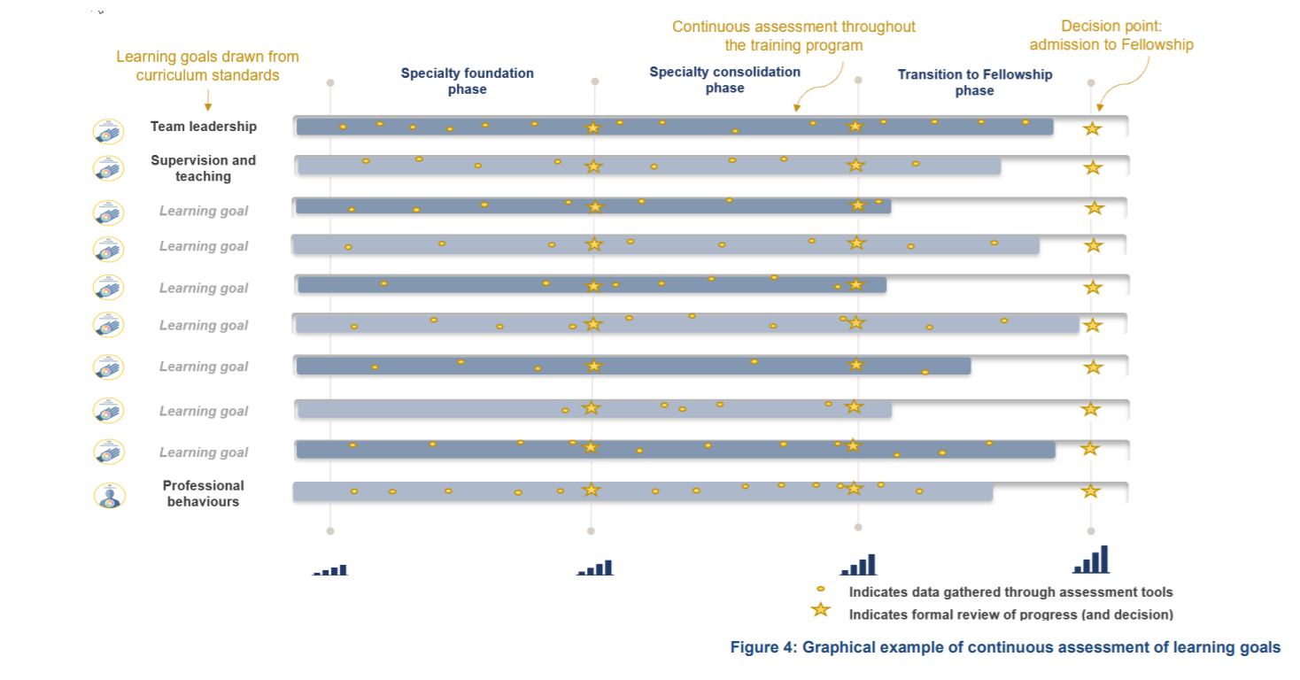
Continuous assessment
Notes:
Trainees will be continuously assessed on the key learning goals through regular capture of work-based learning in a range of assessment tools. The use of multiple data points build a complete picture of trainee progress over time. Supervisors offer ongoing feedback through multiple tools to support progressive assessment, encouraging the use of narrative feedback to explain the ratings selected in the assessment tools.

Slide 23
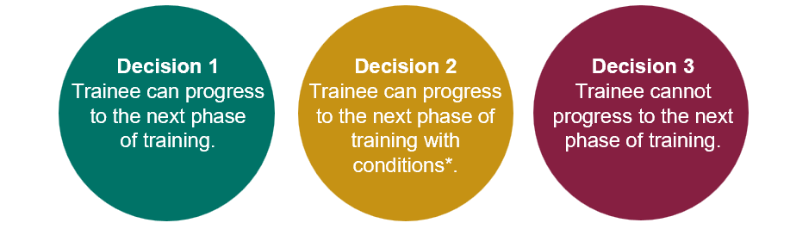
Progression
Each phase of training has clear progression criteria. Trainees must meet these standards to progress to the next phase or complete the program.
Progression decisions and completion decisions will be based on aggregated assessment data, providing richer evidence.
The Progress Review Panel will assess the evidence and make one of the following decisions:
Notes:
The alignment between the learning goals and learning, teaching and assessment programs forms a comprehensive picture of trainee performance over a phase of training. The data comes together to provide robust assessment information that is used by a progress review panel to make decisions about progression.

Slide 24
Progression criteria
Learning goals | Entry into training | Specialty foundation | Specialty consolidation | Transition to fellowship
01. Professional behaviours | Level 5 | Level 5 | Level 5 | Level 5
02. Team leadership | Level 2 | Level 3 | Level 4 | Level 5
03. Supervision and teaching | Level 2 | Level 3 | Level 4 | Level 5
04. Quality and clinical research | Level 2 | Level 3 | Level 4 | Level 5
05. Clinical assessment and management | Level 2 | Level 3 | Level 4 | Level 5
06. Management of transitions in care | Level 2 | Level 3 | Level 4 | Level 5
07. Acute care | Level 2 | Level 3 | Level 4 | Level 5
08. Longitudinal care | Level 2 | Level 3 | Level 4 | Level 5
09. Communications with patients | Level 2 | Level 3 | Level 4 | Level 5
10. Prescribing | Level 2 | Level 3 | Level 4 | Level 5
11. Procedures | Level 1 | Level 2 | Level 3 | Level 5
12. Investigations | Level 2 | Level 3 | Level 4 | Level 5
13. Clinic management | Level 2 | Level 3 | Level 4 | Level 5
14. End-of-life care | Level 2 | Level 3 | Level 4 | Level 5
15. Anaemia and iron disorders | Level 2 | Level 3 | Level 4 | Level 5
16. Bone marrow failure syndromes and other cytopenias | Level 2 | Level 3 | Level 4 | Level 5
17. Myeloid disorders | Level 2 | Level 3 | Level 4 | Level 5
18. Lymphoid disorders | Level 2 | Level 3 | Level 4 | Level 5
19. Plasma cell dyscrasias | Level 2 | Level 3 | Level 4 | Level 5
20. Bone marrow transplantation | Level 2 | Level 3 | Level 4 | Level 4
21. Cellular and immune effector therapies | Level 2 | Level 3 | Level 4 | Level 4
22. Thrombosis | Level 3 | Level 4 | Level 4 | Level 5
23. Bleeding | Level 2 | Level 3 | Level 4 | Level 5
24. Transfusion medicine | Level 2 | Level 3 | Level 4 | Level 4
25. Laboratory haematology in clinical practice | Level 1 | Level 2 | Level 3 | Level 4
Notes:
Trainees progress through phases based on meeting established criteria for knowledge and skills. There are clear standards that a trainee must meet to advance, with supervisors playing a key role in documenting trainee performance to inform progression decisions.

Slide 25
Joint training

Slide 26
About the following slide (Joint Training)
Slide purpose:
A draft to document the summary of a proposal for training program requirements for joint haematology training in 2027
For consideration by the Training Program Committee – haematology and for consultation purposes with RCPA
To inform a more detailed joint training guide for trainees and supervisors (yet to be developed)
Assumptions in preparing this slide:
No changes to current fee structure and invoicing process.
No changes to acceptance of RCPA dissertation towards RACP ATRP.
No concessions in terms of RCPA training requirements.

Slide 27
Joint trainees | New haematology curriculum - program requirements
RACP requirements
DRAFT
RCPA requirements
1 x RACP Training application
Before 28 February or 31 August
1 x RCPA Initial Registration Form
(online Risr/apply portal)
Within 2 months of commencing training
Entry applications
Joint trainees will need to select their RACP Training Program and upload evidence of their appointment to either a clinical or joint training position
Rotation plans / Annual registration
1 x RACP rotation plan per rotation
Before 28 February or 31 August
Joint Trainees will submit a rotation plan in the TMP for clinical and laboratory rotations to notify of professional experience and to inform invoicing for training fees. If undertaking lab training, trainees select 'non-accredited' rotation plan type, as laboratories are not accredited by the RACP.
1 x RCPA Annual registration form
Before 28 February each year
Proficiency-based assessments
1 x RACP Advanced Training Research Project (ATRP) [satisfied by RCPA project dissertation]
1 x Haematology Part I Phase I written and slides exam
1 x Haematology Part I Phase II dry and oral exam
1 x Haematology Part II Oral exam
1 x project dissertation
Before 9 July final year of training
Learning courses
4 x RACP Online Learning courses
By the end of training
4 x RCPA E-Modules
within 3 months of starting training
During clinical rotations
During laboratory rotations
Work-based assessments
12 x Learning Captures per phase
12 x Observation Captures per phase
Recommended 1 per month
Portfolio activities – See relevant RCPA discipline handbook
Joint trainees will not need to complete RACP work-based assessments, including learning captures, observation captures and progress reports, during laboratory rotations.
Progress reports / Supervisor’s Reports
1 x RCPA supervisor report due at end of each rotation and before 9 July when sitting examinations
Annual supervisor report due by 31 January
4 x progress reports per phase
Minimum 1 every 3 months
The concessions described above only relate to joint haematology trainees. Clinical-only (non-joint) trainees undertaking a laboratory rotation will need to complete all work-based assessment requirements, including learning captures & observation captures, which are generic, highly adaptable and can be lab-based.

Slide 28
Education policy
The RACP is committed to ensuring high quality, equitable and transparent training and assessment practices.
Our education policies provide the foundation for delivering consistent and effective medical education, supporting both trainees and supervisors. Key areas include:
Accreditation of training settings
Progression requirements and assessments
Supervisors and trainee roles and responsibilities
Professional behaviours and ethical conduct
Visit the Education Policies and Governance webpage for the latest updates and resources.
By aligning with these policies, we ensure a structured and fair approach to training and the development of future physicians.

Slide 29
Next steps for new ATs
Apply for your training program before the close date
28 February if starting at the beginning of the year.
31 August if starting mid-year
Review your curriculum standards and learning, teaching and assessment programs documents on the RACP eLearning portal
Nominate 2 x supervisors who meet the Haematology teaching requirements for the upcoming rotation. A list of eligible supervisors can be found on MyRACP
Find out what the learning opportunities at your setting might be so you can complete your rotation plan
Notes:
<read slide>
<share links with participants> RACP eLearning portal MyRACP

Slide 30



More information
RACP Implementation webpage
Visit the RACP Implementation webpage to find updates about 2025 implementation
RACP Online Learning
Log into RACP Online Learning to learn about the new curricula
RACP Member services
Contact memberservices@racp.edu.au if you have any questions about the new curricula
Notes:
Thank participants for attending and review where they can get some more information

