Slide 1

Introduction to the new curriculum 2026 implementation – Advanced Training: Palliative Medicine
Notes:
This information session is as an introduction to the new Palliative Medicine curriculum.

Slide 2
About this session
At the end of this session, participants will be able to:
Discuss the changes and components of the new curriculum
Outline the learning and assessment requirements
Notes:
During this session we will be reviewing the curriculum and associated learning and assessment requirements

Slide 3




What is changing?
Standards
Practical, work-focused learning goals
Explicit standards of achievement
Learning and assessment
New learning and assessment tools
Increased assessment frequency
Progression
Progress Review Panels
Technology
New technology (TMP)
Notes:
Assessments are designed to be quick and integrated into routine activities.
Assessment feedback is streamlined and unnecessary paperwork is reduced.
The new tech minimizes administrative burden.
The panels provide a structured way to evaluate trainee progress.
The differences between PREP and the new curriculum will be discussed on the next slide.
Trainees will need to complete some different learning and assessment tools
Trainees will need to complete more assessments in the new program
There is new technology to support these changes – Training Management Platform (TMP)
We are introducing Progress Review Panels to check that trainees are ok to pass into their next stage of training.

Slide 4
The new curricula
What's not changing
Trainees and supervisors will still....
Plan learning for a rotation
Work with and observe trainees doing their job
Provide feedback to trainees on their performance and progress
Assess trainees through rotation and at the end via a report
Contribute to the learning and understanding of the curriculum
Enter learning and assessment information onto an online platform
PREP versus new curricula
Be aware of the different learning goals/outcomes
New curriculum learning goals
PREP and PQC
Use 2 online platforms
PREP portal
TMP
Use different learning and assessment tools with differences in rating scales
LNA or rotation plan
Mini-CEX/CbD or observation capture
Use expected standards to benchmark performance
Progression criteria (new program only)
Notes:
On the left handside, Here is a supervision overview, highlighting the things that are staying the same and the things that are changing that supervisors must be aware of.
Supervisors will still plan learning and work with trainees day-to-day, providing feedback throughout. They will assess them and enter this information into an online platform, taking responsibility to contribute to their understanding of the new curriculum.
The learning goals are changing as well as the online platform. The new curriculum has different assessment tools and standards for trainees. It is important for supervisors to understand these changes, especially when managing trainees on both programs. PREP trainee follow PREP requirements and use the PREP portal. New curriculum trainees follow new requirements and use the Training Management Platform (TMP).

Slide 5
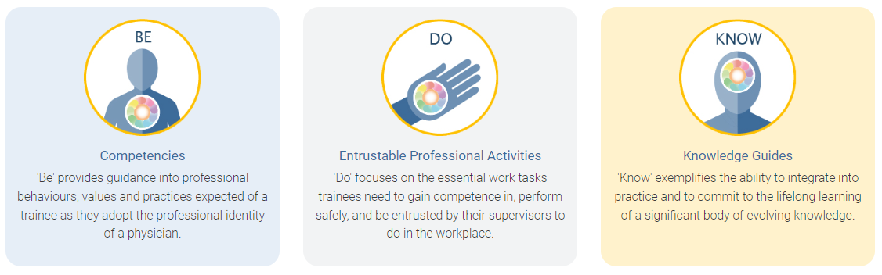
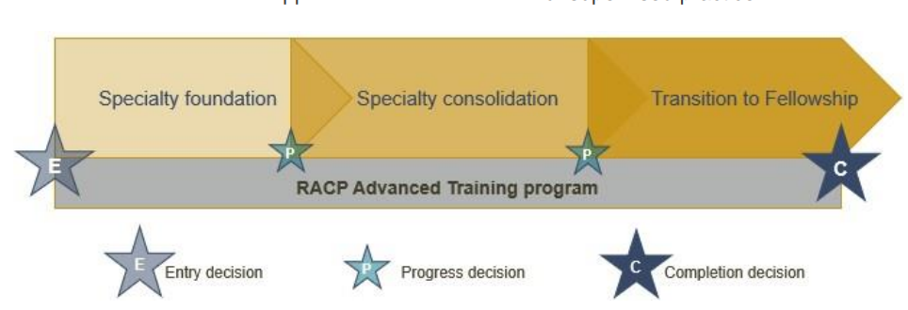
Framework overview
All new curricula in Advanced Training programs use the same frameworks
Curriculum standards
Learning, teaching and assessment (LTA)
structure
Learning goals within each training program categorised by the curriculum standards: Be, Do and Know.
More information about the curriculum standards and learning, teaching & assessment structure can be found in the LTA of each training program.
Notes:
All new curricula in Advanced Training programs use the same framework.
Within the Curriculum standards, You can see the learning goals, categorised as Be, Do and Know.
the learning, teaching and assessment requirements outline the program requirements.
This includes the phases of the training: foundation, consolidation and transition to fellowship.
We will go though each of these areas in more detail.

Slide 6
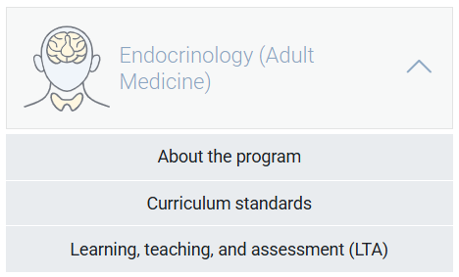
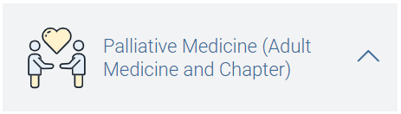
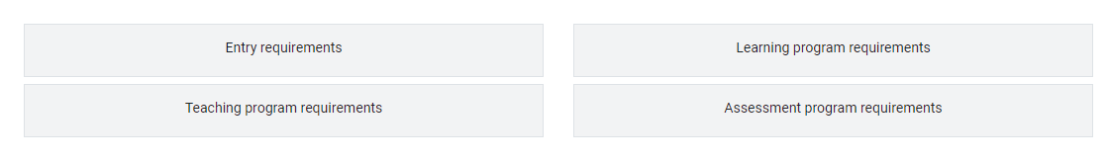
Curriculum documents: Adult
<insert training program curriculum standards location>
<insert training program LTA location>
Notes:
The information that we are going to refer to today is outlined in the Palliative Medicine Curricula which can be found on the RACP eLearning Portal.
The curriculum standards contains the key learning goals used in Training programs, and include ‘Be’ – the competencies which outline the professional behaviours expected of a trainee, ‘Do’ , the EPAs or important work tasks, and ‘Know’ the knowledge guides outlining important knowledge per specialty.
The learning, teaching and assessment programs outline the entry requirements, teaching program requirements, learning program requirements and the assessment program requirements

Slide 7
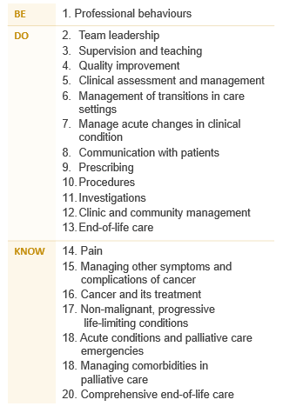
Learning goals: Adult
Palliative Medicine - Adult Medicine
The Advanced Training curricula standards are grouped into 20 key learning goals that guide learning, teaching, and assessment in the new programs.
Notes:
Each training program is grouped into learning goals, guided by the curriculum standards: Be, Do & Know. This includes professional behaviours, entrustable professional activities or EPAs and knowledge. These learning goals are used for all learning and assessment activities across each program. More information about your program’s specific learning goals can be found in the LTA of each training program.

Slide 8

Curriculum documents: Paediatric
<insert training program curriculum standards location>
<insert training program LTA location>
Notes:
The information that we are going to refer to today is outlined in the Basic and Advanced Training Curricula which can be found on the RACP eLearning Portal.
The curriculum standards contains the key learning goals used in Training programs, and include ‘Be’ – the competencies which outline the professional behaviours expected of a trainee, ‘Do’ , the EPAs or important work tasks, and ‘Know’ the knowledge guides outlining important knowledge per specialty.
The learning, teaching and assessment programs outline the entry requirements, teaching program requirements, learning program requirements and the assessment program requirements

Slide 9
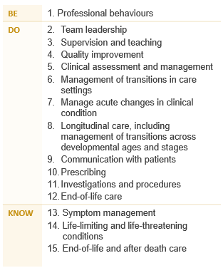
Learning goals: Paediatric
Palliative Medicine - Paediatrics and Child Health
The Advanced Training curricula standards are grouped into 15 key learning goals that guide learning, teaching, and assessment in the new programs.
Notes:
Each training program is grouped into learning goals, guided by the curriculum standards: Be, Do & Know. This includes professional behaviours, entrustable professional activities or EPAs and knowledge. These learning goals are used for all learning and assessment activities across each program. More information about your program’s specific learning goals can be found in the LTA of each training program.

Slide 10



Applying learning goals
How an observed clinical activity achieves the learning goal components in real time.
Dr Alex, an Advanced Trainee in palliative medicine consults with an oncology patient with metastatic breast cancer who has been told that preventative and invasive treatments are unlikely to improve her outcomes
05. Clinical assessment and management
06. Management of transitions in care settings
08. Communication with patients
09. Prescribing
13. End-of-life care
01. Professional behaviours
Medical expertise
Communication
Cultural safety
Ethics and professional behaviour
15. Pain
16. Managing other symptoms and complications of cancer
18. Acute conditions and palliative care emergencies
29. Managing comorbidities in palliative care
20. Comprehensive end-of-life care
Notes:
Here is an example of how the learning goals might be applied when you are performing a task in the workplace.
(Read scenario)
(click, click, click)
There are a number of skills and knowledge that are displayed at different times during this encounter.
In this example, Dr Alex is using skills, knowledge and competencies across a number of learning goals. If you were to use this scenario as a formal assessment, you would need to focus on one learning goal.

Slide 11
Covering learning goals
Each trainee is expected to develop and demonstrate progress across all learning goals by the end of the Advanced Training program, not in every rotation.
It is normal for some learning goals to have limited or no exposure in certain settings.
Use your rotation plan to identify which goals can be developed in your current setting
Use learning captures for less common, more complex tasks that may not be available during a rotation
Progress Review Panels review evidence across all phases of training, considering overall growth rather than exposure per rotation.
Watch the rotation plan on-demand workshop to learn how to choose and track learning goals across each phase of training.
Settings and networks are encouraged to participate in curriculum mapping to show which learning goals are covered in their rotations and provide a resource to help trainees plan their learning.
Notes:
Send links to participants
Rotation plan (video)
Curriculum mapping (video)

Slide 12
Learning and assessment programs
Requirements over the course of training
1 training application
Complete at least 36 months FTE training - professional experience
Learning courses ​
Research project ​
Complete developmental and psychosocial training (PCH Only)
Requirements per phase
1 rotation plan (per rotation)
12 learning captures
12 observation captures
4 progress reports
Notes:
Here we have the learning and assessment programs information. Over the course of training, trainees are required to complete 36 months of full time clinical experience, 1 rotation plan per rotation and a variety of learning courses.
Per phase of training, there are assessment program requirements. Here we have outlined the requirements for the foundation year of training.
We will have a closer look at all the required tools over the next few slides.

Slide 13




Supervision overview for Advanced Training
All supervisors
Role specific activities
Are nominated by trainee
Access to trainee information
Identify learning opportunities
Plan how to achieve learning goals
Review rotation plans
Feedback on learning captures (optional)
Feedback and ratings on observation captures
Complete progress reports and make a progression decision
Rotation Supervisor
Advanced Training
Research Project Supervisor
Advanced Training
The research project supervisor guides trainees with their project choice, method, data analysis and interpretation, and quality of written and oral presentation
Identify rotation learning opportunities
Complete progress reports and make progression recommendations for a phase of training
Progress Review Panel
RACP oversight committees
Review and assess trainee’s progress
Report on progress decisions
Monitor local training delivery
Ensure compliance
Oversee implementation of training programs
Work with progress review panels
Decision making feedback and guidance
Assessors
No access to TMP (unless they are a nominated supervisor)
Feedback and ratings for observation captures
Check the teaching requirements for more information about supervisor requirements
Notes:
There are several supervisor roles in the new curriculum, with differing roles and responsibilities. This information can be found in the program handbook on the e-learning site.
Overall, all supervisors will be nominated by a trainee, have access to training dashboards on TMP, help to identify learning opportunities and plan how to achieve the learning goals. They review rotation plans and give feedback on the assessment tools.
Supervisors may have some involvement with progress review panels.

Slide 14
Quarter 1 (Q1)
Nominate and meet with 2 supervisors
Discuss learning opportunities and learning goals
Complete rotation plan
Complete learning and observation captures
Begin thinking about research project
Learning goals
Learning opportunities
Professional behaviours
Team leadership
Clinical assessment and management
Communication with patients
Knowledge (3 specific knowledge guide learning goals selected)
Ward rounds ​
Family meetings ​
Handovers ​
Teaching medical students ​
Family meetings ​
Palliative Medicine
Example
Training Journey
Learning captures
Observation captures
Professional behaviours
Comprehensive end-of-life care
Team leadership
Pain
Prescribing
Clinical assessment and management
Communication with patients
Cancer and its treatment
Start role
12 months core training – training setting 1
End of phase
Q1
Q2
Q3
Q4
Learning and assessment activities
Progress report
Learning and assessment activities
Progress report
Learning and assessment activities
Progress report
Learning and assessment activities
Progress report
Apply for program
Application approved
End of phase progression
The Rotation Supervisor makes an overall progress recommendation at the end of the phase.
The Progress Review Panel make a progression decision based on:
Compliance with learning, teaching and assessment requirements
Evidence of competence (assessment data)
Rotation Supervisors' recommendation
Notes:
How does this all come together?
This is the overall journey of an Advanced Trainee over a phase of training.
In this example, the trainee is completing 4 quarters over their phase of training.
Looking at their first quarter, you can see the learning and assessment activities that take place.
These activities are conducted in each quarter.
End of phase progression - The rotation supervisor reviews the information and makes a progression decision which is forwarded to the Progress Review Panel for a decision.

Slide 15
Learning and assessment cycle
Progression decision
The supervisor rating and evidence of trainee performance are reviewed by a Progress Review Panel who decide if/how the trainee progresses in the training program
Entry application
Apply for and be approved to enter an RACP Training Program
01
Plan and support learning
Plan goals for a rotation based on the curriculum learning goals and opportunities available at the setting with a supervisor
05
02
Progress Report
Reflect on and discuss progress during the rotation
Trainee and supervisor meet
Supervisor provides feedback and an overall rating against each learning goal
04
03
Assessment tools
Complete work-based tasks and assessment activities throughout the rotation
The five-point rating scale is used to assess each assessment encounter
Notes:
As per our overall learning journey, in each rotation, steps 2, 3 and 4 are repeated. This cycle is planning learning using the Rotation Plan, demonstrating achievement towards learning goals via the assessment tools and being rated by a Rotation Supervisor in a progress report. The progress decision occurs at the end of the final rotation for a phase.

Slide 16





New assessment tools
Rotation plan
Trainee and supervisor outline rotation details, learning goals and opportunities for the upcoming rotation.
Observation capture
Trainee is observed by an assessor to demonstrate their skills and knowledge in one learning goal.
Learning capture
Trainee reflects and provides evidence on a professional development experience linked to one learning goal.
Progress reports
Supervisors document trainee progress against learning goals.
Roles involved:
Trainee
Supervisor(s)
Roles involved:
Trainee
Assessor
Roles involved:
Trainee
Assessor (optional)
Roles involved:
Trainee
Supervisor(s)
Notes:
Here is an overview of the new assessment tools in the new curriculum.
For more details, please visit the e-learning portal to find on demand workshops and information packages about each type.

Slide 17



Rotation Plan workflow
Trainee initiates the rotation plan
Trainee selects learning goals that they plan to cover that rotation
Trainee meets with their supervisor to co-develop the rotation plan
Trainee inputs this into the TMP
Supervisor is sent the rotation plan for verification
Tip: Trainees can select as many learning goals as they like. We recommend 4-5 per rotation, ensuring that each learning goal is covered across each phase and adhering to the progression criteria of each goal.
Advanced Trainees should consider how they will apply knowledge learning goals throughout a phase.
Plan learning: Trainee
Co-developed rotation plan to guide learning
TMP
Support learning: Supervisor
Notes:
Here is the workflow for rotation plans.
Trainee initiates the rotation plan
Trainee selects learning goals that they plan to cover that rotation
Trainee meets with their supervisor to co-develop the rotation plan
Trainee inputs this into the TMP
Supervisor is sent the rotation plan for verification
Tip: Trainees can select as many learning goals as they like. We recommend 4-5 per rotation, ensuring that each learning goal is covered across each phase and adhering to the progression criteria of each goal.

Slide 18

Trainee and supervisor roles
Trainee
Supervisors
Provide learning opportunities
Are there experiences or resources I can suggest?
How can I support this trainee’s learning goals?
Initiate
What opportunities does my setting have?
Which skills or competencies do I need to focus on?
What learning goals should I prioritise for this rotation?
Verify
Are the learning goals achievable for this trainee during their rotation?
Are there any gaps in the trainee’s skill or knowledge that require further attention?
Do
Trainee completes rotation plan form in the Training Management Platform (TMP) and sends it to their supervisor.
Monitor and support
During the rotation:
Is the trainee progressing in the learning goals they chose to focus on?
Do they need extra support in a particular learning goal?
Reflect
During the rotation:
Am I making progress towards my initial goals?
What areas have I improved in, and where do I still need development?
Notes:
So, who’s responsible for what?
The trainee leads the process by identifying focus areas and completing the rotation plan form in TMP. They’re also encouraged to reflect during the term, checking their progress and thinking about areas for improvement.
Supervisors provide guidance along the way. They suggest relevant experiences, verify that the goals are realistic and monitor the trainee’s development during the rotation. It’s a shared responsibility, but the process works best when the trainee takes the lead and the supervisor offers ongoing support.

Slide 19



Observation capture workflow
Trainee selects one learning goal
Either trainee or assessor initiates the observation capture
Assessor observes trainee performing a task
Trainee and assessor fill out the form. This can be completed in one login.
If the trainee initiates → assessor verifies in TMP If assessor initiates → trainee reflects in TMP
TMP*
Observation encounter
Assessor prepares to observe
*This can be done via one login/one moment or can be completed separately at later times.
Notes:
Here is the Observation Capture workflow.
<<4 steps: Read slide as each animation appears>>
This can all be done in with one login where the trainee hands their phone to their assessor, and the assessor fills in the details in the moment. Alternatively, they can be completed separately at a later time.
(Support) will pop a link into the chat now which provides step-by-step instructions for assessors to review and provide feedback on an OC.
Observation capture Try its
How to complete an observation capture
Trainee
https://www.iorad.com/player/2526002/Trainee-submits-an-Observation-Capture
Observation captures
How to give feedback on an observation capture
https://elearning.racp.edu.au/mod/page/view.php?id=47276#video3

Slide 20
Learning capture
Definition: A work-based assessment that involves a trainee capturing, and reflecting on, professional development activities, including evidence of work-based learning linked to specified learning goals.
Purpose: To assist trainees to articulate and formalise their learning by reflecting on their experiences, encouraging critical thinking, linking these experiences to their learning goals, and supporting the development of professional knowledge and skills.
Types of learning:
Clinical experiences
Courses and workshops
Personal reflection
Readings and resources
Other learning experiences
Notes:
What is a learning capture?
<<click>> It is a work‑based assessment where trainees record and reflect on professional development activities linked to learning goals.
<<click>> The purpose is to help trainees formalise their learning, think critically, connect experiences to goals, and build professional knowledge and skills.
<<click>> Learning captures can come in many forms, including clinical experiences, courses, workshops, personal reflections, readings, resources and any other learning experiences

Slide 21
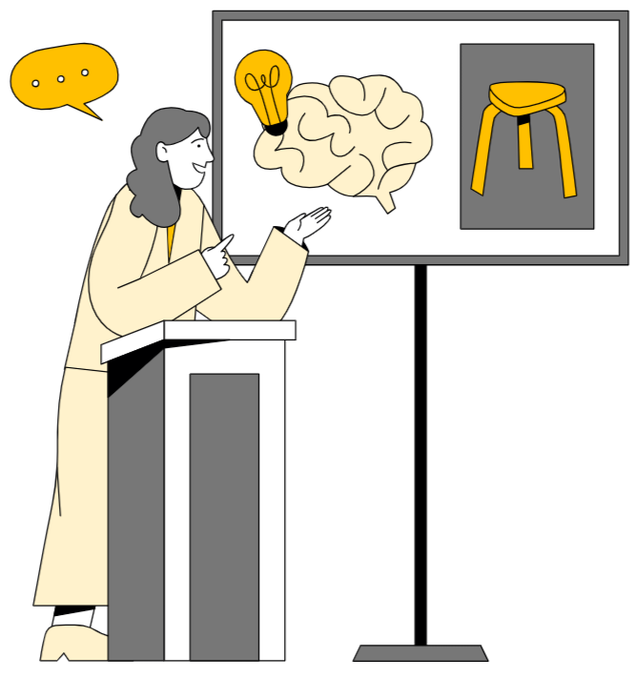
Learning Capture workflow
Trainee selects an activity related to one learning goal
Trainee submits evidence and reflection of learning via TMP
Trainee requests assessor feedback (optional)
TMP
Learning
encounter
Assessor provides feedback
Notes:
This slide shows the workflow for a learning capture:
Trainees review the learning goals in their rotation plan <<click>> and undertake an important work activity or review a resource that is linked to one of the learning goals.
<<click>> After the learning encounter, the trainee submits evidence and reflection of learning via the TMP portal. <<click>> They have the option to request feedback from an assessor. In this case, the assessor reviews the reflections and provides feedback online.
(support) will pop a link into the chat now showing how supervisors can provide feedback on a learning capture.
Supervisor
https://www.iorad.com/player/2508641/Assessor-provides-Feedback-on-a-Learning-Capture

Slide 22
Progress report workflow
Either trainee or supervisor* initiates the progress report
Trainee rates themselves against their learning goals and completes a written reflection, enters leave taken
Supervisor rates the trainee against each learning goal, completes a written reflection and selects a progression recommendation
Form is submitted in TMP
Self-assess and reflect on learning
TMP
Trainee
Assess learning
Discussion meeting
Complete and submit the report**
Decision 1
Decision 2
Decision 3
This trainee is progressing satisfactorily
Closely review this trainee’s progress
Refer to the training support pathway
Supervisor*
**This can be done via one login
Notes:
The process starts with either the trainee or supervisor initiating the progress report.
The trainee rates themselves against each learning goal and completes a written reflection
The supervisor also rates the trainee against each learning goal, completes a written reflection and selects a progression recommendation using our traffic light system
Once both parts are complete, the form is submitted in TMP

Slide 23

Resources: Learning & Assessment
RACP Online Learning: Curriculum training and support resources
Application to training
Trainee (Applicant) submits an Advanced Training application
Rotation plans
AT Trainee- submits a rotation plan
AT Supervisor- reviews a rotation plan
Observation captures (OC) and Learning Captures (LC)
Trainee- submit an OC
Assessor- review and provide feedback on an OC
Trainee- submit an LC
Progress Reports
Progress reports: How it looks in TMP | RACP Online Learning

Slide 24



Other learning and assessment requirements
Learning programs
Professional experience
Learning courses
Research project
A trainee-led study involving significant involvement in design, conduct and analysis.
When: Before the end of Advanced Training
Roles involved:
Trainee
When: Before the end of Advanced Training
Roles involved:
Trainee
Research Project Supervisor
Notes:
Here is an overview of the other learning and assessment requirements. For more details, please visit the program LTA.

Slide 25
Rating scales
Be - Professional behaviours ​
0 ​ | Not assessed
1 ​ | needs to work on their behaviour in more than five domains of professional practice ​
2 ​ | needs to work on their behaviour in four or five domains of professional practice ​
3 ​ | needs to work on their behaviour in two or three domains of professional practice ​
4 ​ | needs to work on their behaviour in one domain of professional practice ​
5 ​ | consistently behaves in line with each of the ten domains of professional practice ​
Do – Entrustable professional activities
0 ​ | Not assessed
1 ​ | able to be present and observe
2 ​ | able to act with direct supervision
3 ​ | able to act with indirect supervision (i.e., ready access to a supervisor)
4 ​ | able to act with supervision at a distance (i.e., limited access to a supervisor)
5 ​ | able to supervise others
Know - Knowledge ​
0 ​ | Not assessed
1 ​ | has heard of some of the topics in this knowledge guide
2 ​ | knows the topics and concepts described in this knowledge guide
3 ​ | knows how to apply this knowledge to practice
4 ​ | frequently shows they apply this knowledge to practice
5 ​ | consistently demonstrates application of this knowledge to practice
Traditional rating scales | Level of new rating scales
Satisfactory to superior ratings Task components separated (e.g. medical interviewing skills, clinical judgement) No links to the expectation of the standards required | Increased levels of independence over time Comprehensive rating of clinical and professional expertise Expected standards of performance at the end of each phase to direct learning
Notes:
These are the rating scales that will be used in all the assessment tools. There is a rating scale for the three types of learning goals. These rating scales also relate to the progression criteria outlined at the end of each phase of training. This criteria specifies the standard of achievement for trainees at the end of each phase.
<Click for animation>
The new rating scales compared to traditional rating scales align to the increased levels of independence over time, rather than using satisfactory to superior descriptors. The new scales provide a comprehensive rating of clinical and professional expertise, where in the past, components have been separated. They also explain the expected standard of performance at the end of each phase.

Slide 26
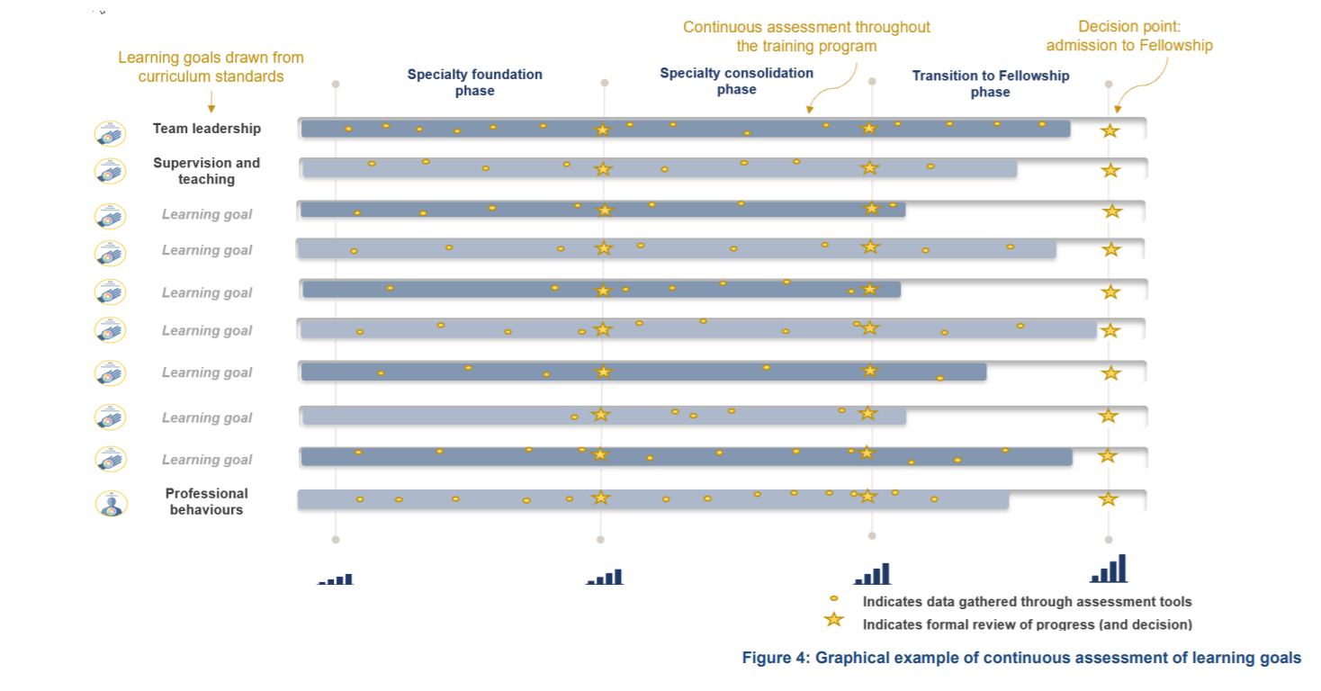
Continuous assessment
Notes:
Trainees will be continuously assessed on the key learning goals through regular capture of work-based learning in a range of assessment tools. The use of multiple data points build a complete picture of trainee progress over time. Supervisors offer ongoing feedback through multiple tools to support progressive assessment, encouraging the use of narrative feedback to explain the ratings selected in the assessment tools.

Slide 27
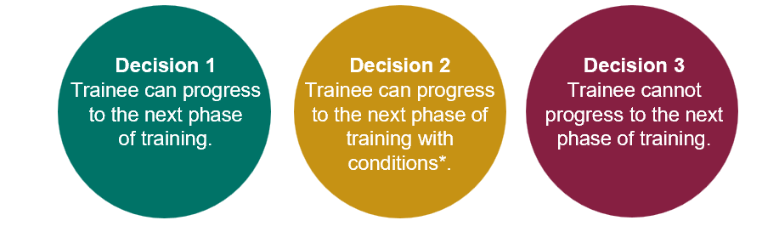
Progression
Each phase of training has clear progression criteria. Trainees must meet these standards to progress to the next phase or complete the program.
Progression decisions and completion decisions will be based on aggregated assessment data, providing richer evidence.
The Progress Review Panel will assess the evidence and make one of the following decisions:
Notes:
The alignment between the learning goals and learning, teaching and assessment programs forms a comprehensive picture of trainee performance over a phase of training. The data comes together to provide robust assessment information that is used by a progress review panel to make decisions about progression.

Slide 28

Progression decision workflow
Complete rotations
Ensure all rotation progress reports are submitted
Progress Review Panel
The trainee and supervisor/s are notified of the progression decision
Trainee
Meet and discuss trainees
Review trainee progression recommendations and assessment data
Determine if the trainee has met the progression criteria* for a phase
Enter in a progression decision
TMP
TMP*
Determine progression recommendation
Complete final progress report
Supervisor
*Decision is certified by RACP staff
Notes:
Here is an outline of the Progression Decision workflow:
Trainees and supervisors work together to submit the progress report into TMP. The supervisor also provides their Progression Recommendation, which we will cover in more detail in the next few slides.
The Progress Review Panel meet and discuss the trainees. They review the progression recommendation from the supervisor on the Progress Report and determine whether the trainee has met the progression criteria for the respective phase against the learning goals and assessment data (OC’s, LC’s etc). Once the panel makes their progression decision, it is recorded directly in TMP.
RACP staff then certify the decision through TMP, and this is formally communicated to both the trainee and supervisor.
This process ensures transparency and a clear, traceable record for all parties.

Slide 29
Progression decision
After reviewing the Supervisor's progression recommendation and trainee's Progress Report/assessment data, the PRP records the progression decision:
Unable to progress to the next phase
Progressing satisfactorily
Progress with Conditions
Trainee is unable to progress to the next phase, due to:
Insufficient evidence presented
Progression criteria not achieved
Stage 2 – Training Support Pathway
Trainee can progress to the next phase of training.
Trainee has completed all phase requirements and has met expected standards in the progression criteria.
Training conditions are placed on trainee.
This could include additional assessments to ensure a competency is achieved before a trainee can progress further.
Notes:
Once the panel reviews all the available evidence, there are three possible outcomes for the trainee’s progression decision:
Progress satisfactorily – this means the trainee has met all requirements and can move to the next phase.
Progress with conditions – the trainee moves forward but conditions are placed, such as additional OC’s or LC’s. This could be from a compliance standpoint if the trainee has failed to complete the required number of WBA’s for the phase, or from a competency standpoint if they are not meeting the expected standard against the learning goals. These conditions don’t add time to training if met promptly.
Unable to progress – the trainee hasn’t met the required standards against the learning goals in multiple areas, they may lack sufficient evidence, or the supervisor might have concerning feedback. These trainees will remain in their current phase, which extends their training until they meet expectations. They’re also referred to Stage 2 of the TSP.
Historically, these decisions were made by individual supervisors. The panel model shifts that responsibility to a group, which helps to promote consistency and it reduces reliance on a single person’s judgment.

Slide 30
Progression criteria: Adult
Learning goals | Entry to Training | End of specialty foundation | End of specialty consolidation | End of Transition to Fellowship
01. Professional behaviours | Level 5 | Level 5 | Level 5 | Level 5
02. Team leadership | Level 1 | Level 2 | Level 4 | Level 5
03. Supervision and teaching | Level 1 | Level 2 | Level 4 | Level 5
04. Quality improvement | Level 2 | Level 3 | Level 4 | Level 5
05. Clinical assessment and management | Level 1 | Level 2 | Level 3 | Level 5
06. Management of transitions in care settings | Level 2 | Level 3 | Level 4 | Level 5
07. Manage acute changes in clinical condition | Level 2 | Level 3 | Level 4 | Level 5
08. Communication with patients | Level 2 | Level 3 | Level 4 | Level 5
09. Prescribing | Level 1 | Level 2 | Level 4 | Level 5
10. Procedures | Level 1 | Level 2 | Level 3 | Level 4
11. Investigations | Level 1 | Level 2 | Level 4 | Level 5
12. Clinic and community management | Level 1 | Level 2 | Level 3 | Level 5
13. End-of-life care | Level 2 | Level 3 | Level 4 | Level 5
14. Pain | Level 1 | Level 2 | Level 4 | Level 5
15. Managing other symptoms and complications of cancer | Level 1 | Level 2 | Level 4 | Level 5
16. Cancer and its treatment | Level 1 | Level 2 | Level 4 | Level 5
17. Non-malignant, progressive life-limiting conditions | Level 1 | Level 2 | Level 4 | Level 5
18. Acute conditions and palliative care emergencies | Level 2 | Level 3 | Level 4 | Level 5
19. Managing comorbidities in palliative care | Level 1 | Level 2 | Level 4 | Level 5
20. Comprehensive end-of-life care | Level 2 | Level 3 | Level 4 | Level 5
Notes:
Trainees progress through phases based on meeting established criteria for knowledge and skills. There are clear standards that a trainee must meet to advance, with supervisors playing a key role in documenting trainee performance to inform progression decisions.

Slide 31
Progression criteria: Paediatric
Learning goals | Entry to training | End of specialty foundation | End of specialty consolidation | End of Transition to Fellowship
01. Professional behaviours | Level 5 | Level 5 | Level 5 | Level 5
02. Team leadership | Level 1 | Level 2 | Level 3 | Level 5
03. Supervision and teaching | Level 1 | Level 2 | Level 4 | Level 5
04. Quality improvement | Level 1 | Level 2 | Level 3 | Level 4
05. Clinical assessment and management | Level 2 | Level 3 | Level 4 | Level 5
06. Management of transitions in care settings | Level 2 | Level 2 | Level 4 | Level 5
07. Manage acute changes in clinical condition | Level 2 | Level 3 | Level 4 | Level 5
08. Longitudinal care, including management of transitions across developmental ages and stages | Level 1 | Level 2 | Level 3 | Level 5
09. Communication with patients | Level 2 | Level 3 | Level 4 | Level 5
10. Prescribing | Level 2 | Level 3 | Level 4 | Level 5
11. Investigations and procedures | Level 2 | Level 3 | Level 4 | Level 5
12. End-of-life care | Level 1 | Level 3 | Level 4 | Level 5
13. Symptom management | Level 1 | Level 3 | Level 4 | Level 5
14. Life-limiting and life-threatening conditions | Level 1 | Level 3 | Level 4 | Level 5
15. End-of-life and after death care | Level 1 | Level 3 | Level 4 | Level 5
Notes:
Trainees progress through phases based on meeting established criteria for knowledge and skills. There are clear standards that a trainee must meet to advance, with supervisors playing a key role in documenting trainee performance to inform progression decisions.

Slide 32

Dual Training: Ideal State
Unified Training Experience
Single TMP application for multiple programs
Consolidated list of learning goals and integrated assessments
Combined progress reports with integrated goals
Progress Review Panels see relevant trainee data only
Reduced training time with enhanced educational rigour
Greater efficiency for trainees, supervisors & College team
Notes:
In the long term <<click>> our goal is to move towards an integrated dual training experience.
<<click>> Ideally, we want trainees to be able to submit a single application through TMP <<click>> and be able to view a consolidated list of learning goals across both programs when planning their rotations and completing assessments.
<<click>> This integrated approach would allow for a unified set of learning goals, simplified progress reports, <<click>> and a clearer picture of trainee progress across both specialties.
<<click>> Ultimately, this will help maintain reduced overall training time while enhancing educational quality <<click>> and improving efficiency for trainees, supervisors, and the College team.
However, our current systems don’t yet support this level of integration. As a result, the College Education Committee has approved a set of interim arrangements to help manage this complexity. I’ll walk you through those on the next slide.

Slide 33
Dual Training: Interim Arrangements
There are 3 Key interim arrangements for dual trainees:
1
2
3
PREP + PREP
No changes
PREP + New Curriculum
New assessments (OCs, LCs, progress reports) will replace PREP tools and supervisor reports.
New Curriculum + New Curriculum
For shared training periods, assessments are split evenly e.g., 6 Observation Captures linked to one program’s goals, 6 OC’s to the other program’s goals.
Dual Training Guide
Notes:
There are 3 Key interim arrangements for dual trainees:
<<Click>> 1. If trainees are undertaking 2 PREP programs: No changes—existing assessment tools remain in place.
<<Click>> 2. For Dual training across 1 PREP program + 1 New Curriculum program: New work-based assessments will replace PREP tools and supervisor reports.
<<Click>> 3. For Dual training across 2 New Curricula programs: During periods of training time that is counted towards both programs concurrently, the work-based assessments will be split 50:50 between each program. i.e 6 observations captures will need to be linked to learning goals for one program, and the other six linked to learning goals for the second program.
These arrangements aim to support dual trainees while maintaining clarity and consistency across both programs.
<<Click>> A dual training guide has also been developed and is now available on the RACP webpage.
Q/A that might come up but does not need to be presented
Concern about how to balance the learning goals of two programs without compromising the integrity of either program, will it dilute core training. This can happen currently in PREP-PREP dual training, and what the new programs are doing now is making this apparent. Trainees can submit more than minimum WBAs if they want to strengthen the evidence of progress against the LGs.
How do trainees choose which learning goals for non core?
The assumption is that for the non core training program its likely trainees will be focused on more common learning goals like professional qualities, communication, clinical assessment – that sort of thing. This will depend on how relevant the non core training is and whether they will have exposure to more program specific learning goals during the rotation

Slide 34
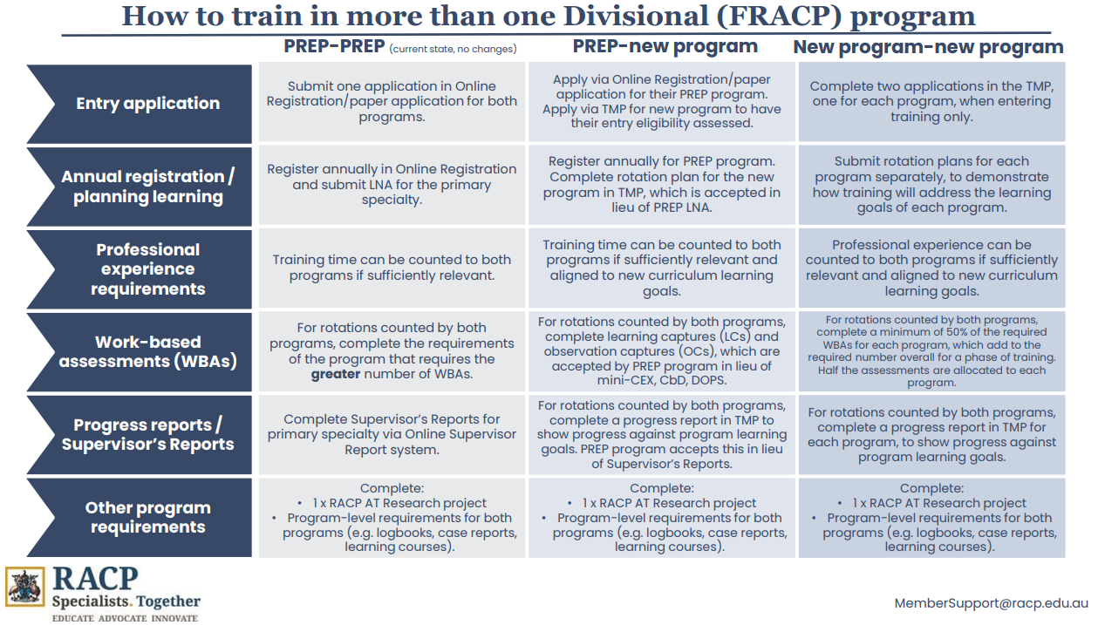

Slide 35
Education policy
The RACP is committed to ensuring high quality, equitable and transparent training and assessment practices.
Our education policies provide the foundation for delivering consistent and effective medical education, supporting both trainees and supervisors. Key areas include:
Accreditation of training settings
Progression requirements and assessments
Supervisors and trainee roles and responsibilities
Professional behaviours and ethical conduct
Visit the Education Policies and Governance webpage for the latest updates and resources.
By aligning with these policies, we ensure a structured and fair approach to training and the development of future physicians.

Slide 36
Quality supervision and protected time
The College is advocating for protected time and quality supervision through several initiatives:
1
2
An evaluation with a report due by the end of 2025
Education governance reforms
3
4
Collaboration with the AMC and other colleges to define and measure quality supervision, aiming to embed this in accreditation standards
Advocacy with government and health networks for trainee and supervisor protected time
Notes:
We acknowledge the time and commitment involved in implementing the new curricula and progress review panels.
The College is advocating for protected time and quality supervision through several initiatives:
<<click>> Curriculum evaluation is underway, focusing on trainee and supervisor workload. Initial findings are due end of 2025, with ongoing data collection into next year to guide usability and TMP improvements.
<<click>> Governance changes include delegating some committee functions to staff and expanding membership to support rollout. Supervisor training will be led by the Curriculum Improvement and Supervision Advisory Committee.
<<click>> We are collaborating with AMC and other colleges to define supervision quality outcomes and a shared measurement approach, aiming to embed standards (including protected time) into accreditation by end of 2025.
<<click>> Advocacy efforts with government and health networks to include guidance on protected time—featuring case studies, policies, and workplace models—for use in 2026 discussions.

Slide 37
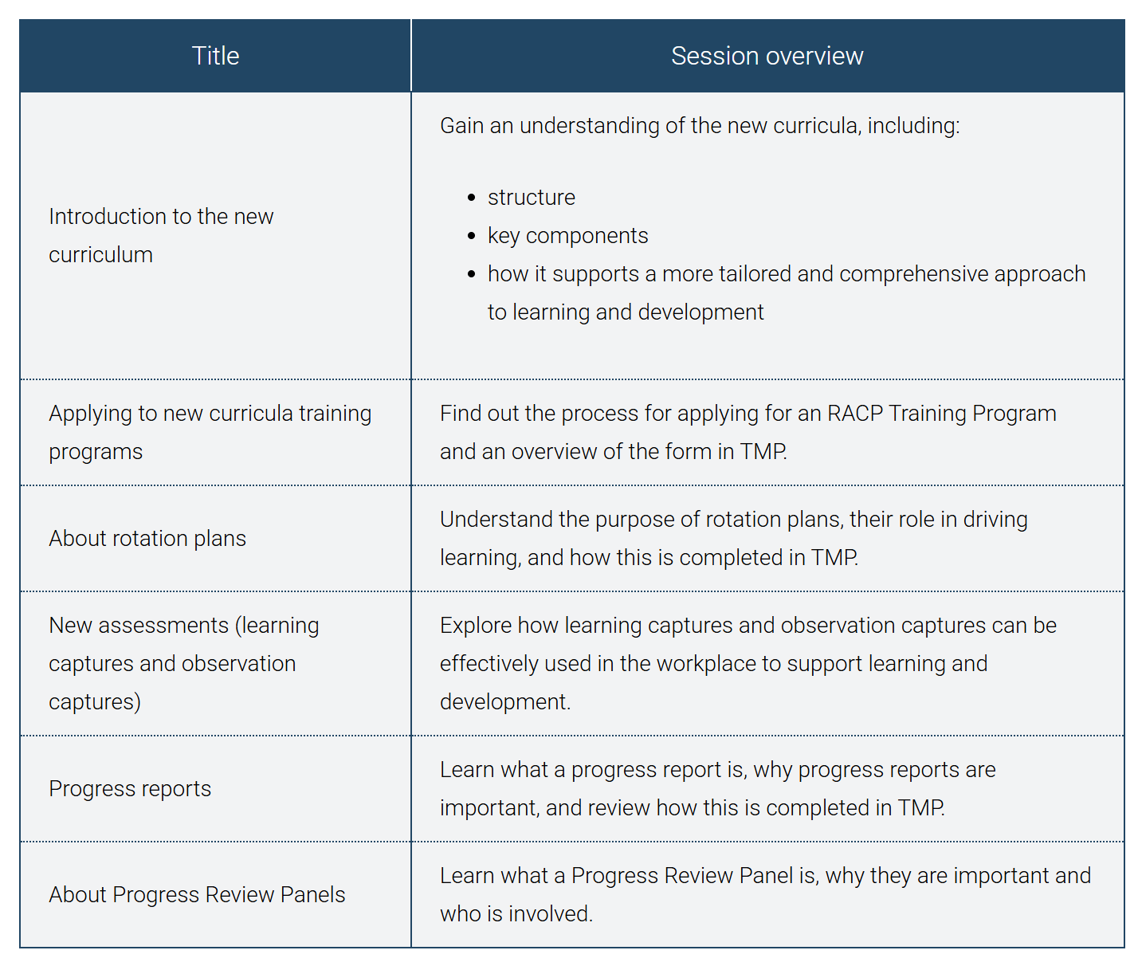
Online training sessions
See upcoming training sessions
We’re offering online training sessions via Zoom for all trainees and educators across Australia and Aotearoa New Zealand.
These sessions provide an overview of the new curriculum programs, including how learning and assessment will work. They’re open to all trainees and educators, no registration needed.
Our staff will run the sessions. They’re designed for a wide audience and include time for questions.
Notes:
We’re running Zoom training sessions for trainees and educators across Australia and Aotearoa New Zealand. They cover the new curriculum, assessments, rotation plans, and progress reviews. No registration needed, and each session includes time for questions.

Slide 38
Next steps for new ATs
Apply for your training program before the close date
28 February if starting at the beginning of the year.
31 August if starting mid-year
Review your curriculum standards and learning, teaching and assessment programs documents on the RACP eLearning portal
Nominate 2 x supervisors who meet the Palliative Medicine (Adult Medicine) teaching requirements for the upcoming rotation. A list of eligible supervisors can be found on MyRACP
Find out what the learning opportunities at your setting might be so you can complete your rotation plan

Slide 39



More information
RACP Implementation webpage
Visit the RACP Implementation webpage to find updates about 2025 implementation
RACP Online Learning
Log into RACP Online Learning to learn about the new curricula
RACP Member services
Contact memberservices@racp.edu.au if you have any questions about the new curricula
Notes:
Thank participants for attending and review where they can get some more information

