Slide 1

Introduction to the new curriculum 2026 implementation – Advanced Training: Occupational and Environmental Medicine
October 2025
Notes:
This information session is for trainees completing the Advanced Training: Occupational and Environmental Medicine, as an introduction to the new curriculum.

Slide 2
About this session
At the end of this session, participants will be able to:
Discuss the changes and components of the new curriculum
Outline the learning and assessment requirements
Notes:
During this session we will be reviewing the curriculum and associated learning and assessment requirements

Slide 3




What is changing?
Standards
Practical, work-focused learning goals
Explicit standards of achievement
Learning and assessment
New learning and assessment tools
Increased assessment frequency
Progression
Progress Review Panels
Technology
New technology (TMP)
Notes:
Assessments are designed to be quick and integrated into routine activities.
Assessment feedback is streamlined and unnecessary paperwork is reduced
The new tech minimizes administrative burden
The panels provide a structured way to evaluate trainee progress.
The differences between PREP and the new curriculum will be discussed on the next slide.
Trainees will need to complete some different learning and assessment tools
Trainees will need to complete more assessments in the new program
There is new technology to support these changes
We are introducing Progress Review Panels to check that trainees are ok to pass into their next stage of training.

Slide 4
The new curricula
What's not changing
Trainees and supervisors will still....
Plan learning for a rotation
Work with and observe trainees doing their job
Provide feedback to trainees on their performance and progress
Assess trainees through rotation and at the end via a report
Contribute to the learning and understanding of the curriculum
Enter learning and assessment information onto an online platform
PREP versus new curricula
Be aware of the different learning goals/outcomes
New curriculum learning goals
PREP and PQC
Use 2 online platforms
PREP portal
TMP
Use different learning and assessment tools with differences in rating scales
LNA or rotation plan
Mini-CEX/CbD or observation capture
Use expected standards to benchmark performance
Progression criteria (new program only)
Notes:
Here is a supervision overview, highlighting the things that are staying the same and the things that are changing that supervisors must be aware of. Supervisors will still plan learning and work with trainees day-to-day, providing feedback throughout. They will assess them and enter this information into an online platform, taking responsibility to contribute to their understanding of the new curriculum.
The learning goals are changing as well as the online platform. The new curriculum has different assessment tools and standards for trainees. It is important for supervisors to understand these changes, especially when managing trainees on both programs.

Slide 5
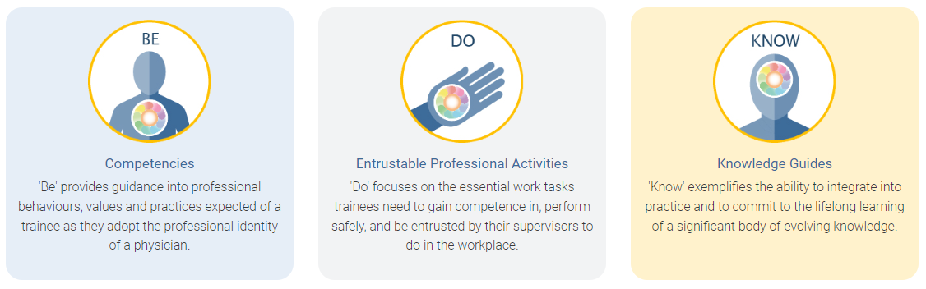
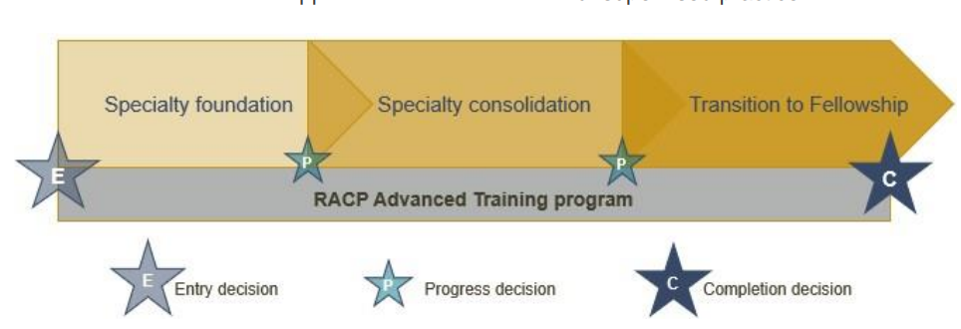
Framework overview
All new curricula in Advanced Training programs use the same frameworks
Curriculum standards
Learning, teaching and assessment (LTA)
structure
Learning goals within each training program categorised by the curriculum standards: Be, Do and Know.
More information about the curriculum standards and learning, teaching & assessment structure can be found in the LTA of each training program.
Notes:
All new curricula in Advanced Training programs use the same framework. You can see here the ten learning goals, the three phases of the training program and the learning, teaching and assessment requirements as outlined in the program requirements. We will go though each of these areas in more detail.

Slide 6

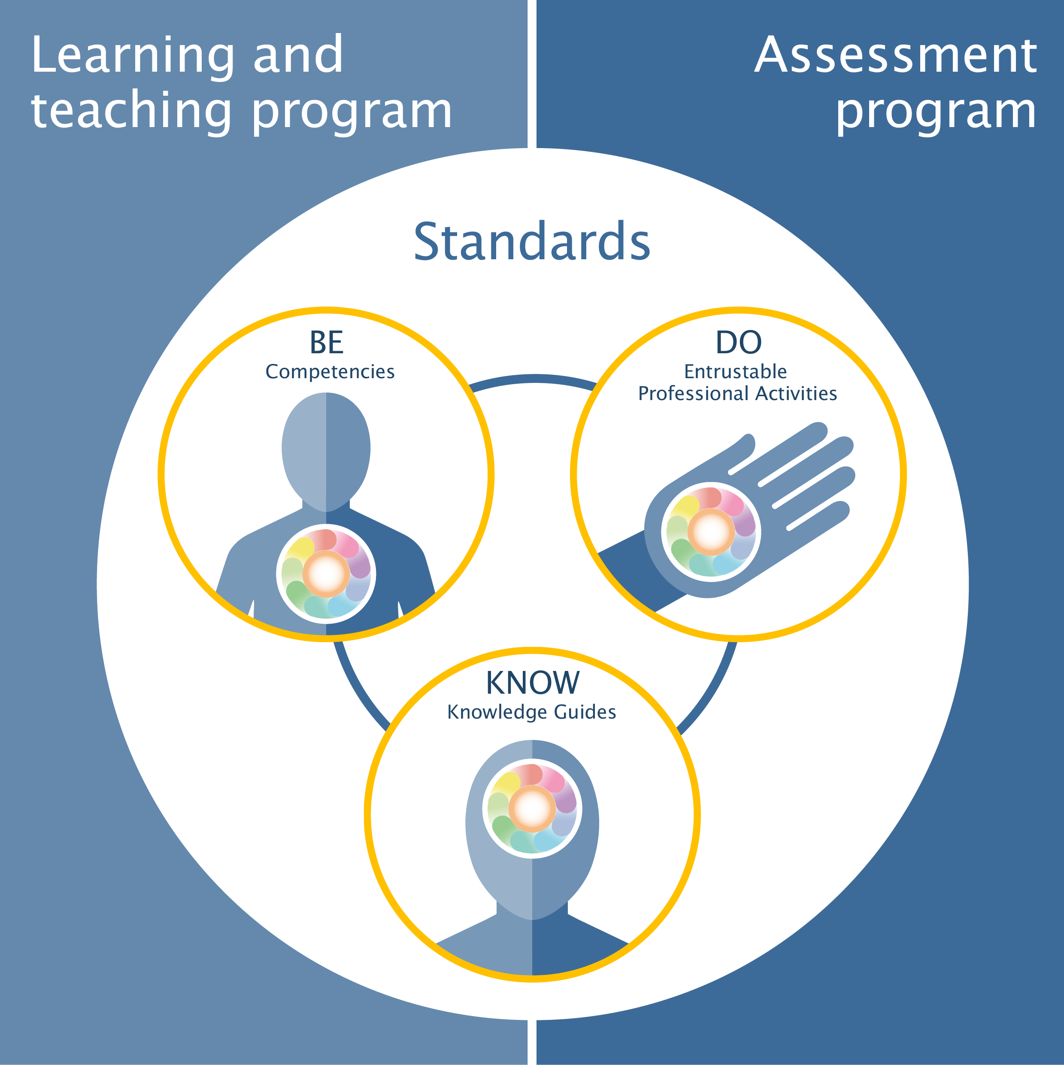
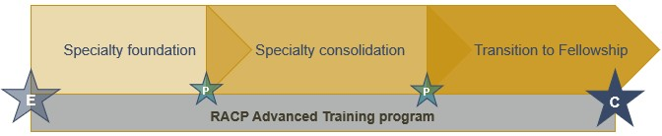
Advanced Training Curricula Renewal Occupational and Environmental Medicine At a glance
CURRICULUM STANDARDS
OCCUPATIONAL AND ENVIRONMENTAL MEDICINE
LEARNING GOALS
LEARNING, TEACHING AND ASSESSMENT*
The curriculum standards are summarised as learning goals. Learning and assessment activities are linked to the learning goals to ensure that trainees demonstrate learning across the breadth of the curriculum.
ENTRY CRITERIA
Entry into the program is assessed against entry attributes and criteria by the Faculty Training Committee.
All trainees enter into the specialty foundation phase (see LTA summary for details)
BE | 1. Professional behaviours
DO | Team Leadership Supervision and teaching Quality improvement Clinical assessment, investigation and management 6. Communication with workers, patients, communities, third parties and other stakeholders 7. Analysis and application of data 8. Occupational and environmental screening, surveillance and investigations 9. Hazard identification and risk assessment 10. Fitness for work assessment
KNOW | 11. Key clinical systems of occupational and environmental medicine 12. Health promotion and illness prevention Hazard recognition, evaluation and control of risk Policy development and workplace relations Business continuity, disaster preparedness and emergency management Environmental issues in occupational and environmental medicine Occupational health and safety, and legislation Epidemiology and causation
PROFESSIONAL EXPERIENCE
Minimum 36 months of relevant professional experience in accredited settings, recommended in at least two different training settings.
LEARNING PROGRAM
Australian Aboriginal, Torres Strait Islander and Māori Cultural Competence and Cultural Safety resource (online)
Advanced Training Orientation resource (online)
Health Policy, Systems and Advocacy resource (online)
Supervisor Professional Development Program (online or face-to-face)
Advanced Life Support course
3 Regional Training Meeting attendance (per six months)
1 Regional Training Meeting presentation (per six months)
Annual Training Meeting attendance
TEACHING PROGRAM
BE | DO | KNOW
Competencies are statements of professional behaviours, values and practices | Entrustable Professional Activities (EPAs) are essential work tasks that trainees need to be able to do unsupervised by the end of training | Knowledge Guides provide guidance on important topics and concepts trainees need to know
1 Rotation Supervisor who is a Fellow of the AFOEM.
1 Research Project Supervisor (may be the Education Supervisor)
1 Regional Training Program Director
ASSESSMENT PROGRAM
1 Learning plan (per phase)
12 Learning Captures, on the range of learning goals (per year)
12 Observation Captures, on the range of learning goals (per year)
4 Progress reports (per phase)
1 Research project (during course of training)
1 Ramazzini Presentation
AFOEM consolidation Written Examination and Practical Examination
The learning goals articulate what trainees need to be, do and know, and are assessed throughout training.
*For more information on the LTA programs, see the LTA Summary

Slide 7
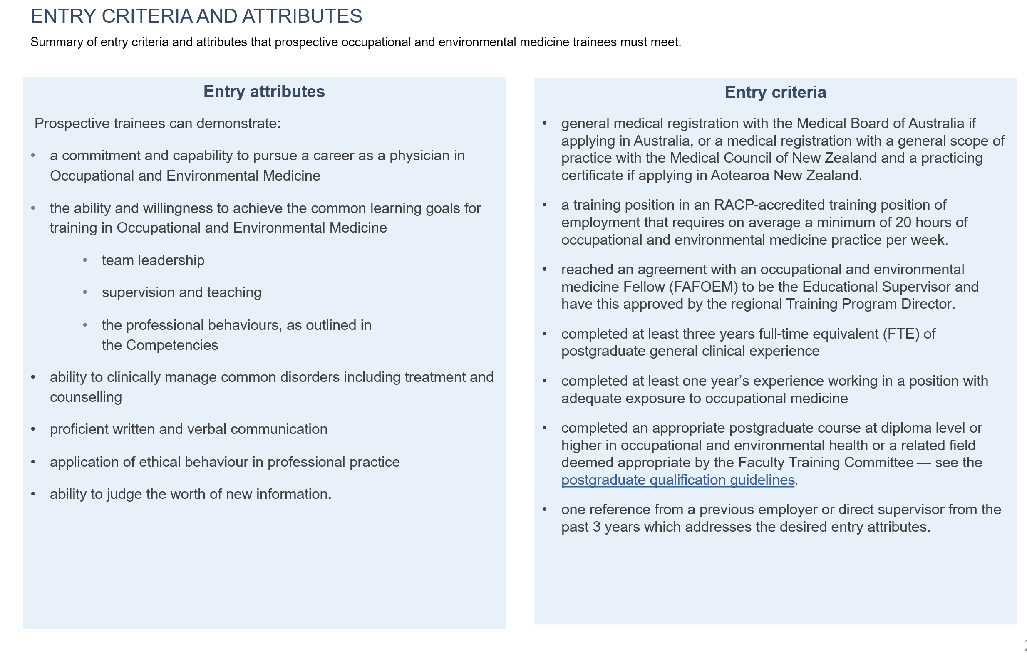
Rotation Supervisor and

Slide 8
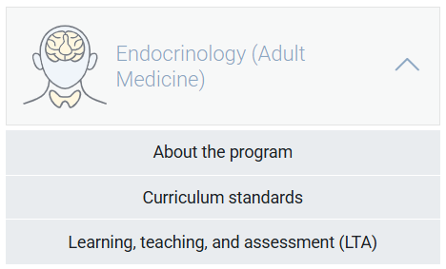
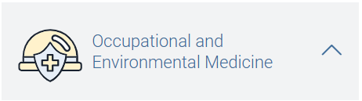
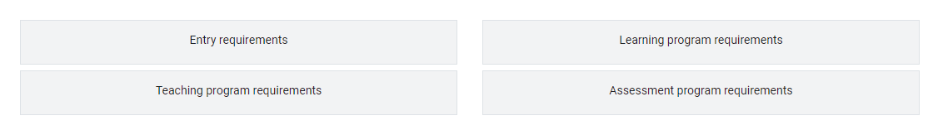
Curriculum documents
<insert training program curriculum standards location>
<insert training program LTA location>
Notes:
The information that we are going to refer to today is outlined in the Basic and Advanced Training Curricula which can be found on the RACP eLearning Portal.
The curriculum standards contains the key learning goals used in Training programs, and include ‘Be’ – the competencies which outline the professional behaviours expected of a trainee, ‘Do’ , the EPAs or important work tasks, and ‘Know’ the knowledge guides outlining important knowledge per specialty.
The learning, teaching and assessment programs outline the entry requirements, teaching program requirements, learning program requirements and the assessment program requirements

Slide 9
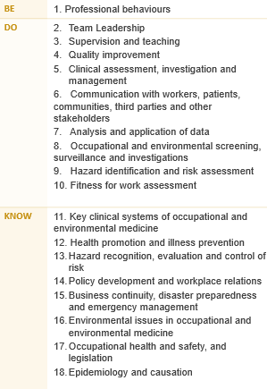
Learning goals
Occupational and Environmental Medicine
The Advanced Training curricula standards are grouped into key learning goals that guide learning, teaching, and assessment in the new programs.
Notes:
Each training program is grouped into learning goals, guided by the curriculum standards: Be, Do & Know. This includes professional behaviours, entrustable professional activities or EPAs and knowledge. These learning goals are used for all learning and assessment activities across each program. More information about your program’s specific learning goals can be found in the LTA of each training program.

Slide 10



Applying learning goals
How an observed clinical activity achieves the learning goal components in real time.
Dr Alex, an Advanced Trainee in Occupational and Environmental Medicine and is tasked to manage a 52-year-old male patient, referred for assessment of abnormal liver function tests (LFTs). John works as a chemical plant operator and has a 25-year history of occupational exposure to solvents. He reports fatigue, mild abdominal discomfort, and occasional nausea.
01. Professional behaviours
Medical expertise
Communication
Ethics and professional behaviour
Judgement and decision making
Leadership, management, and teamwork
11. Key clinical systems of occupational and
environmental medicine
12. Health promotion and illness prevention
13. Hazard recognition, evaluation and control of risk
05. Clinical assessment, investigation and management
06. Communication with workers, patients, communities, third parties and other stakeholders
09. Hazard identification and risk assessment
10. Fitness for work assessment
Notes:
Here is an example of how the learning goals might be applied when you are performing a task in the workplace. There are a number of skills and knowledge that are displayed at different times during an encounter with patient. In this example, Dr Alex is using skills, knowledge and competencies across a number of learning goals. If you were to use this scenario as a formal assessment, you would need to focus on one learning goal. If you were to use this scenario as a formal assessment, you would need to focus on one learning goal.

Slide 11
Covering learning goals
Each trainee is expected to develop and demonstrate progress across all learning goals by the end of the Advanced Training program, not in every rotation.
It is normal for some learning goals to have limited or no exposure in certain settings.
Use your rotation plan to identify which goals can be developed in your current setting
Use learning captures for less common, more complex tasks that may not be available during a rotation
Progress Review Panels review evidence across all phases of training, considering overall growth rather than exposure per rotation.
Watch the rotation plan on-demand workshop to learn how to choose and track learning goals across each phase of training.
Settings and networks are encouraged to participate in curriculum mapping to show which learning goals are covered in their rotations and provide a resource to help trainees plan their learning.
Notes:
Send links to participants
Rotation plan (video)
Curriculum mapping (video)

Slide 12
Learning and assessment programs
Requirements over the course of training
1 training application
Complete at least 36 months FTE training - professional experience
1 Ramazzini Presentation
3 Regional training meeting attendance per 6 months
1 Regional training meeting presentation per 6 months
2 Annual training meetings
1 Research Project
AFOEM consolidation Written Examination and Practical Examination
Requirements per phase
1 rotation plan (rotation plan)
12 learning captures
12 observation captures
4 progress reports
Notes:
Here we have the learning and assessment programs information. Over the course of training, trainees are required to complete <insert months> months of full time clinical experience, 1 rotation plan per rotation and a variety of learning courses.
Per phase of training, there are assessment program requirements. Here we have outlined the requirements for the foundation year of training.
We will have a closer look at all the required tools over the next few slides.

Slide 13




Supervision overview for Advanced Training
All supervisors
Role specific activities
Are nominated by trainee and
Access to trainee dashboards
Identify learning opportunities
Plan how to achieve learning goals
Review rotation plans
Feedback on learning captures (optional)
Feedback and ratings on observation captures
Complete progress reports and make a progression decision
Have some involvement with Progress Review Panels
Rotation Supervisor
Advanced Training
Research Project Supervisor
Advanced Training
The research project supervisor guides trainees with their project choice, method, data analysis and interpretation, and quality of written and oral presentation
Identify rotation learning opportunities
Complete progress reports and make progression recommendations for a phase of training
Progress Review Panel
RACP oversight committees
Review and assess trainee’s progress
Report on progress decisions
Monitor local training delivery
Ensure compliance
Oversee implementation of training programs
Work with progress review panels
Decision making feedback and guidance
Assessors
No access to TMP (unless they are a nominated supervisor)
Feedback and ratings for observation captures
Check the teaching requirements for more information about supervisor requirements
Notes:
There are several supervisor roles in the new curriculum, with differing roles and responsibilities. This information can be found in the basic program handbook on the e-learning site. Overall, all supervisors will be nominated by either a trainee or DPE, access their dashboards on TMP, identify learning opportunities and plan how to achieve the learning goals. They review rotation plans and give feedback on the assessment tools. Supervisors may have some involvement with progress review panels.

Slide 14
Quarter 1 (Q1)
Nominate and meet with 1 supervisors
Discuss learning opportunities and learning goals
Complete rotation plan
Complete learning and observation captures
Begin thinking about research project
Learning goals
Learning opportunities
Professional behaviours
Team leadership
Clinical assessment, investigation and management
Analysis and application of data
Health promotion and illness prevention
Epidemiology and causation
Research
Case studies
Work setting visits
Occupational and Environmental Medicine Example
Training Journey
Learning captures
Observation captures
Professional behaviours
Analysis and application of data
Team leadership
Epidemiology and causation
Epidemiology and causation
Clinical assessment, investigation and management
Health promotion and illness prevention
Start role
12 months core training – training setting 1
End of phase
Q1
Q2
Q3
Q4
Learning and assessment activities
Progress report
Learning and assessment activities
Progress report
Learning and assessment activities
Progress report
Learning and assessment activities
Progress report
Apply for program
Application approved
End of phase progression
The Rotation Supervisor makes an overall progress recommendation at the end of the phase.
The Progress Review Panel make a progression decision based on:
Compliance with learning, teaching and assessment requirements
Evidence of competence (assessment data)
Rotation Supervisors' recommendation
Notes:
How does this all come together?
This is the overall journey of an Advanced Trainee over a phase of training. In this example, the trainee is completing 4 quarters over their phase of training. Looking at their first quarter, you can see the learning and assessment activities that take place. These activities are conducted in each quarter, with the addition of a Phase Progress report check-in point in quarter 2 and the Phase Progress Report in quarter 4 that brings together the evidence from the phase. The rotation supervisor reviews the information and makes a progression decision which is forwarded to the Progress Review Panel for a decision.

Slide 15
Learning and assessment cycle
Progression decision
The supervisor rating and evidence of trainee performance are reviewed by a Progress Review Panel who decide if/how the trainee progresses in the training program
Entry application
Apply for and be approved to enter an RACP Training Program
01
Plan and support learning
Plan goals for a rotation based on the curriculum learning goals and opportunities available at the setting with a supervisor
05
02
Progress Report
Reflect on and discuss progress during the rotation
Trainee and supervisor meet
Supervisor provides feedback and an overall rating against each learning goal
04
03
Assessment tools
Complete work-based tasks and assessment activities throughout the rotation
The five-point rating scale is used to assess each assessment encounter
Notes:
As per our overall learning journey, in each rotation, steps 2, 3 and 4 are repeated. This cycle is planning learning using the rotation plan, demonstrating achievement towards learning goals via the assessment tools and being rated by a Rotation Supervisor in a Rotation Progress Report. The progress decision occurs at the end of the final rotation for a phase.

Slide 16





New assessment tools
Rotation plan
Trainee and supervisor outline rotation details, learning goals and opportunities for the upcoming rotation.
Observation capture
Trainee is observed by an assessor to demonstrate their skills and knowledge in one learning goal.
Learning capture
Trainee reflects and provides evidence on a professional development experience linked to one learning goal.
Progress reports
Supervisors document trainee progress against learning goals.
Roles involved:
Trainee
Supervisor(s)
Roles involved:
Trainee
Assessor
Roles involved:
Trainee
Assessor (optional)
Roles involved:
Trainee
Supervisor(s)
Notes:
Here is an overview of the new assessment tools in the new curriculum. For more details, please visit the e-learning portal to find on demand workshops and information packages about each type.

Slide 17





Other learning and assessment requirements
Learning programs
Professional experience
Learning courses
Meeting attendance
AFOEM Exam
Ramazzini Presentation
The primary purpose of the Ramazzini presentation is to assess trainees on their presentation and communication skills in the context of presenting research to a scientific audience.
Research project
A trainee-led study involving significant involvement in design, conduct and analysis.
Trainees complete AFOEM consolidation Written and Practical Examinations after at least 18 months of training.
When: Before the end of Advanced Training
Roles involved:
Trainee
When: Before the Transition to Fellowship phase
Roles involved:
Trainee
When: Before the end of Advanced Training
Roles involved:
Trainee
When: Before the end of Advanced Training
Roles involved:
Trainee
Research Project Supervisor
Notes:
Here is an overview of the other learning and assessment requirements. For more details, please visit the program LTA.

Slide 18
Rating scales
Be - Professional behaviours ​
0 ​ | Not assessed
1 ​ | needs to work on their behaviour in more than five domains of professional practice ​
2 ​ | needs to work on their behaviour in four or five domains of professional practice ​
3 ​ | needs to work on their behaviour in two or three domains of professional practice ​
4 ​ | needs to work on their behaviour in one domain of professional practice ​
5 ​ | consistently behaves in line with each of the ten domains of professional practice ​
Do – Entrustable professional activities
0 ​ | Not assessed
1 ​ | able to be present and observe
2 ​ | able to act with direct supervision
3 ​ | able to act with indirect supervision (i.e., ready access to a supervisor)
4 ​ | able to act with supervision at a distance (i.e., limited access to a supervisor)
5 ​ | able to supervise others
Know - Knowledge ​
0 ​ | Not assessed
1 ​ | has heard of some of the topics in this knowledge guide
2 ​ | knows the topics and concepts described in this knowledge guide
3 ​ | knows how to apply this knowledge to practice
4 ​ | frequently shows they apply this knowledge to practice
5 ​ | consistently demonstrates application of this knowledge to practice
Traditional rating scales | Level of new rating scales
Satisfactory to superior ratings Task components separated (e.g. medical interviewing skills, clinical judgement) No links to the expectation of the standards required | Increased levels of independence over time Comprehensive rating of clinical and professional expertise Expected standards of performance at the end of each phase to direct learning
Notes:
These are the rating scales that will be used in all the assessment tools. There is a rating scale for the three types of learning goals. These rating scales also relate to the progression criteria outlined at the end of each phase of training. This criteria specifies the standard of achievement for trainees at the end of each phase.
<Click for animation>
The new rating scales compared to traditional rating scales align to the increased levels of independence over time, rather than using satisfactory to superior descriptors. The new scales provide a comprehensive rating of clinical and professional expertise, where in the past, components have been separated. They also explain the expected standard of performance at the end of each phase.

Slide 19
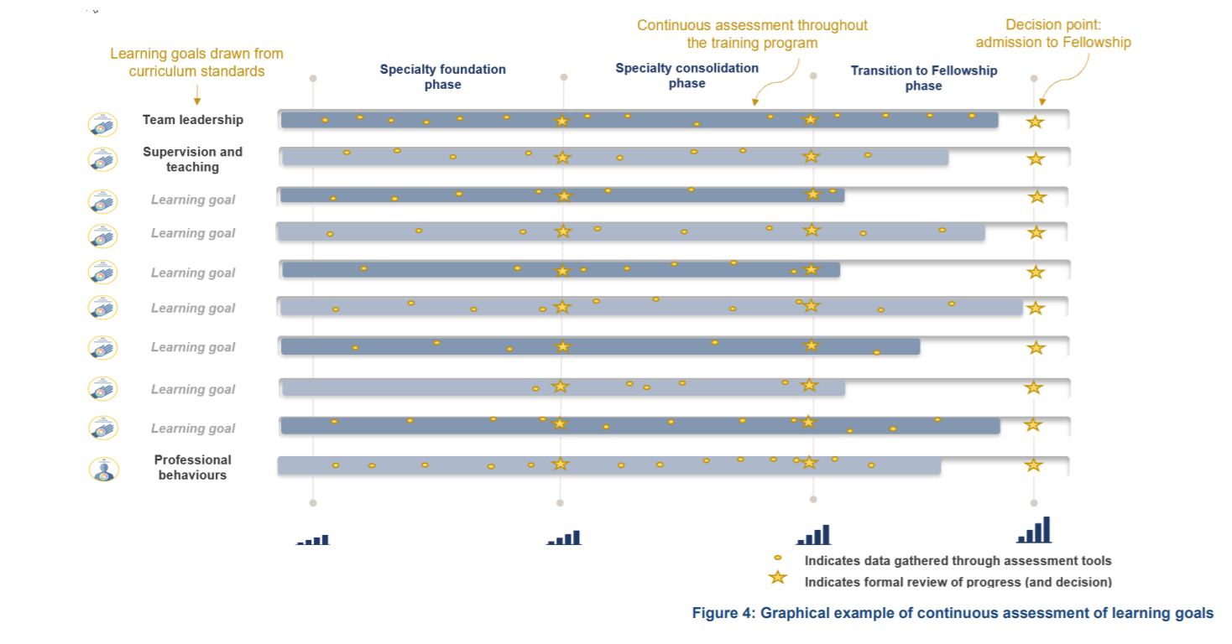
Continuous assessment
Notes:
Trainees will be continuously assessed on the key learning goals through regular capture of work-based learning in a range of assessment tools. The use of multiple data points build a complete picture of trainee progress over time. Supervisors offer ongoing feedback through multiple tools to support progressive assessment, encouraging the use of narrative feedback to explain the ratings selected in the assessment tools.

Slide 20
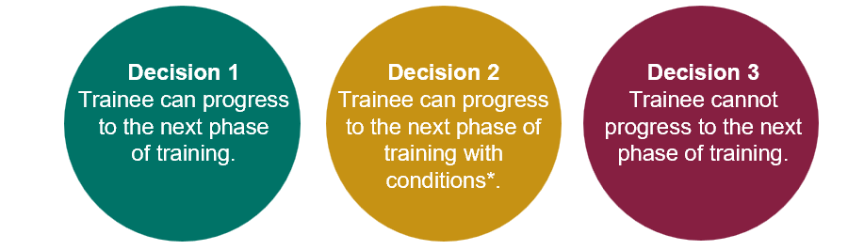
Progression
Each phase of training has clear progression criteria. Trainees must meet these standards to progress to the next phase or complete the program.
Progression decisions and completion decisions will be based on aggregated assessment data, providing richer evidence.
The Progress Review Panel will assess the evidence and make one of the following decisions:
Notes:
The alignment between the learning goals and learning, teaching and assessment programs forms a comprehensive picture of trainee performance over a phase of training. The data comes together to provide robust assessment information that is used by a progress review panel to make decisions about progression.

Slide 21
Progression criteria
Learning goals | Beginning of specialty foundation | Specialty foundation | Specialty consolidation | Transition to fellowship
01. Professional behaviours | Level 5 | Level 5 | Level 5 | Level 5
02. Team Leadership | Level 1 | Level 2 | Level 4 | Level 5
03. Supervision and teaching | Level 1 | Level 2 | Level 4 | Level 5
04. Quality improvement | Level 2 | Level 3 | Level 4 | Level 5
05. Clinical assessment, investigation and management | Level 2 | Level 3 | Level 4 | Level 5
06. Communication with workers, patients, communities, third parties and other stakeholders | Level 2 | Level 3 | Level 4 | Level 5
07. Analysis and application of data | Level 1 | Level 2 | Level 4 | Level 5
08. Occupational and environmental screening, surveillance and investigations | Level 1 | Level 2 | Level 4 | Level 5
09. Hazard identification and risk assessment | Level 1 | Level 3 | Level 4 | Level 5
10. Fitness for work assessment | Level 1 | Level 3 | Level 4 | Level 5
11. Key clinical systems of occupational and environmental medicine | Level 1 | Level 2 | Level 4 | Level 5
12. Health promotion and illness prevention | Level 1 | Level 2 | Level 4 | Level 5
13. Hazard recognition, evaluation and control of risk | Level 1 | Level 2 | Level 4 | Level 5
14. Policy development and workplace relations | Level 1 | Level 2 | Level 4 | Level 5
15. Business continuity, disaster preparedness and emergency management | Level 1 | Level 2 | Level 4 | Level 5
16. Environmental issues in occupational and environmental medicine | Level 1 | Level 2 | Level 4 | Level 5
17. Occupational health and safety, and legislation | Level 1 | Level 2 | Level 4 | Level 5
18. Epidemiology and causation | Level 1 | Level 2 | Level 4 | Level 5
Notes:
Trainees progress through phases based on meeting established criteria for knowledge and skills. There are clear standards that a trainee must meet to advance, with supervisors playing a key role in documenting trainee performance to inform progression decisions.

Slide 22
Education policy
The RACP is committed to ensuring high quality, equitable and transparent training and assessment practices.
Our education policies provide the foundation for delivering consistent and effective medical education, supporting both trainees and supervisors. Key areas include:
Accreditation of training settings
Progression requirements and assessments
Supervisors and trainee roles and responsibilities
Professional behaviours and ethical conduct
Visit the Education Policies and Governance webpage for the latest updates and resources.
By aligning with these policies, we ensure a structured and fair approach to training and the development of future physicians.

Slide 23
Next steps for new ATs
Apply for your training program before the close date
28 February if starting at the beginning of the year.
31 August if starting mid-year
Review your curriculum standards and learning, teaching and assessment programs documents on the RACP eLearning portal
Nominate 2 x supervisors who meet the Occupational and Environmental Medicine teaching requirements for the upcoming rotation. A list of eligible supervisors can be found on MyRACP
Find out what the learning opportunities at your setting might be so you can complete your rotation plan

Slide 24



More information
RACP Implementation webpage
Visit the RACP Implementation webpage to find updates about 2025 implementation
RACP Online Learning
Log into RACP Online Learning to learn about the new curricula
RACP Member services
Contact memberservices@racp.edu.au if you have any questions about the new curricula
Notes:
Thank participants for attending and review where they can get some more information

