Slide 1

Introduction to the new curriculum 2026 implementation – Advanced Training: Nuclear Medicine
October 2025
Notes:
This information session is for trainees completing the Advanced Training: Nuclear Medicine, as an introduction to the new curriculum.

Slide 2
About this session
At the end of this session, participants will be able to:
Discuss the changes and components of the new curriculum
Outline the learning and assessment requirements
Notes:
During this session we will be reviewing the curriculum and associated learning and assessment requirements

Slide 3




What is changing?
Standards
Practical, work-focused learning goals
Explicit standards of achievement
Learning and assessment
New learning and assessment tools
Increased assessment frequency
Progression
Progress Review Panels
Technology
New technology (TMP)
Notes:
Assessments are designed to be quick and integrated into routine activities.
Assessment feedback is streamlined and unnecessary paperwork is reduced
The new tech minimizes administrative burden
The panels provide a structured way to evaluate trainee progress.
The differences between PREP and the new curriculum will be discussed on the next slide.
Trainees will need to complete some different learning and assessment tools
Trainees will need to complete more assessments in the new program
There is new technology to support these changes
We are introducing Progress Review Panels to check that trainees are ok to pass into their next stage of training.

Slide 4
The new curricula
What's not changing
Trainees and supervisors will still....
Plan learning for a rotation
Work with and observe trainees doing their job
Provide feedback to trainees on their performance and progress
Assess trainees through rotation and at the end via a report
Contribute to the learning and understanding of the curriculum
Enter learning and assessment information onto an online platform
PREP versus new curricula
Be aware of the different learning goals/outcomes
New curriculum learning goals
PREP and PQC
Use 2 online platforms
PREP portal
TMP
Use different learning and assessment tools with differences in rating scales
LNA or rotation plan
Mini-CEX/CbD or observation capture
Use expected standards to benchmark performance
Progression criteria (new program only)
Notes:
Here is a supervision overview, highlighting the things that are staying the same and the things that are changing that supervisors must be aware of. Supervisors will still plan learning and work with trainees day-to-day, providing feedback throughout. They will assess them and enter this information into an online platform, taking responsibility to contribute to their understanding of the new curriculum.
The learning goals are changing as well as the online platform. The new curriculum has different assessment tools and standards for trainees. It is important for supervisors to understand these changes, especially when managing trainees on both programs.

Slide 5
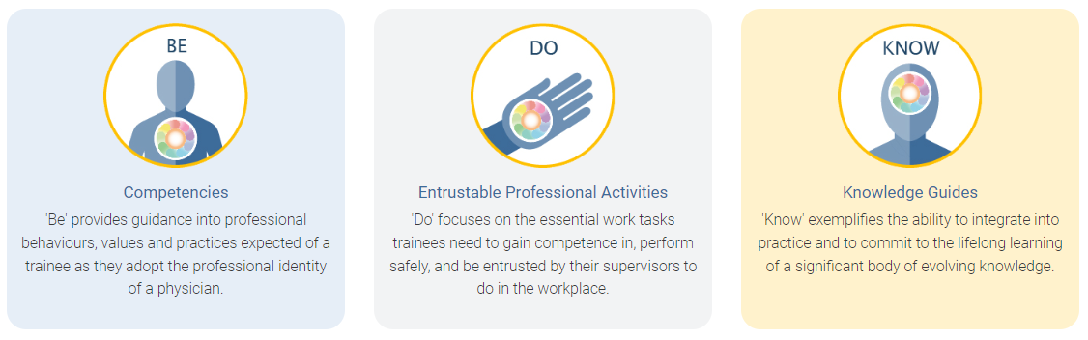
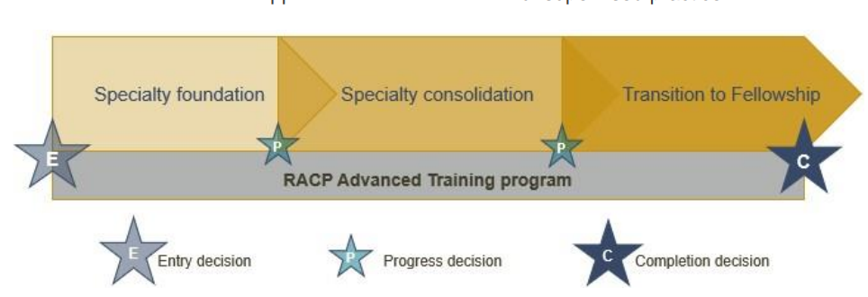
Framework overview
All new curricula in Advanced Training programs use the same frameworks
Curriculum standards
Learning, teaching and assessment (LTA)
structure
Learning goals within each training program categorised by the curriculum standards: Be, Do and Know.
More information about the curriculum standards and learning, teaching & assessment structure can be found in the LTA of each training program.
Notes:
All new curricula in Advanced Training programs use the same framework. You can see here the ten learning goals, the three phases of the training program and the learning, teaching and assessment requirements as outlined in the program requirements. We will go though each of these areas in more detail.

Slide 6
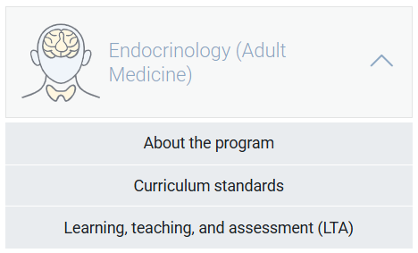
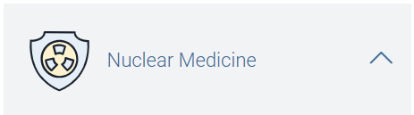
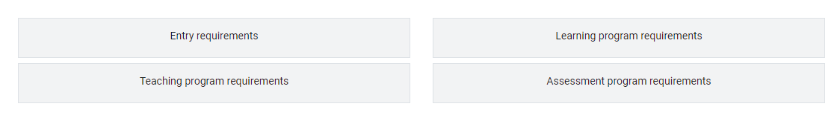
Curriculum documents
<insert training program curriculum standards location>
<insert training program LTA location>
Notes:
The information that we are going to refer to today is outlined in the Basic and Advanced Training Curricula which can be found on the RACP eLearning Portal.
The curriculum standards contains the key learning goals used in Training programs, and include ‘Be’ – the competencies which outline the professional behaviours expected of a trainee, ‘Do’ , the EPAs or important work tasks, and ‘Know’ the knowledge guides outlining important knowledge per specialty.
The learning, teaching and assessment programs outline the entry requirements, teaching program requirements, learning program requirements and the assessment program requirements

Slide 7
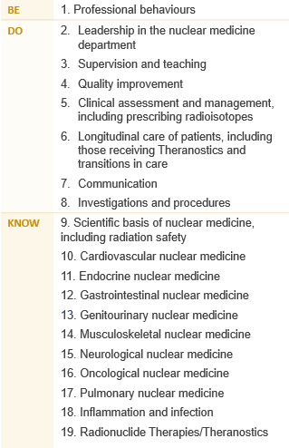
Learning goals
Nuclear Medicine
The Advanced Training curricula standards are grouped into 19 key learning goals that guide learning, teaching, and assessment in the new programs.
Notes:
Each training program is grouped into learning goals, guided by the curriculum standards: Be, Do & Know. This includes professional behaviours, entrustable professional activities or EPAs and knowledge. These learning goals are used for all learning and assessment activities across each program. More information about your program’s specific learning goals can be found in the LTA of each training program.

Slide 8



Applying learning goals
How an observed clinical activity achieves the learning goal components in real time.
Dr Alex, an Advanced Trainee in Nuclear Medicine, is tasked with managing a 52-year-old patient presenting with joint pain, stiffness and swelling, later diagnosed as arthritis.
01. Professional behaviours
Medical expertise
Communication
Ethics and professional behaviour
Judgement and decision making
Leadership, management, and teamwork
09. Scientific basis of nuclear medicine, including radiation safety
14. Musculoskeletal nuclear medicine
02. Leadership in the nuclear medicine department
05. Clinical assessment and management, including prescribing radioisotopes
07. Communication
08. Investigations and procedures
Notes:
Here is an example of how the learning goals might be applied when you are performing a task in the workplace. There are a number of skills and knowledge that are displayed at different times during an encounter with patient. In this example, Dr Alex is using skills, knowledge and competencies across a number of learning goals. If you were to use this scenario as a formal assessment, you would need to focus on one learning goal. If you were to use this scenario as a formal assessment, you would need to focus on one learning goal.

Slide 9
Covering learning goals
Each trainee is expected to develop and demonstrate progress across all learning goals by the end of the Advanced Training program, not in every rotation.
It is normal for some learning goals to have limited or no exposure in certain settings.
Use your rotation plan to identify which goals can be developed in your current setting
Use learning captures for less common, more complex tasks that may not be available during a rotation
Progress Review Panels review evidence across all phases of training, considering overall growth rather than exposure per rotation.
Watch the rotation plan on-demand workshop to learn how to choose and track learning goals across each phase of training.
Settings and networks are encouraged to participate in curriculum mapping to show which learning goals are covered in their rotations and provide a resource to help trainees plan their learning.
Notes:
Send links to participants
Rotation plan (video)
Curriculum mapping (video)

Slide 10
Learning and assessment programs
Requirements over the course of training
1 training application
Complete at least 24-36 months FTE training - professional experience
Logbooks
Case reports
Radionuclide therapy/theranostics learning package
Bone densitometry training (course or logbook)
CT anatomy course
RACP Learning courses
1 Research project
AANMS Basic Sciences Course and Continuous Assessment Program
Requirements per phase
1 rotation plan (per rotation)
12 learning captures
12 observation captures
4 progress reports
Notes:
Here we have the learning and assessment programs information. Over the course of training, trainees are required to complete <insert months> months of full-time clinical experience, 1 rotation plan per rotation and a variety of learning courses.
Per phase of training, there are assessment program requirements. Here we have outlined the requirements for the foundation year of training.
We will have a closer look at all the required tools over the next few slides.

Slide 11




Supervision overview for Advanced Training
All supervisors
Role specific activities
Are nominated by trainee
Access to trainee information
Identify learning opportunities
Plan how to achieve learning goals
Review rotation plans
Feedback on learning captures (optional)
Feedback and ratings on observation captures
Complete progress reports and make a progression decision
Rotation Supervisor
Advanced Training
Research Project Supervisor
Advanced Training
The research project supervisor guides trainees with their project choice, method, data analysis and interpretation, and quality of written and oral presentation
Identify rotation learning opportunities
Complete progress reports and make progression recommendations for a phase of training
Progress Review Panel
RACP oversight committees
Review and assess trainee’s progress
Report on progress decisions
Monitor local training delivery
Ensure compliance
Oversee implementation of training programs
Work with progress review panels
Decision making feedback and guidance
Assessors
No access to TMP (unless they are a nominated supervisor)
Feedback and ratings for observation captures
Check the teaching requirements for more information about supervisor requirements
Notes:
There are several supervisor roles in the new curriculum, with differing roles and responsibilities. This information can be found in the basic program handbook on the e-learning site. Overall, all supervisors will be nominated by either a trainee or DPE, access their dashboards on TMP, identify learning opportunities and plan how to achieve the learning goals. They review rotation plans and give feedback on the assessment tools. Supervisors may have some involvement with progress review panels.

Slide 12
Quarter 1 (Q1)
Nominate and meet with 2 supervisors
Discuss learning opportunities and learning goals
Complete rotation plan
Complete learning and observation captures
Begin thinking about research project
Learning goals
Learning opportunities
Nuclear Medicine
Example
Training Journey
Professional behaviours
Team leadership
Clinical assessment and management, including prescribing radioisotopes
Knowledge (3 specific knowledge guide learning goals selected)
Clinical consultations ​
Family meetings ​
Handovers ​
Teaching medical students ​
Meetings ​
Learning captures
Observation captures
Professional behaviours
Gastrointestinal nuclear medicine
Team leadership
Inflammation and infection
Clinical assessment and management, including prescribing radioisotopes
Communication with patients
Start role
12 months core training – training setting 1
End of phase
Q1
Q2
Q3
Q4
Learning and assessment activities
Progress report
Learning and assessment activities
Progress report
Learning and assessment activities
Progress report
Learning and assessment activities
Progress report
Apply for program
Application approved
End of phase progression
The Rotation Supervisor makes an overall progress recommendation at the end of the phase.
The Progress Review Panel make a progression decision based on:
Compliance with learning, teaching and assessment requirements
Evidence of competence (assessment data)
Rotation Supervisors' recommendation
Notes:
How does this all come together?
This is the overall journey of an Advanced Trainee over a phase of training. In this example, the trainee is completing 4 quarters over their phase of training. Looking at their first quarter, you can see the learning and assessment activities that take place. These activities are conducted in each quarter, with the addition of a Phase Progress report check-in point in quarter 2 and the Phase Progress Report in quarter 4 that brings together the evidence from the phase. The rotation supervisor reviews the information and makes a progression decision which is forwarded to the Progress Review Panel for a decision.

Slide 13
Learning and assessment cycle
Progression decision
The supervisor rating and evidence of trainee performance are reviewed by a Progress Review Panel who decide if/how the trainee progresses in the training program
Entry application
Apply for and be approved to enter an RACP Training Program
01
Plan and support learning
Plan goals for a rotation based on the curriculum learning goals and opportunities available at the setting with a supervisor
05
02
Progress Report
Reflect on and discuss progress during the rotation
Trainee and supervisor meet
Supervisor provides feedback and an overall rating against each learning goal
04
03
Assessment tools
Complete work-based tasks and assessment activities throughout the rotation
The five-point rating scale is used to assess each assessment encounter
Notes:
As per our overall learning journey, in each rotation, steps 2, 3 and 4 are repeated. This cycle is planning learning using the Rotation Plan, demonstrating achievement towards learning goals via the assessment tools and being rated by a Rotation Supervisor in a progress report. The progress decision occurs at the end of the final rotation for a phase.

Slide 14





New assessment tools
Rotation plan
Trainee and supervisor outline rotation details, learning goals and opportunities for the upcoming rotation.
Observation capture
Trainee is observed by an assessor to demonstrate their skills and knowledge in one learning goal.
Learning capture
Trainee reflects and provides evidence on a professional development experience linked to one learning goal.
Progress reports
Supervisors document trainee progress against learning goals.
Roles involved:
Trainee
Supervisor(s)
Roles involved:
Trainee
Assessor
Roles involved:
Trainee
Assessor (optional)
Roles involved:
Trainee
Supervisor(s)
Notes:
Here is an overview of the new assessment tools in the new curriculum. For more details, please visit the e-learning portal to find on demand workshops and information packages about each type.

Slide 15




Other learning and assessment requirements
Learning programs
Professional experience
RACP Learning courses
Radionuclide therapy/theranostics learning package
Bone densitometry training (course or logbook)
CT anatomy course
Logbooks
Case report
A paediatric case report allows trainees to discuss their management of a specific case.
AANMS courses
Australasian Association of Nuclear Medicine Specialists (AANMS) Basic Sciences
AANMS Continuous Assessment Program (CAP) per 12 months FTE of core training.
Research project
A trainee-led study involving significant involvement in design, conduct and analysis.
Trainees capture data about and reflect on specific workplace experiences.
Cardiac cases logbook
Positron emission tomography logbook
When: Before the end of Advanced Training
Roles involved:
Trainee
Research Project Supervisor
When: Before the end of Advanced Training
Roles involved:
Trainee
When: Before the end of Advanced Training
Roles involved:
Trainee
When: Before the end of Advanced Training
Roles involved:
Trainee
When: Before the end of Advanced Training
Roles involved:
Trainee
Notes:
Here is an overview of the other learning and assessment requirements. For more details, please visit the program LTA.

Slide 16
Rating scales
Be - Professional behaviours ​
0 ​ | Not assessed
1 ​ | needs to work on their behaviour in more than five domains of professional practice ​
2 ​ | needs to work on their behaviour in four or five domains of professional practice ​
3 ​ | needs to work on their behaviour in two or three domains of professional practice ​
4 ​ | needs to work on their behaviour in one domain of professional practice ​
5 ​ | consistently behaves in line with each of the ten domains of professional practice ​
Do – Entrustable professional activities
0 ​ | Not assessed
1 ​ | able to be present and observe
2 ​ | able to act with direct supervision
3 ​ | able to act with indirect supervision (i.e., ready access to a supervisor)
4 ​ | able to act with supervision at a distance (i.e., limited access to a supervisor)
5 ​ | able to supervise others
Know - Knowledge ​
0 ​ | Not assessed
1 ​ | has heard of some of the topics in this knowledge guide
2 ​ | knows the topics and concepts described in this knowledge guide
3 ​ | knows how to apply this knowledge to practice
4 ​ | frequently shows they apply this knowledge to practice
5 ​ | consistently demonstrates application of this knowledge to practice
Traditional rating scales | Level of new rating scales
Satisfactory to superior ratings Task components separated (e.g. medical interviewing skills, clinical judgement) No links to the expectation of the standards required | Increased levels of independence over time Comprehensive rating of clinical and professional expertise Expected standards of performance at the end of each phase to direct learning
Notes:
These are the rating scales that will be used in all the assessment tools. There is a rating scale for the three types of learning goals. These rating scales also relate to the progression criteria outlined at the end of each phase of training. This criteria specifies the standard of achievement for trainees at the end of each phase.
<Click for animation>
The new rating scales compared to traditional rating scales align to the increased levels of independence over time, rather than using satisfactory to superior descriptors. The new scales provide a comprehensive rating of clinical and professional expertise, where in the past, components have been separated. They also explain the expected standard of performance at the end of each phase.

Slide 17
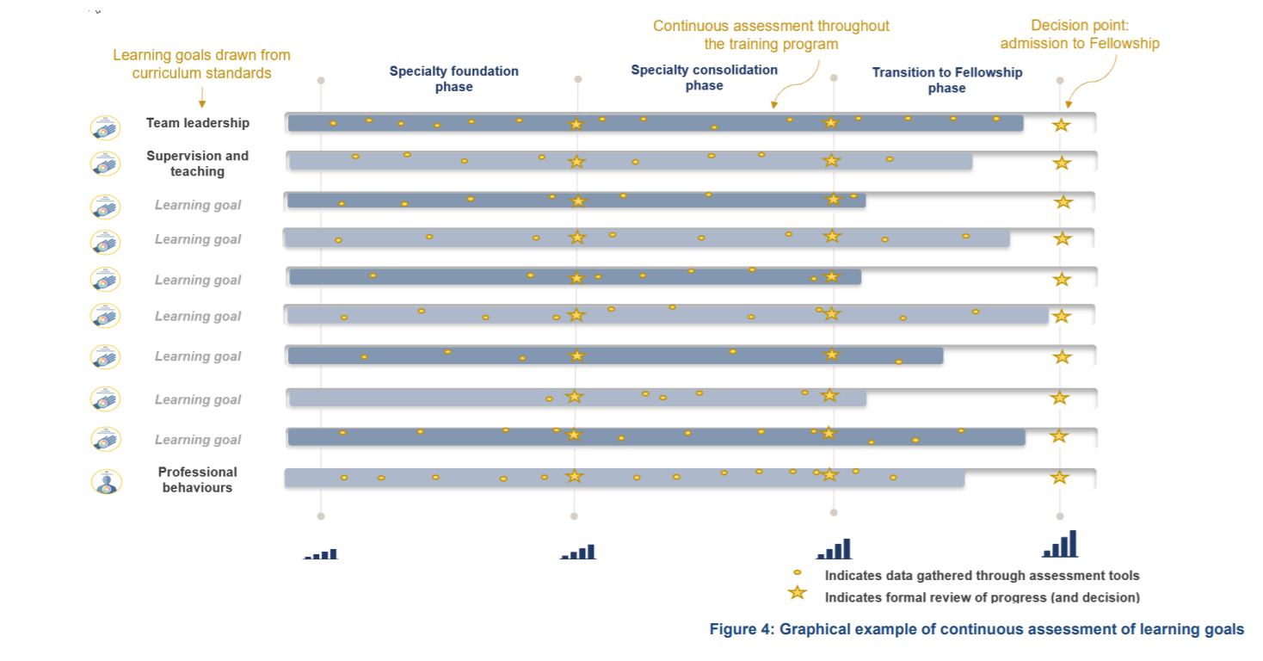
Continuous assessment
Notes:
Trainees will be continuously assessed on the key learning goals through regular capture of work-based learning in a range of assessment tools. The use of multiple data points build a complete picture of trainee progress over time. Supervisors offer ongoing feedback through multiple tools to support progressive assessment, encouraging the use of narrative feedback to explain the ratings selected in the assessment tools.

Slide 18
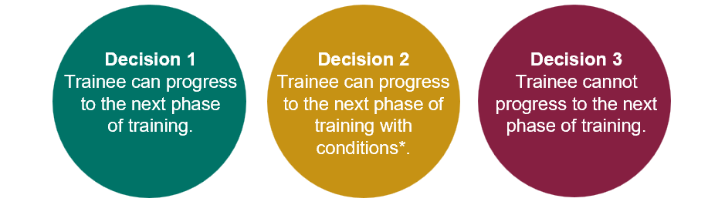
Progression
Each phase of training has clear progression criteria. Trainees must meet these standards to progress to the next phase or complete the program.
Progression decisions and completion decisions will be based on aggregated assessment data, providing richer evidence.
The Progress Review Panel will assess the evidence and make one of the following decisions:
Notes:
The alignment between the learning goals and learning, teaching and assessment programs forms a comprehensive picture of trainee performance over a phase of training. The data comes together to provide robust assessment information that is used by a progress review panel to make decisions about progression.

Slide 19
Progression criteria
Learning goals | Entry into training | Specialty foundation | Specialty consolidation | Transition to fellowship
01. Professional behaviours | Level 5 | Level 5 | Level 5 | Level 5
02. Leadership in the nuclear medicine department | Level 1 | Level 2 | Level 3 | Level 5
03. Supervision and teaching | Level 1 | Level 2 | Level 3 | Level 5
04. Quality improvement | Level 1 | Level 2 | Level 3 | Level 5
05. Clinical assessment and management, including prescribing radioisotopes | Level 1 | Level 2 | Level 3 | Level 5
06. Longitudinal care of patients, including those receiving Theranostics and transitions in care | Level 1 | Level 2 | Level 3 | Level 5
07. Communication | Level 1 | Level 2 | Level 3 | Level 5
08. Investigations and procedures | Level 1 | Level 2 | Level 3 | Level 5
09. Scientific basis of nuclear medicine, including radiation safety | Level 1 | Level 2 | Level 3 | Level 5
10. Cardiovascular nuclear medicine | Level 1 | Level 2 | Level 3 | Level 5
11. Endocrine nuclear medicine | Level 1 | Level 2 | Level 3 | Level 5
12. Gastrointestinal nuclear medicine | Level 1 | Level 2 | Level 3 | Level 5
13. Genitourinary nuclear medicine | Level 1 | Level 2 | Level 3 | Level 5
14. Musculoskeletal nuclear medicine | Level 1 | Level 2 | Level 3 | Level 5
15. Neurological nuclear medicine | Level 1 | Level 2 | Level 3 | Level 5
16. Oncological nuclear medicine | Level 1 | Level 2 | Level 3 | Level 5
17. Pulmonary nuclear medicine | Level 1 | Level 2 | Level 3 | Level 5
18. Inflammation and infection | Level 1 | Level 2 | Level 3 | Level 5
19. Radionuclide Therapies/Theranostics | Level 1 | Level 2 | Level 3 | Level 4
Notes:
Trainees progress through phases based on meeting established criteria for knowledge and skills. There are clear standards that a trainee must meet to advance, with supervisors playing a key role in documenting trainee performance to inform progression decisions.

Slide 20
Education policy
The RACP is committed to ensuring high quality, equitable and transparent training and assessment practices.
Our education policies provide the foundation for delivering consistent and effective medical education, supporting both trainees and supervisors. Key areas include:
Accreditation of training settings
Progression requirements and assessments
Supervisors and trainee roles and responsibilities
Professional behaviours and ethical conduct
Visit the Education Policies and Governance webpage for the latest updates and resources.
By aligning with these policies, we ensure a structured and fair approach to training and the development of future physicians.

Slide 21
Next steps for new ATs
Apply for your training program before the close date
28 February if starting at the beginning of the year.
31 August if starting mid-year
Review your curriculum standards and learning, teaching and assessment programs documents on the RACP eLearning portal
Nominate 2 x supervisors who meet the nuclear medicine teaching requirements for the upcoming rotation. A list of eligible supervisors can be found on MyRACP
Find out what the learning opportunities at your setting might be so you can complete your rotation plan

Slide 22
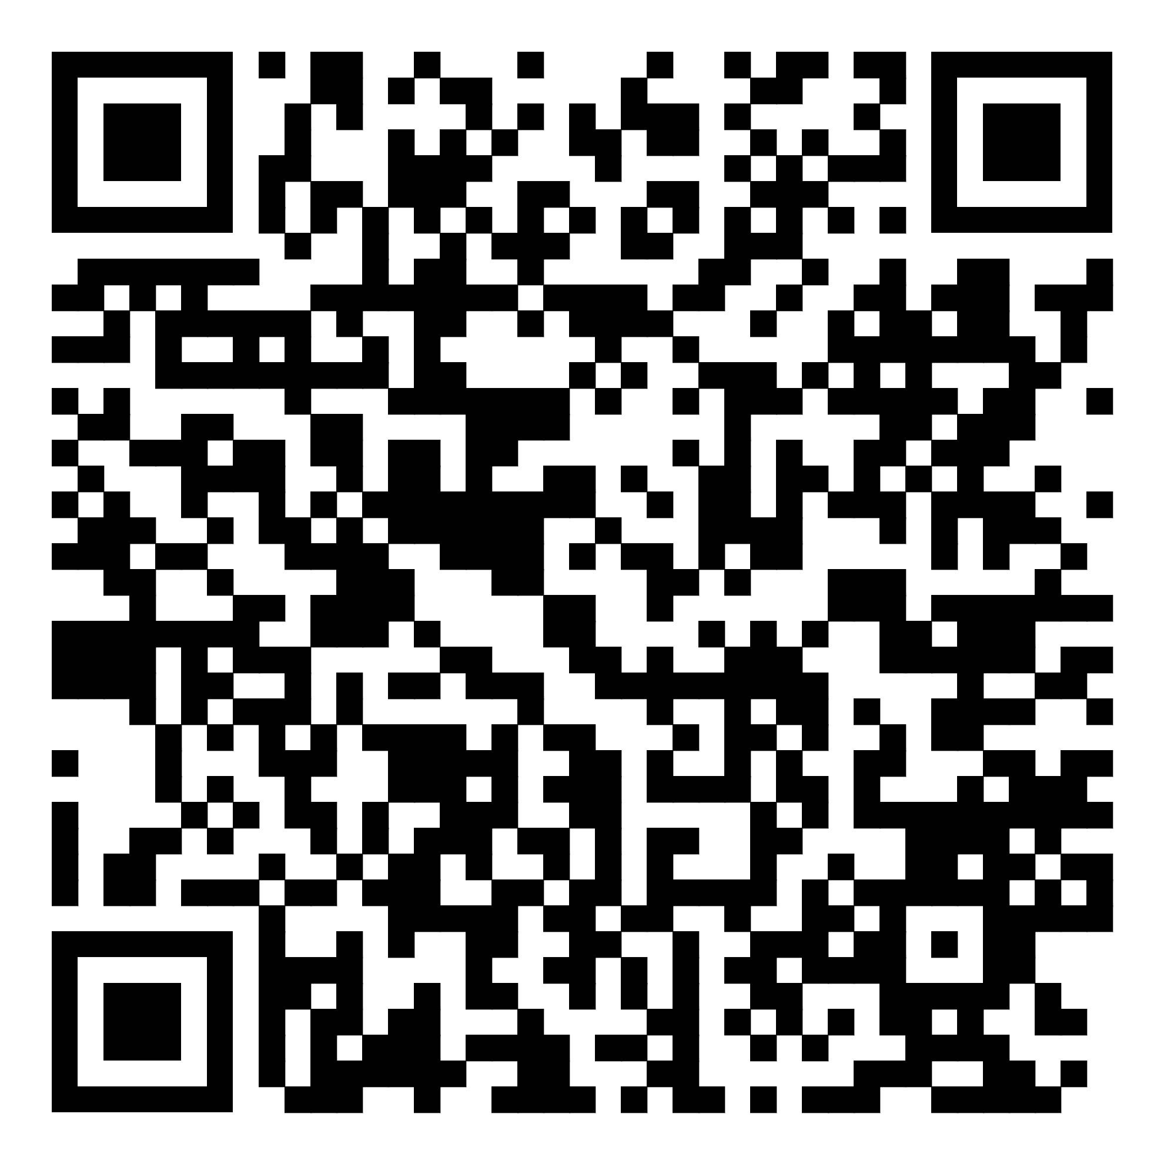
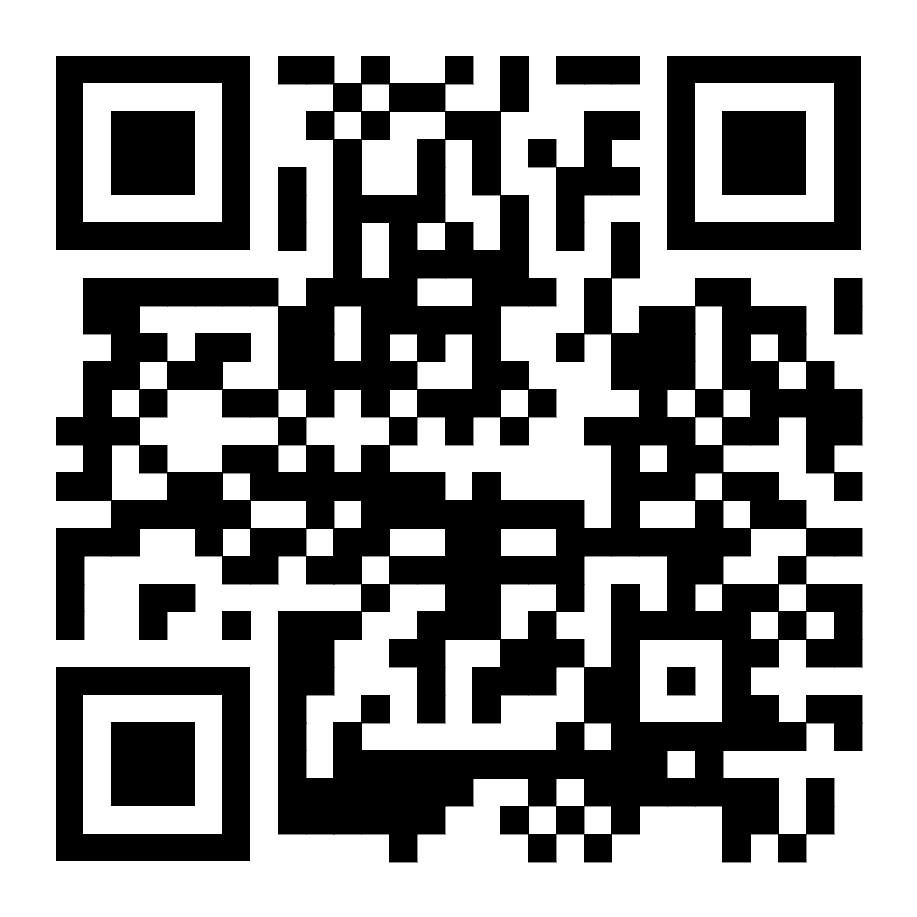
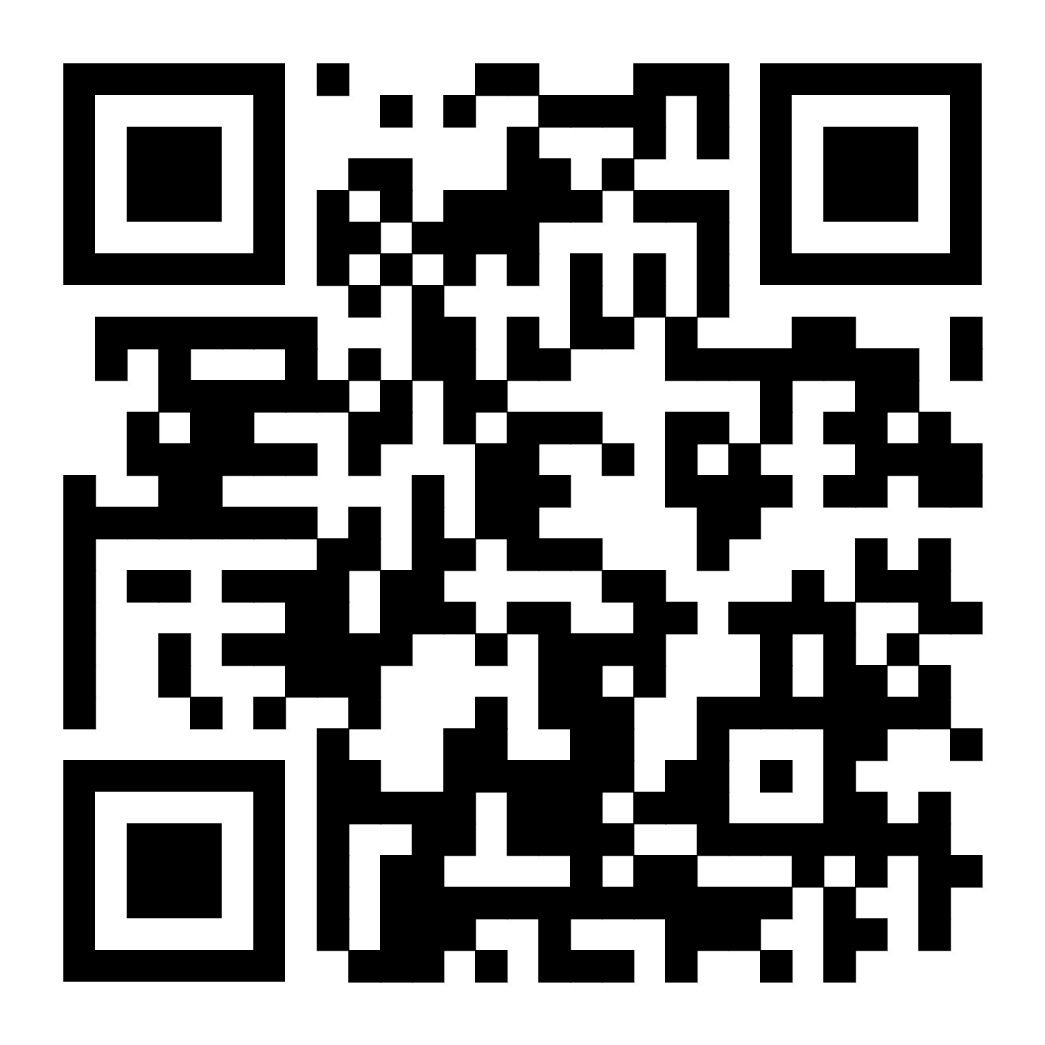
More information
RACP Implementation webpage
Visit the RACP Implementation webpage to find updates about 2025 implementation
RACP Online Learning
Log into RACP Online Learning to learn about the new curricula
RACP Member services
Contact memberservices@racp.edu.au if you have any questions about the new curricula
Notes:
Thank participants for attending and review where they can get some more information

