Slide 2
About this session
Please allow 15 minutes to complete this module
At the end of this session, participants will be able to:
Recognise the purpose of progress reports and how they fit into the learning and assessment cycle
Discuss the interim approach to progress reports for the 2025 curriculum rollout
Notes:
In this workshop we will discuss progress reports which are used in the new training program to assess a trainees progress over a rotation or phase. After completing this workshop you will be able to
Recognise the purpose of progress reports and how they fit into the learning and assessment cycle
Discuss the interim approach to Progress Reports for the 2025 curriculum rollout

Slide 3
Learning and assessment cycle
Entry application
Apply for and be approved to enter an RACP
Training Program
Progression decision
The supervisor rating and evidence of trainee performance are reviewed by a Progress Review Panel who decide if/how the trainee progresses in the training program
01
05
Plan and support learning
Plan goals for a rotation based on the curriculum Learning Goals and opportunities available at the setting with a supervisor
02
04
03
Progress Report
Reflect on and discuss progress during the rotation
Trainee and supervisor meet
Supervisor provides feedback and an overall rating against each learning goal
Assessment tools
Complete work-based tasks and assessment activities throughout the rotation
The five-point rating scale is used to assess each assessment encounter
Notes:
The progress report is completed at the end of a rotation or the end of a phase. The trainee would have completed the learning outlined in their rotation plan, been observed by assessors performing important work tasks and worked on completing other requirements outlined in the learning, teaching and assessment programs. In the progress report, a supervisor will make an overall assessment of the trainee against the learning goals and make a progression recommendation.

Slide 4
Progress reports
Rotation progress report definition: This assessment documents trainees’ and supervisors’ assessment of trainee progress against the training program learning goals over the course of a training rotation/s. The report is completed by a Rotation Supervisor.
Phase progress report definition (BT only): This assessment documents trainees’ and supervisors’ assessment of trainee progress against the training program learning goals over the course of a phase. This report relates to the Basic Training Program and is completed by an Education Supervisor.
Purpose: to assess knowledge and skill development, track progress against the phase criteria, and provide targeted feedback for improvement.

Slide 5
Roles in assessment
Trainees will
Supervisors will
undertake frequent, but meaningful, authentic, low-stakes assessments based on what they are expected to be, do and know.
have their progress judged more on their day-to-day work
obtain continuous, targeted and structured feedback on areas for improvement.
focus their training on improving core competencies.
provide more direct, structured feedback using simple assessment tools.
have a better picture of trainee progress against clear standards.
better identify trainees’ needs and support their learning.
maintain better continuity with their trainees.
Progress Review Panels will
make robust judgements around trainees’ progression based on more evidence that is aligned to the outcomes of the program.
better link learning and assessment with expected program and practice-level outcomes.
enable the development of physicians who are better prepared for work in evolving healthcare teams and environments.
Notes:
The new curriculum programs include three distinct roles involved in the assessment of trainee performance. This slide outlines the role of the trainee, supervisor and progress review panels in the assessment and progression of trainees in a training program.
It should be noted that the progress report will not be available in the TMP until mid way through 2025. It is anticipated that Progress Review Panels will be formed at the end of 2025. The reports used by training programs may differ across settings during the first half of 2025 and this will be communicated to you via your DPE or supervisor.

Slide 6
Progress report workflow – interim 2025
This is an interim workflow; the progress report will be available on TMP from mid-2025
Review and reflect on learning
Review rotation plan
Reflect on progress and learning experiences during the rotation
Plan a discussion meeting with your supervisor
Feedback discussion
Complete a WSC report or the manual RACP form
Basic training: submit your form as per advice from your DPE* for rotations ending before June 2025
Advanced Training: submit a manual form to the RACP
From late-2025 settings will have Progress Review Panels who will make progression decisions based on progression recommendations from supervisors
Trainee
Discussion meeting
Basic Trainees will have two reports
Rotation progress report from their Rotation Supervisors
Phase progress report from their Education supervisor
Assess learning
Review the rotation plan and consider trainee progress that has been made over the rotation
Reflect on your encounters with the trainee
Review evidence from work-based assessments conducted over the rotation
Plan a discussion with the trainee and meet with them to review the information and your supervisor rating for the term
Supervisor

Slide 7
Trainee and supervisor roles
Observe
How is the trainee performing in their day-to-day tasks?
Is the trainee on track with their learning goals?
Are we regularly checking in to keep the trainee on track?
Supervisor
Trainee
Before initiating a progress report, trainees must ensure that they have:
Completed the work-based activities and tasks as outlined in the rotation plan.
Completed learning and assessment activities
Met with their supervisor regularly to check-in
Reflect on performance
How does the trainee’s performance this rotation align with the progression criteria?
What feedback have colleagues provided about the trainee?
What are the trainee’s strengths, and what areas need development?
Do
What progress have I made toward my goal this rotation?
Am I on track to meet the phase requirements?
Overall rating
How much supervision did the trainee require in each of the learning goals?
Use the rating scale related to the learning goal type to assess the overall rating. For example, an EPA learning goal:
Present and observing
Direct supervision
Indirect supervision
Supervision at a distance
Provide supervision
Reflect on and discuss with supervisor
What went well in this rotation?
What areas do I feel need improvement?
What should I be focusing on in my next rotation?

Slide 8
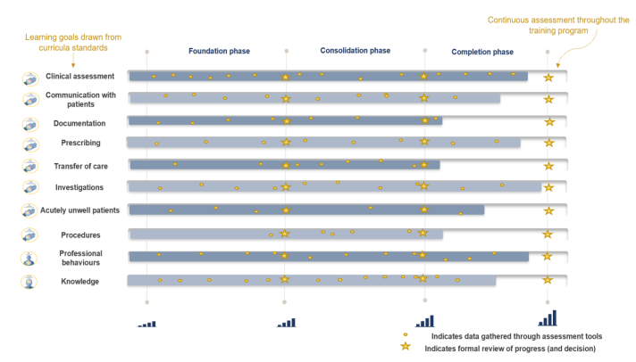
Continuous assessment and progression
Each phase of training has clear progression criteria for trainees to meet.
Progression decisions and completion decisions will be based on aggregated assessment data, providing richer evidence.
The Progress Review Panel will assess the evidence and make one of the following decisions:
Advanced training programs follow the same assessment structure and have set progression criteria for their program specific learning goals.
Notes:
Trainees will be continuously assessed on the key learning goals through regular capture of work-based learning in a range of assessment tools. The use of multiple data points build a complete picture of trainee progress over time. Supervisors offer ongoing feedback through multiple tools to support progressive assessment, encouraging the use of narrative feedback to explain the ratings selected in the assessment tools.
Trainees progress through phases based on meeting established criteria for knowledge and skills. There are clear standards that a trainee must meet to advance, with supervisors playing a key role in documenting trainee performance to inform progression decisions.

Slide 9
Rating scales
The same rating scales used across all work-based assessments including the progress reports
‘Point in-time’ assessment versus a ‘global assessment’
Be - Professional behaviours ​
0 ​ | unable to rate ​
1 ​ | needs to work on their behaviour in five or more areas of professional practice ​
2 ​ | needs to work on their behaviour in four or five areas of professional practice ​
3 ​ | needs to work on their behaviour in two or three areas of professional practice ​
4 ​ | needs to work on their behaviour in one area of professional practice ​
5 ​ | consistently behaves in line with each of the ten areas of professional practice ​
Do - Entrustable professional activities
0 ​ | unable to rate ​
1 ​ | can be present and observe ​
2 ​ | can act with direct supervision ​
3 ​ | can act with indirect supervision (e.g. supervisor is physically located within the training setting)
4 ​ | can act with supervision as a distance (e.g. supervisor available to assist via phone)
5 ​ | can provide supervision ​
Know - Knowledge ​
0 ​ | unable to rate ​
1 ​ | has heard of some of the important medical topics and concepts underpinning patient care (heard of) ​
2 ​ | knows the important medical topics and concepts that underpin patient care (know) ​
3 ​ | knows how to apply their medical knowledge to patient care (knows how) ​
4 ​ | frequently shows that they can apply their medical knowledge to patient care (shows how) ​
5 ​ | consistently applies a sound medical knowledge base to their care of patients (does) ​

Slide 10
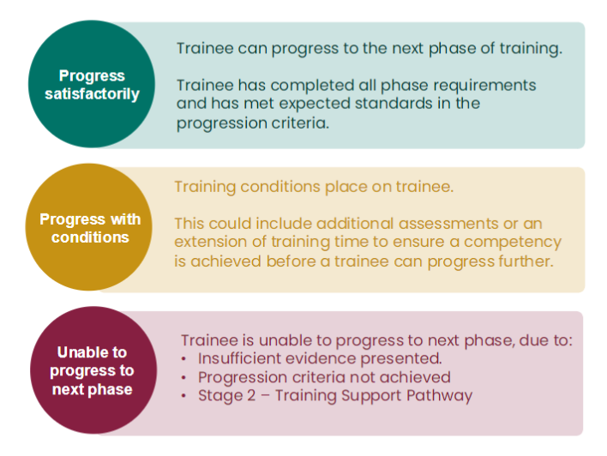
Progression recommendations and decisions
Progression recommendation
Made by the Education Supervisor to the local Progress Review Panel
Based on information provided from assessment data and experience working with the trainee
Trainee performance benchmarked via the progression criteria
Progression decision
Made by a Progress Review Panel
Based on aggregated assessment data and assess their performance against the learning goals and progression criteria
Takes away the decision onus falling to one person

Slide 11
Assessing performance using evidence
Before making a progress decision, supervisors will:
Competence
Compliance
Assess whether the trainee has met their other learning and assessment requirements outlined in the learning, teaching and assessment programs
Assess if the learning goals have been met based on the progression criteria

Slide 12
Case study: Competence
The rotation supervisor determines whether the trainee is competent in all learning goals.
Learning goal | Coverage | LCs | OCs | Complexity | Supervision | Progression criteria
01. Professional behaviours |  | 1 |  |  |  | 5
02. Clinical assessment |  | 1 | 4 |  |  | 3
03. Communication with patients |  | 5 |  |  |  | 3
04. Documentation |  |  | 3 |  |  | 3
05. Prescribing |  |  |  |  |  | 3
06. Transfer of care |  | 1 |  |  |  | 1
07. Investigations |  |  | 2 |  |  | 3
08. Acutely unwell patients |  |  | 2 |  |  | 1
09. Procedures |  | 1 | 1 |  |  | 1
10. Knowledge |  | 3 |  |  |  | 3
Rotation supervisor feedback
What they have done well:
All learning goals have been covered over the phase
Most learning goals were assessed using a learning or observation capture
Adequate supervision ratings were given based on cases ranging in complexity
Progression in most learning goals was evident and assessor feedback was positive
Development and application was documented in learning captures
What improvements need to be made:
Goal 05. Prescribing has not been assessed
1 | 2 | 2 | 1
2 | 2 | 4 | 4
1 | 2 | 2
1 | 3 | 2
2 | 1
2 | 3
1 | 1
1 | 2
1
5
Notes:
Competence
Here is an example map of a Basic Trainee showing how they have progressed in their foundation phase. Some of the areas of note include:
Has the trainee covered their learning goals adequately over a phase? Learning goals with a specific progression criteria against them in Basic Training (Foundation and Consolidation phases) have been bolded.
Is the trainee on track to achieve their progression criteria against each learning goal?
Is the overall complexity rating and assessment rating a good average? Will you need to consider changes to the average based on the complexity of the task completed?
Are there any comments from assessors in Observation Captures or Rotation Progress Reports of note?

Slide 13
Case study: Compliance
The rotation supervisor also ensures the trainee is compliant with all learning and assessment requirements.
Learning program requirements completed | Assessment requirements
Clinical/professional time validation 12 months FTE clinical experience (Australia) 4 x 13-week terms 39 weeks core 13 weeks non-core | Assessments completed 12 learning captures 12 observation captures 4 rotation progress reports (RS) 1 mid-phase phase progress report (ES)
Learning courses completed Basic Training Orientation Advanced Life Support Course RACP Communication Skills
Rotation supervisor feedback
All clinical and professional time is completed and validated
All learning courses are completed
All assessment requirements have been completed
After assessing competence and compliance, the supervisors recommends the trainee to progress satisfactorily.
Rotation/term 1 – General and acute​
Rotation/term – Emergency medicine
Rotation/term – Gastroenterology​
Rotation/term – Non-core nights
Notes:
Compliance
Along with the learning goal coverage, it is also important to make sure the trainee is on track to progress against the rest of the progression criteria. Here, we are checking whether the trainee has met the learning requirements and their assessment requirements. It can be helpful to review the written feedback in each of the reports to determine if there is any information listed that will impact on the progression recommendation you choose.

Slide 14
Assessing performance using evidence
After competence and compliance has been assessed, the Rotation Supervisor makes a progress decision.
Add in written feedback about how the trainee has performed over the phase of training against the expected standard
Determine the overall rating against the learning goals
Add in a progression recommendation
Progress satisfactorily
Progress with conditions
Unable to progress to next phase

Slide 15
In Summary,
Progress reports bring together evidence of trainee performance over a period of time
Progression criteria outlines the standard of achievement expected by the of a phase
Supervisors make progression recommendations, progress decisions will be made by Progress Review Panels
More information and resources can be found https://elearning.racp.edu.au

Slide 16
Practical Activity
Download the supervisor activity template
Review the scenario
Outline your review comments for the trainee.

