Slide 1
Introduction to the new curriculum 2025 implementation – supervisors
November 2024
Notes:
This information session is for supervisors as an introduction to the new curriculum.

Slide 2
About this session
At the end of this session, participants will be able to:
Discuss the changes and components of the new curriculum
Outline the learning and assessment requirements
Notes:
During this session we will be reviewing the curriculum and associated learning and assessment requirements

Slide 3
What is changing?
Standards
Practical, work-focused learning goals
Explicit standards of achievement
Learning and assessment
New learning and assessment tools
Increased assessment frequency (phased rollout in 2025)
Progression
Progress Review Panels (to be introduced from Q4 2025)
Technology
New technology (TMP)
Notes:
Assessments are designed to be quick and integrated into routine activities.
Assessment feedback is streamlined and unnecessary paperwork is reduced
The new tech minimizes administrative burden
The panels (coming mid 2025) provide a structured way to evaluate trainee progress.
The differences between PREP and the new curriculum will be discussed on the next slide.
Trainees will need to complete some different learning and assessment tools
Trainees will need to complete more assessments in the new program (*from 2026)
There is new technology to support these changes
We are introducing Progress Review Panels to check that trainees are ok to pass into their next stage of training.

Slide 4
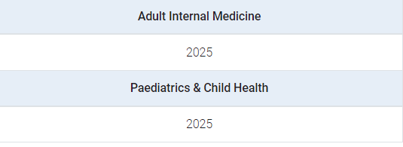
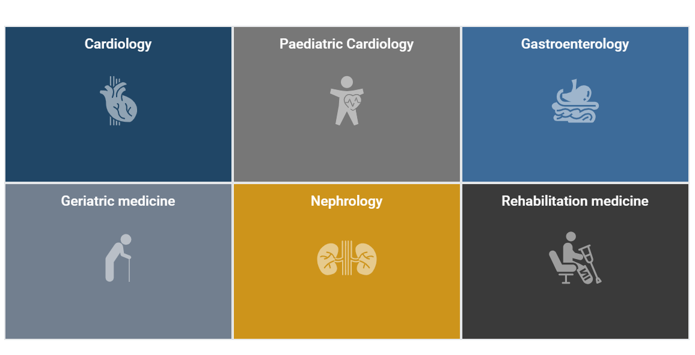
Training programs impacted for 2025
Basic Training
Basic Training (AIM)
Basic Training (PCH)
Advanced Training
Cardiology (Adult medicine)
Paediatric cardiology
Gastroenterology
Geriatric medicine
Nephrology
Rehabilitation medicine
Notes:
Basic Training
First year trainees starting Basic Training from 2025 will enrol under a new curriculum and use the College’s new Training Management Platform to register for training and complete their learning and assessment tools.
Advanced Training
In 2024, trainees will complete work-based assessments from the previous PREP programs outlined in the 2024 curriculum transition year handbooks.
From 2025, first year trainees and continuing trainees who started in 2024, will use the College’s new Training Management Platform to register for training and complete their updated learning and assessment tools.
First year trainees who enter these Advanced Training programs in 2024 are enrolled under the new curriculum standards

Slide 5
The new curricula
What's not changing
Trainees and supervisors will still....
Plan learning for a rotation
Work with and observe trainees doing their job
Provide feedback to trainees on their performance and progress
Assess trainees through rotation and at the end via a report
Contribute to the learning and understanding of the curriculum
Enter learning and assessment information onto an online platform
PREP versus new curricula
Be aware of the different learning goals/outcomes
New curriculum learning goals
PREP and PQC
Use 2 online platforms
PREP portal
TMP
Use different learning and assessment tools with differences in rating scales
LNA or rotation plan
Mini-CEX/CbD or observation capture
Use expected standards to benchmark performance
Progression criteria (new program only)
Notes:
Here is a supervision overview, highlighting the things that are staying the same and the things that are changing that supervisors must be aware of. Supervisors will still plan learning and work with trainees day-to-day, providing feedback throughout. They will assess them and enter this information into an online platform, taking responsibility to contribute to their understanding of the new curriculum.
The learning goals are changing as well as the online platform. The new curriculum has different assessment tools and standards for trainees. It is important for supervisors to understand these changes, especially when managing trainees on both programs.

Slide 6
Supervision roles
All supervisors
Role specific activities
Are nominated by trainee and/or the DPE (BT only)
Access to trainee dashboards
Identify learning opportunities
Plan how to achieve learning goals
Review rotation plans
Feedback on learning captures
Feedback and ratings on observation captures
Complete rotation progress reports and make a progression decision
Have some involvement with Progress Review Panels
Rotation Supervisor
Basic Training
Rotation Supervisor
Advanced Training
Identify rotation learning opportunities
Complete rotation progress reports for a rotation
Identify rotation learning opportunities
Complete rotation progress reports and make progression recommendations for a phase of training
Education Supervisor
Basic Training
Research Project Supervisor
Advanced Training
Oversee trainee progress over a phase
Complete mid and end phase progress reports and make a progression recommendation for a phase of training
The research project supervisor guides trainees with their project choice, method, data analysis and interpretation, and quality of written and oral presentation
Assessors
No access to TMP (unless they are a nominated supervisor or DPE)
Feedback and ratings for observation captures
Notes:
There are several supervisor roles in the new curriculum, with differing roles and responsibilities. This information can be found in the basic program handbook on the e-learning site. Overall, all supervisors will be nominated by either a trainee or DPE, access their dashboards on TMP, identify learning opportunities and plan how to achieve the learning goals. They review rotation plans and give feedback on the assessment tools. Supervisors may have some involvement with progress review panels.

Slide 7
Leadership and oversight roles
Leadership
Oversight
DPE
Basic Training
Progress Review Panel
From Q4 2025
Setting or Network
Approve training applications
Access to trainee dashboards
Allocate trainees to rotations
Allocate supervisors
Identify learning opportunities
Oversee trainee progression
Sit on progress review panels
Review and assess trainee’s progress
Report on progress decisions
Monitor local training delivery
Ensure compliance
Training Program Coordinator
Basic Training
RACP oversight committees
Support DPEs
Allocate rotations and supervisors
Support progress review panels
Support supervisors
Oversee implementation of training programs
Work with DPEs and progress review panels
Decision making feedback and guidance
Notes:
There are also leadership roles such as DPEs and Training program coordinatiors, as well as oversight roles such as progress review panels and racp oversight committees.

Slide 8
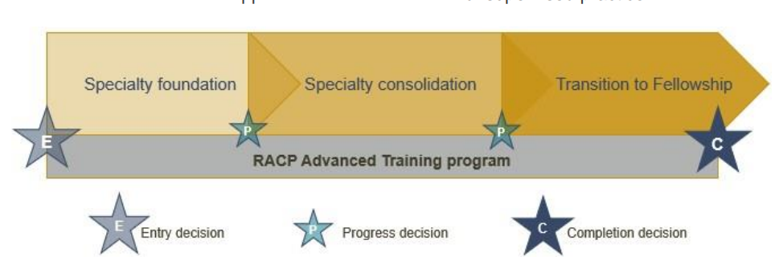
Framework overview
Both Basic and Advanced training programs adhere the same frameworks, ensuring a seamless transition.
Curriculum standards
Learning, teaching and assessment (LTA)
structure
Learning goals within each training program categorised by the curriculum standards: Be, Do and Know.
*Some Advanced Training Programs have four phases of training
More information about the curriculum standards and learning, teaching & assessment structure can be found in the LTA of each training program.
Notes:
This diagram outlines the overall picture for the Basic Training program. You can see here the be, do and know standards, the three phases of the training program and the learning, teaching and assessment requirements as outlined in the program requirements. We will go though each of these areas in more detail.

Slide 9
Curriculum documents
Notes:
The information that we are going to refer to today is outlined in the Basic and Advanced Training Curricula which can be found on the RACP eLearning Portal.
The curriculum standards contains the key learning goals used in Training programs, and include ‘Be’ – the competencies which outline the professional behaviours expected of a trainee, ‘Do’ , the EPAs or important work tasks, and ‘Know’ the knowledge guides outlining important knowledge per specialty.
The learning, teaching and assessment programs outline the entry requirements, teaching program requirements, learning program requirements and the assessment program requirements

Slide 10
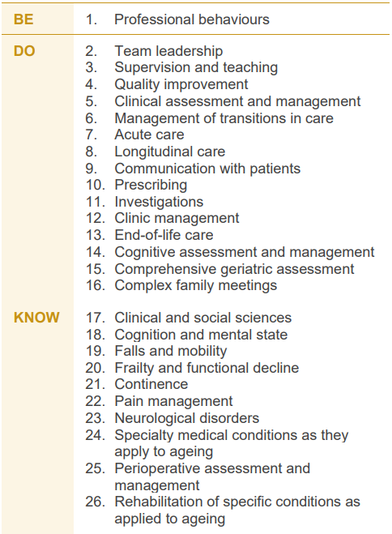
Example Learning Goals
Each training program is grouped into learning goals, guided by the curriculum standards: Be, Do & Know.
Basic Training
Cardiology (AIM)
Geriatric medicine
Notes:
Each training program is grouped into learning goals, guided by the curriculum standards: Be, Do & Know. This includes professional behaviours, entrustable professional activities or EPAs and knowledge. These learning goals are used for all learning and assessment activities across each program. More information about your program’s specific learning goals can be found in the LTA of each training program.

Slide 11
Applying Learning Goals
How an observed clinical activity achieves the learning goal components in real time.
Dr. Alex, a Basic Trainee in their second year of training, is completing a general medicine rotation in a busy metropolitan hospital. During a morning ward round, Dr. Alex is tasked with managing a patient presenting with acute shortness of breath, later diagnosed as congestive heart failure
01. Professional behaviours
Medical expertise
Communication
Leadership, management & teamwork
Ethics & professional behaviour
Cultural competence
02. Clinical assessment
03. Communication with patients
05. Prescribing
08. Acutely unwell patients
10. Knowledge
Cardiology
General medicine
Notes:
Here is an example of how the learning goals might be applied when you are performing a task in the workplace. There are a number of skills and knowledge that are displayed at different times during an encounter with patient. In this example, Dr Alex is using skills, knowledge and competencies across a number of learning goals. If you were to observe a trainee in an assessment situation, you would need to focus on one learning goal.

Slide 12
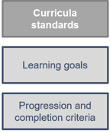
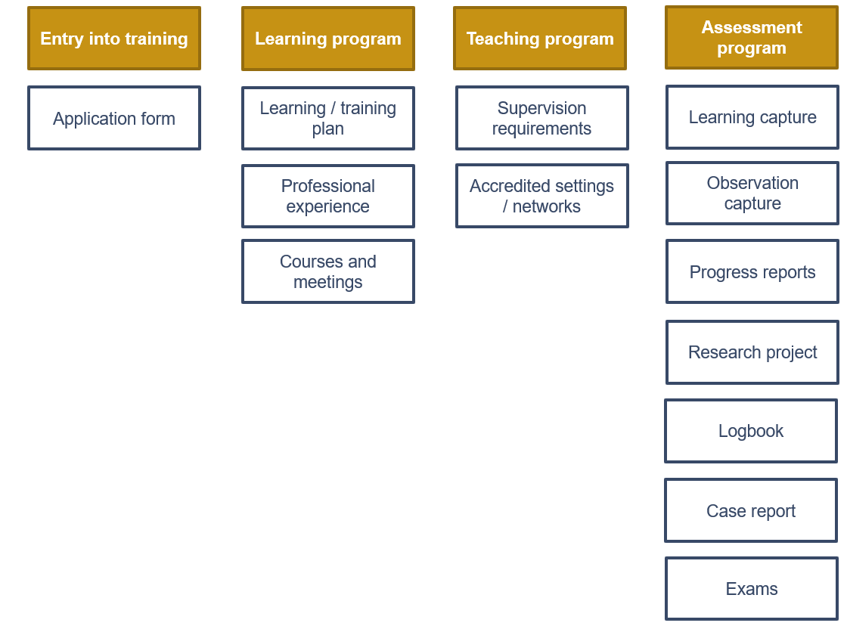
Common learning, teaching and assessment toolkit
Applicable to Advanced Training programs only
Basic Training
Program-specific Advanced Training
Notes:
Here is the common learning, teaching and assessment toolkit for all new programs. Each follow the Be, Do, Know curricula standards, with specific learning goals and progression criteria. All program use common learning, teaching and assessment tools however requirements for each tool. Please refer to the program LTA requirements for specific guidance on requirements.

Slide 13
Learning goals
Learning opportunities
Rotation/term
Nominate and meet with supervisor
Discuss learning opportunities and learning goals
Complete rotation plan
Complete learning and observation captures
Complete end of rotation progress report
Professional behaviours
Clinical assessment
Communication with patients
Documentation
Knowledge
Ward rounds ​
Family meetings ​
Handovers ​
Teaching medical students ​
Family meetings ​
Basic Training Journey
Learning captures
Observation captures
Professional behaviours
Knowledge
Clinical assessment
Documentation
Clinical assessment
Communication with patients
Start role
End of phase
Rotation/term 1
Rotation/term 2
Rotation/term 3
Rotation/term 4
Apply for program
Application approved
Rotation progress report
Rotation progress report
Mid phase progress report
Rotation progress report
Rotation progress report
Phase progress report
The Education Supervisor makes an overall progress recommendation based on rotation progress reports and other evidence.
The Progress Review Panel (from Q4 2025) make a progression decision based on:
Compliance with learning, teaching and assessment requirements
Evidence of competence (assessment data)
Education Supervisors' recommendation
End of phase progression
DPEs approve training applications.
Rotation progress reports are completed by Rotation Supervisors.
Mid and end phase progress reports are completed by Education Supervisors.
Notes:
How does this all come together?
This is the overall journey of a Basic Trainee over a phase of training. In this example, the trainee is completing 4 rotations over their phase of training. Looking at their first rotation, you can see the learning and assessment activities that take place. These activities are conducted in each rotation, with the addition of a Phase Progress report check-in point in rotation 2 and the Phase Progress Report in rotation 4 that brings together the evidence from the phase. The Education Supervisor reviews the information and makes a progression decision which is forwarded to the Progress Review Panel for a decision.

Slide 14
Quarter 1 (Q1)
Nominate and meet with supervisor(s)
Discuss learning opportunities and learning goals
Complete rotation plan
Complete learning and observation captures
Begin thinking about research project
Learning goals
Learning opportunities
Cardiology Training Journey
Professional behaviours
Team Leadership
Clinical assessment and management
Communication with patients
Knowledge (3 specific knowledge guide learning goals selected)
Ward rounds ​
Family meetings ​
Handovers ​
Teaching medical students ​
Family meetings ​
Learning captures
Observation captures
Professional behaviours
Coronary artery disease
Team leadership
Heart Failure
Clinical assessment and management
Communication with patients
Start role
12 months core training – training setting 1
End of phase
Q1
Q2
Q3
Q4
Learning and assessment activities
Progress report
Learning and assessment activities
Mid phase progress report
Learning and assessment activities
Progress report
Learning and assessment activities
End of phase progress report
Apply for program
Application approved
End of phase progression
The Rotation Supervisor makes an overall progress recommendation at the end of the phase.
The Progress Review Panel (from Q4 2025) make a progression decision based on:
Compliance with learning, teaching and assessment requirements
Evidence of competence (assessment data)
Rotation Supervisors' recommendation
Notes:
The journey for advanced trainees differ slightly from program to program, and from the basic program. They still complete rotation plans prior to the quarter, learning and observation captures during each quarter and may have quarterly progress reports depending on the specialty. In this case, cardiology trainees will have one each quarter. Like the Basic training program, mid and phase reports assist in their end of phase progression. Their rotation supervisor makes an overall progress recommendation and from Q4 2025, a progress review panel will make a progression decision.

Slide 15
Learning and assessment cycle
Progression decision
The supervisor rating and evidence of trainee performance are reviewed by a Progress Review Panel who decide if/how the trainee progresses in the training program
Entry application
Apply for and be approved to enter an RACP Training Program
01
Plan and support learning
Plan goals for a rotation based on the curriculum learning goals and opportunities available at the setting with a supervisor
05
02
Progress Report
Reflect on and discuss progress during the rotation
Trainee and supervisor meet
Supervisor provides feedback and an overall rating against each learning goal
04
03
Assessment tools
Complete work-based tasks and assessment activities throughout the rotation
The five-point rating scale is used to assess each assessment encounter
Notes:
As per our overall learning journey, in each rotation, steps 2, 3 and 4 are repeated. This cycle is planning learning using the Rotation Plan, demonstrating achievement towards learning goals via the assessment tools and being rated by a Rotation Supervisor in a Rotation Progress Report. The progress decision occurs at the end of the final rotation for a phase.

Slide 16
New assessment tools – common to BT and AT
Rotation plan
Trainee and supervisor outline rotation details, learning goals and opportunities for the upcoming rotation.
Observation capture
Trainee is observed by an assessor to demonstrate their skills and knowledge in one learning goal.
Learning capture
Trainee reflects and provides evidence on a professional development experience linked to one learning goal.
Progress reports
Supervisors document trainee progress against learning goals.
Roles involved:
Trainee
Rotation Supervisor
Roles involved:
Trainee
Assessor
Roles involved:
Trainee
Assessor (optional)
Roles involved:
Rotation Supervisor:
Rotation progress report
Education Supervisor:
Mid-phase progress report
Phase progress report
Notes:
Here is an overview of the new assessment tools in the new curriculum. For more details, please visit the e-learning portal to find on demand workshops and information packages about each type.

Slide 17
Rating scales
Be - Professional behaviours ​
0 ​ | unable to rate ​
1 ​ | needs to work on their behaviour in five or more areas of professional practice ​
2 ​ | needs to work on their behaviour in four or five areas of professional practice ​
3 ​ | needs to work on their behaviour in two or three areas of professional practice ​
4 ​ | needs to work on their behaviour in one area of professional practice ​
5 ​ | consistently behaves in line with each of the ten areas of professional practice ​
Do - Entrustable professional activities
0 ​ | unable to rate ​
1 ​ | can be present and observe ​
2 ​ | can act with direct supervision ​
3 ​ | can act with indirect supervision ​(e.g. supervisor is physically located in the training setting)
4 ​ | can act with supervision at a distance (​e.g. supervisor available to assist via phone)
5 ​ | can provide supervision ​
Know - Knowledge​
0 ​ | unable to rate ​
1 ​ | has heard of some of the important medical topics and concepts underpinning patient care (heard of)
2 ​ | knows the important medical topics and concepts that underpin patient care (know) ​
3 ​ | knows how to apply their medical knowledge to patient care (knows how) ​
4 ​ | frequently shows that they can apply their medical knowledge to patient care (shows how) ​
5 ​ | consistently applies a sound medical knowledge base to their care of patients (does) ​
Traditional rating scales | Level of new rating scales
Satisfactory to superior ratings Task components separated (e.g. medical interviewing skills, clinical judgement) No links to the expectation of the standards required | Increased levels of independence over time Comprehensive rating of clinical and professional expertise Expected standards of performance at the end of each phase to direct learning
Notes:
These are the rating scales that will be used in all the assessment tools. There is a rating scale for the three types of learning goals. These rating scales also relate to the progression criteria outlined at the end of each phase of training. This criteria specifies the standard of achievement for trainees at the end of each phase.
<Click for animation>
The new rating scales compared to traditional rating scales align to the increased levels of independence over time, rather than using satisfactory to superior descriptors. The new scales provide a comprehensive rating of clinical and professional expertise, where in the past, components have been separated. They also explain the expected standard of performance at the end of each phase.

Slide 18
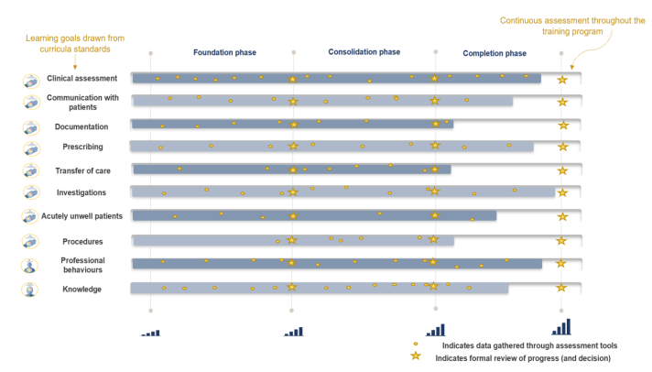
Continuous assessment and progression
Each phase of training has clear progression criteria for trainees to meet.
Progression decisions and completion decisions will be based on aggregated assessment data, providing richer evidence.
The Progress Review Panel will assess the evidence and make one of the following decisions:
Advanced training programs follow the same assessment structure and have set progression criteria for their program specific learning goals.
Notes:
Trainees will be continuously assessed on the key learning goals through regular capture of work-based learning in a range of assessment tools. The use of multiple data points build a complete picture of trainee progress over time. Supervisors offer ongoing feedback through multiple tools to support progressive assessment, encouraging the use of narrative feedback to explain the ratings selected in the assessment tools.
Trainees progress through phases based on meeting established criteria for knowledge and skills. There are clear standards that a trainee must meet to advance, with supervisors playing a key role in documenting trainee performance to inform progression decisions.

Slide 19
Education policy
The RACP is committed to ensuring high quality, equitable and transparent training and assessment practices.
Our education policies provide the foundation for delivering consistent and effective medical education, supporting both trainees and supervisors. Key areas include:
Progression requirements and assessments
Supervisors and trainee roles and responsibilities
Accreditation of training settings
Professional behaviours and ethical conduct
Visit the Education Policies and Governance webpage for the latest updates and resources.
By aligning with these policies, we ensure a structured and fair approach to training and the development of future physicians.

Slide 20
Next steps for supervisors
Review your curriculum standards and learning, teaching and assessment programs documents on the RACP eLearning portal
Review the new curriculum training resources on the RACP eLearning portal
Log into and familiarise yourself with TMP. You will have access to your trainee dashboard’s once you have been nominated.
Determine what the learning opportunities at your setting might be to assist your trainees in completing their rotation plan
Notes:
Now you know some more about the new curriculum you can go ahead and prepare yourself for the commencement of the new Basic Training programs. Here we have a list of next steps you could take.
<read through list>

Slide 21
More information
RACP Implementation webpage
Visit the RACP Implementation webpage to find updates about 2025 implementation
RACP Online Learning
Log into RACP Online Learning to learn about the new curricula
RACP Member services
Contact memberservices@racp.edu.au if you have any questions about the new curricula
Notes:
Thank participants for attending and review where they can get some more information

